Slide 1
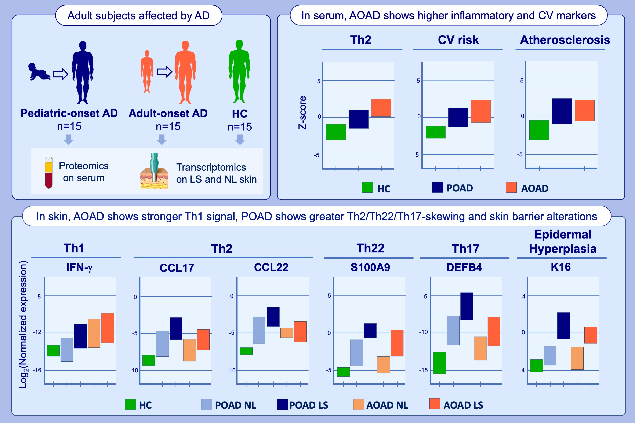
Age of onset defines two distinct profiles of atopic dermatitis in adults
Paola Facheris, Joel Correa Da Rosa, Angel D. Pagan, Michael Angelov, Ester Del Duca, et al.
Allergy. 2023; pages: 2202-2214
https://doi.org/10.1111/all.15741
© 2019 EAACI and John Wiley and Sons A/S. Published by John Wiley and Sons Ltd.
Notes:
HIGHLIGHTS
We compared the skin and serum molecular profiles of POAD versus AOAD in adult patients.
In skin, POAD showed greater Th2/Th22/Th17-skewing, with more pronounced barrier alterations, while AOAD showed less intense Th2/Th22 activation and greater Th1-skewing in both lesional and nonlesional skin.
In serum, AOAD showed a more robust inflammatory signal and higher cardiovascular risk markers.
Abbreviations: AD, atopic dermatitis; AOAD, Adult-onset atopic dermatitis; CV, cardiovascular;
HC, healthy controls; LS, lesional; NL, nonlesional; POAD, pediatric-onset atopic dermatitis.

