Slide 1
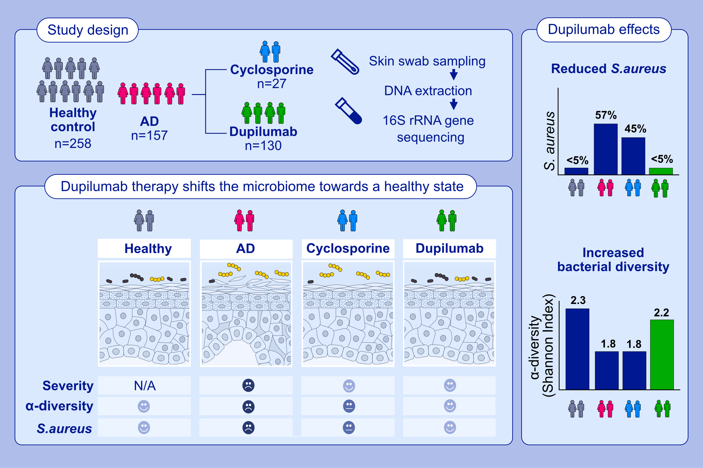
Dupilumab but not cyclosporine treatment shifts the microbiome towards a healthy skin flora in patients with moderate to severe atopic dermatitis
Jan Hartmann, Lucas Moitinho-Silva, Nicole Sander, Inken Harder, Robert Häsler, et al.
Allergy. 2023; pages: 2290-2300
https://doi.org/10.1111/all.15742
© 2019 EAACI and John Wiley and Sons A/S. Published by John Wiley and Sons Ltd.
Notes:
HIGHLIGHTS
157 atopic dermatitis patients were microbiome profiled before and after 3 months of systemic therapy with either dupilumab or cyclosporine.
Dupilumab but not cyclosporine therapy largely restored a healthy skin microbiome by reducing S. aureus abundance and increasing diversity.
The microbiome after 3 months of dupilumab therapy resembled healthy controls.
Abbreviations: AD, atopic dermatitis; S. aureus, Staphylococcus aureus

