Slide 1
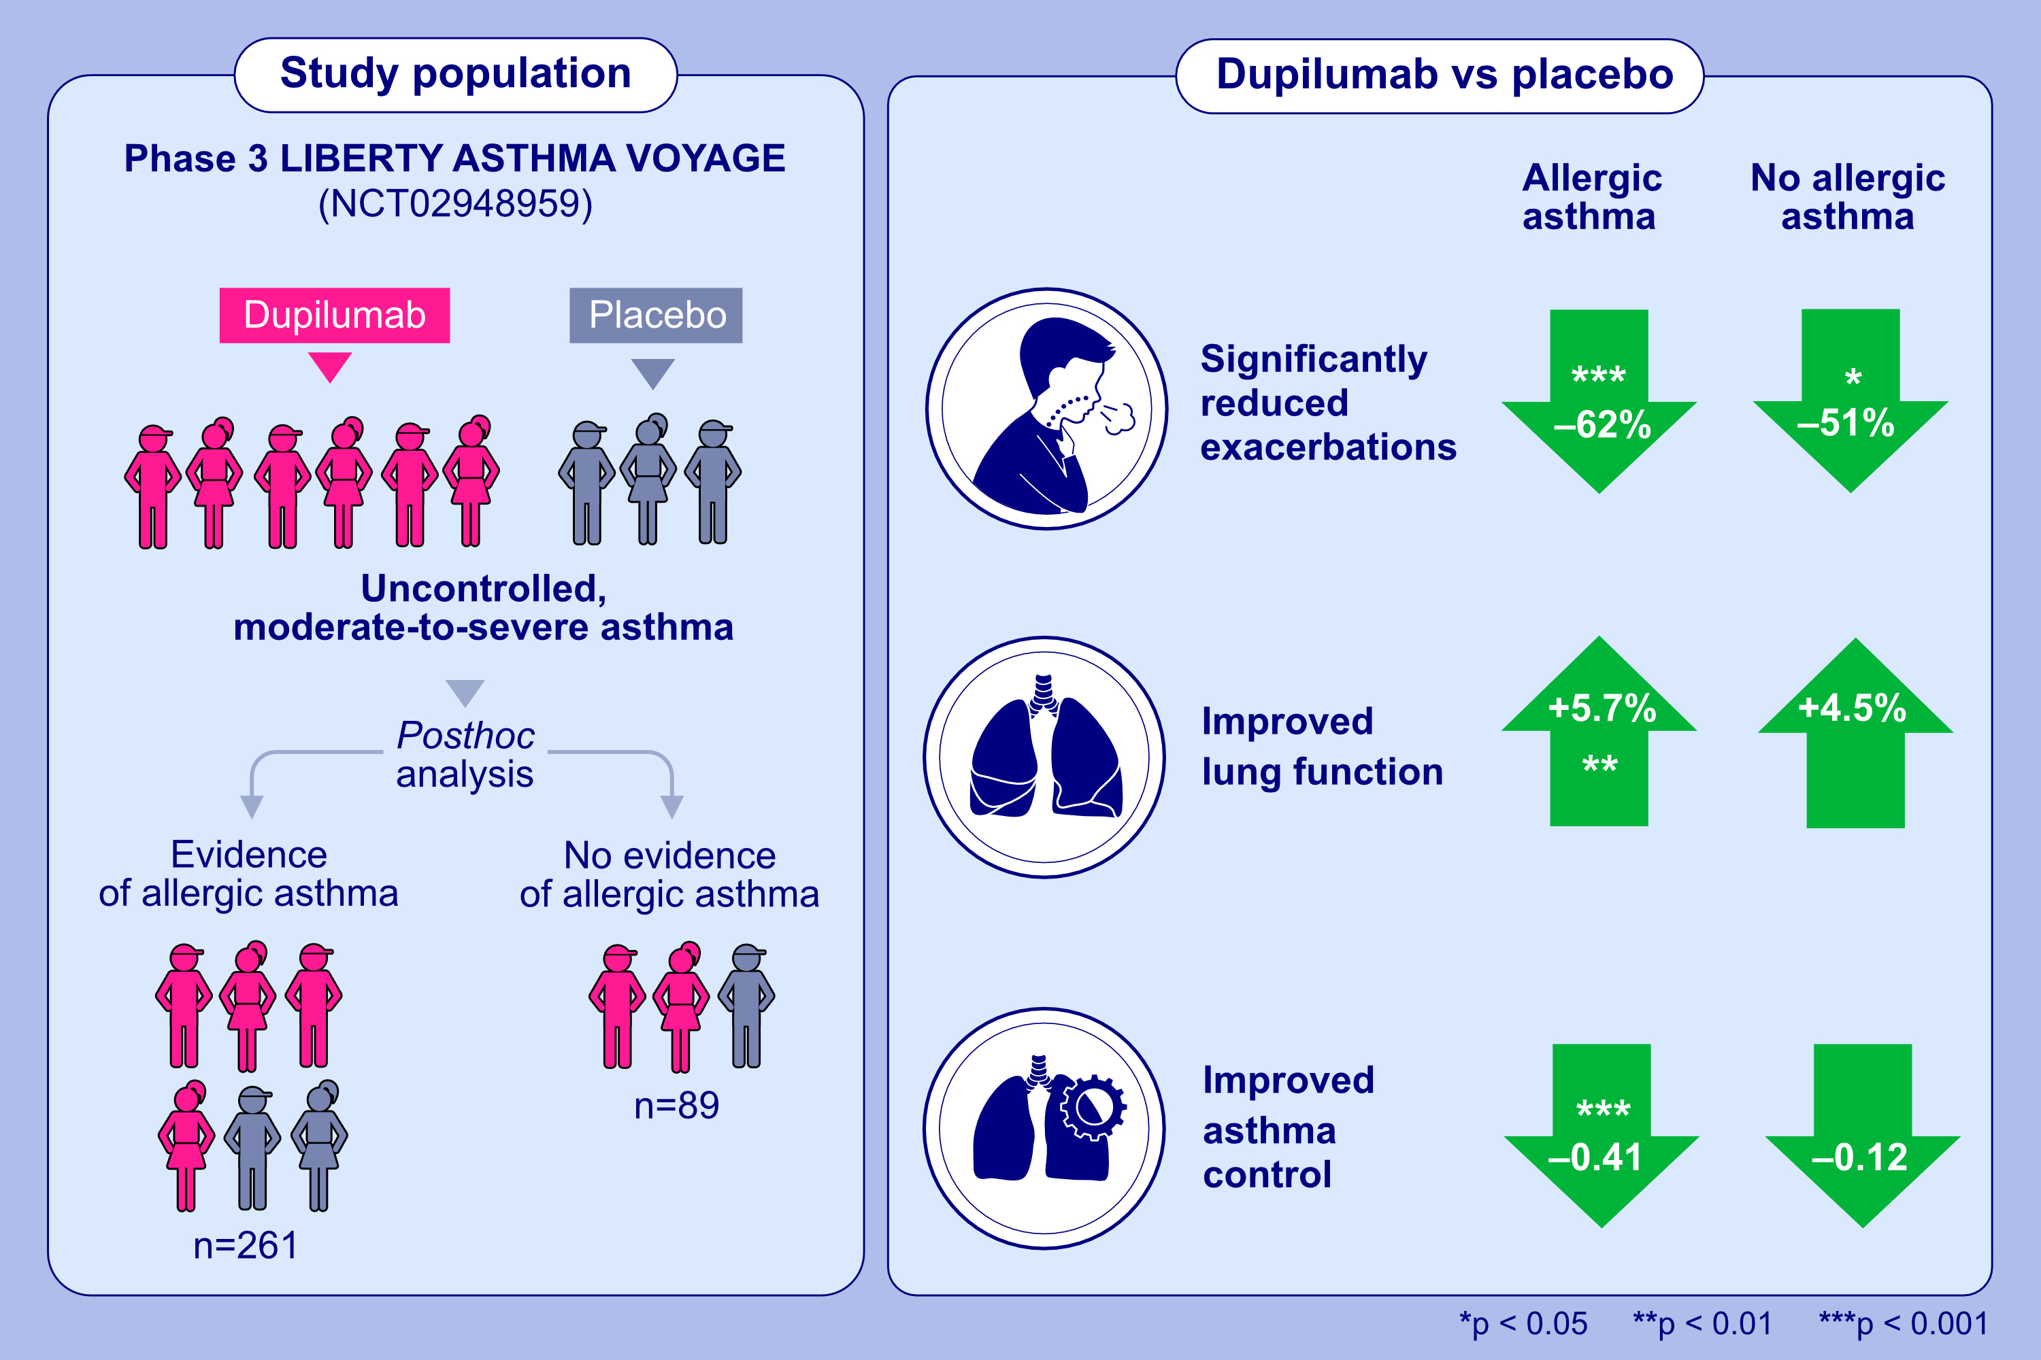
Assessment of dupilumab in children with moderate-to- severe type 2 asthma with or without evidence of allergic asthma
Nikolaos G. Papadopoulos, Stanley J. Szefler, Leonard B. Bacharier, Jorge F. Maspero, Christian Domingo, et al.
Allergy. 2023; pages: 2157-2167
https://doi.org/10.1111/all.15743
© 2019 EAACI and John Wiley and Sons A/S. Published by John Wiley and Sons Ltd.
Notes:
HIGHLIGHTS
This post hoc analysis of VOYAGE (NCT02948959) evaluates efficacy of dupilumab in patients aged 6–11 years with type 2 asthma with or without evidence of allergic asthma.
In type 2 patients, dupilumab vs placebo significantly reduced exacerbation rates irrespective of allergic status.
Significant improvements vs placebo in lung function and asthma control were observed throughout the treatment period in patients with evidence of allergic asthma. In the small population of patients without evidence of allergic asthma, numerical improvements in lung function and asthma control were observed.
Abbreviations: NCT, national clinical trial; VOYAGE, Evaluation of Dupilumab in Children With Uncontrolled Asthma

