Slide 1
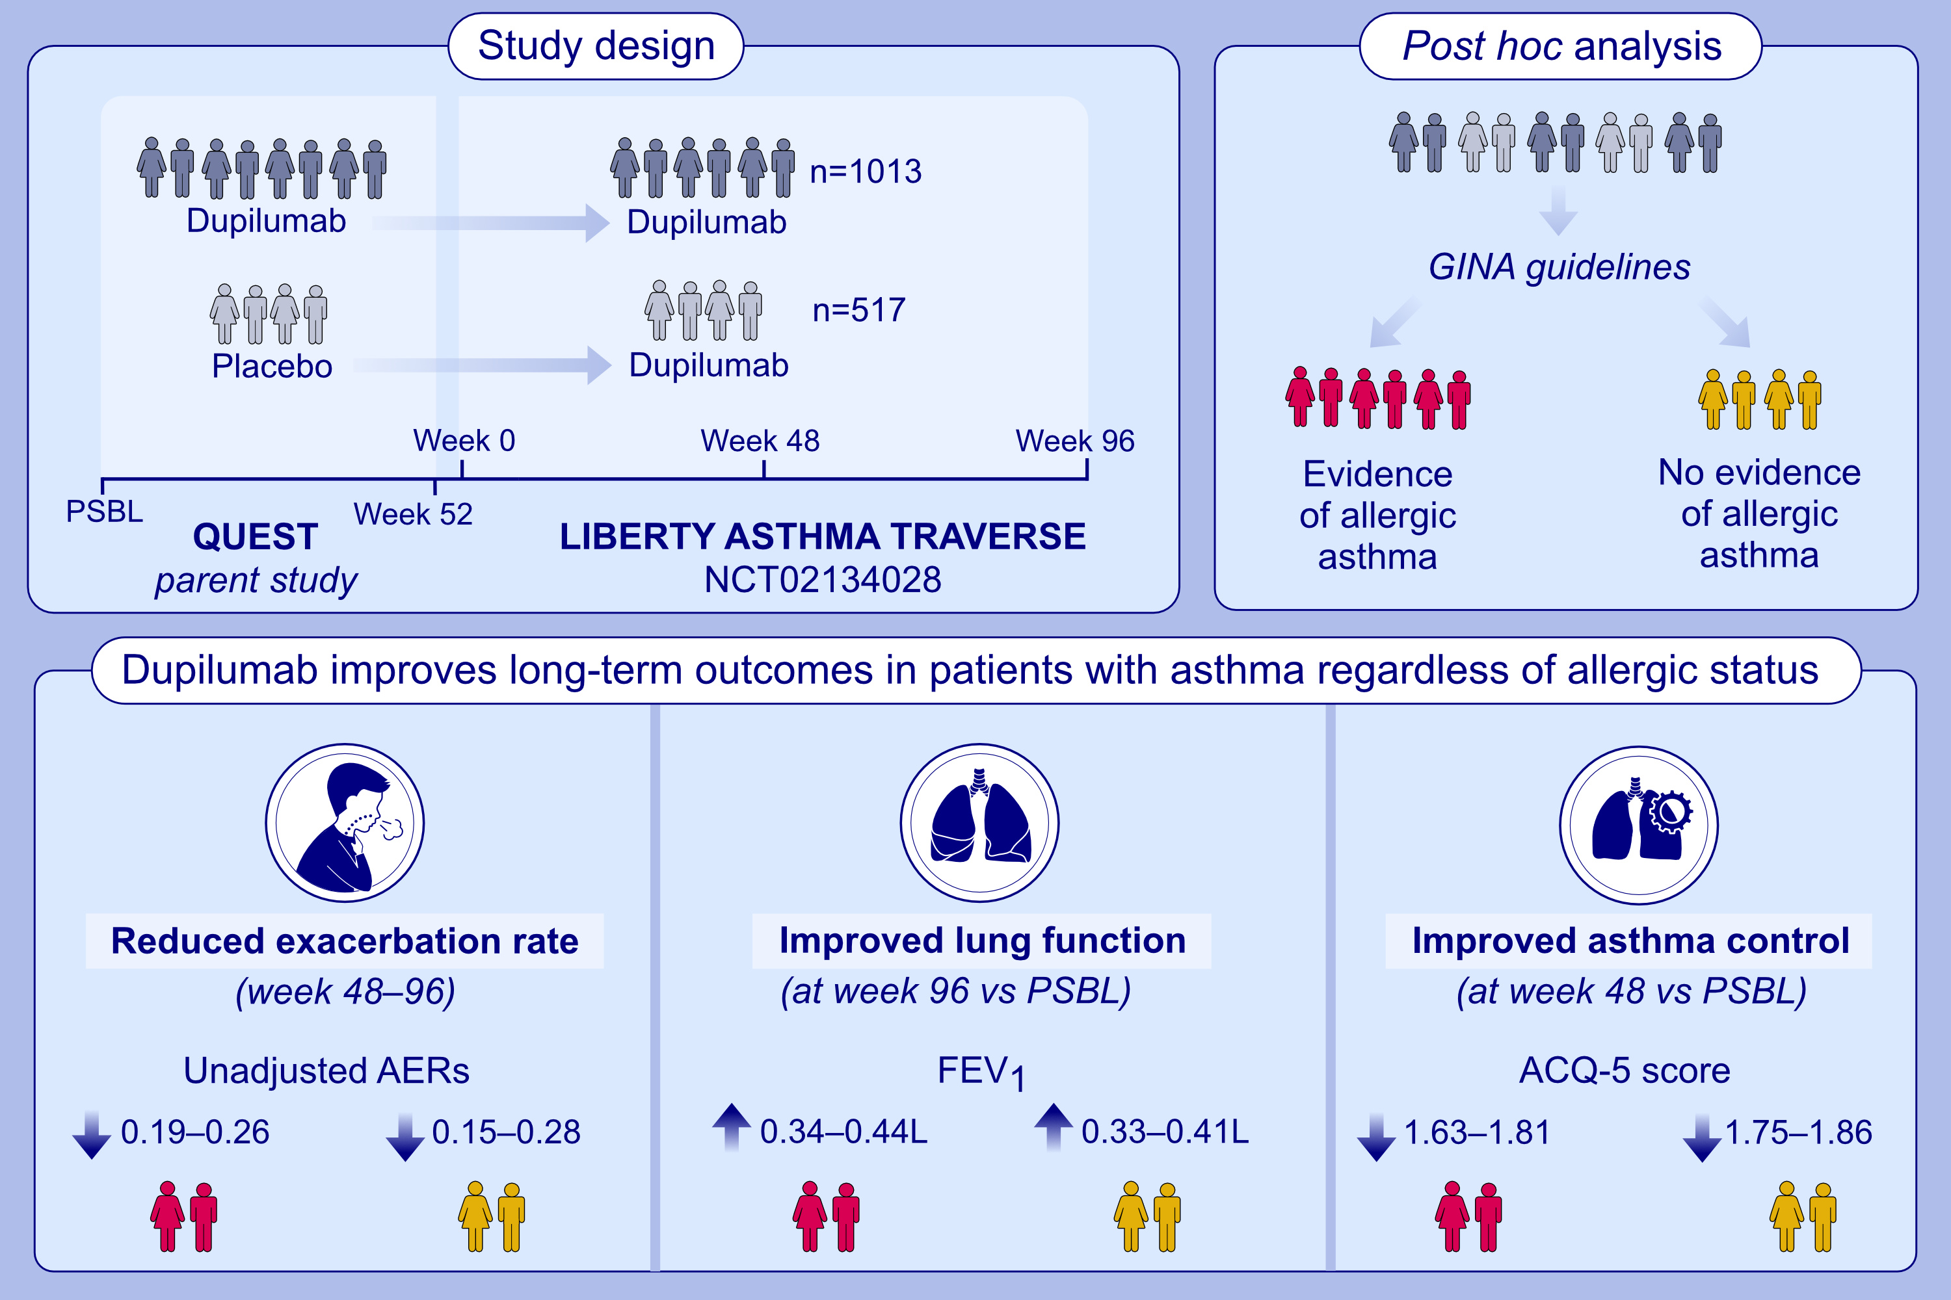
Dupilumab Improves Long-term Outcomes in Patients With Uncontrolled, Moderate-to-Severe GINA-Based Type 2 Asthma, Irrespective of Allergic Status
Klaus F. Rabe, Ian D. Pavord, William W. Busse, Geoffrey L. Chupp, Kenji Izuhara, et al.
Allergy. 2023; pages:2148-2156
https://doi.org/10.1111/all.15747
© 2019 EAACI and John Wiley and Sons A/S. Published by John Wiley and Sons Ltd.
Notes:
HIGHLIGHTS
This post hoc analysis included patients from QUEST who enrolled in TRAVERSE.
Patients were stratified per baseline levels of blood eosinophils and FeNO per current GINA definitions, and evidence of allergic asthma.
Dupilumab reduced exacerbation rates, and improved lung function and asthma control in patients with asthma with type 2 inflammation and irrespective of evidence of allergic asthma.
Abbreviations: ACQ-5, 5-item asthma control questionnaire; AERs, annualized severe asthma exacerbation rates; FeNO, fractional exhaled nitric oxide; GINA, Global Initiative for Asthma; LIBERTY ASTHMA TRAVERSE, Long-Term Safety Evaluation of Dupilumab in Patients With Asthma; NCT, national clinical trial; PSBL, parent study baseline; QUEST, Evaluation of Dupilumab in Patients With Persistent Asthma

