Slide 1
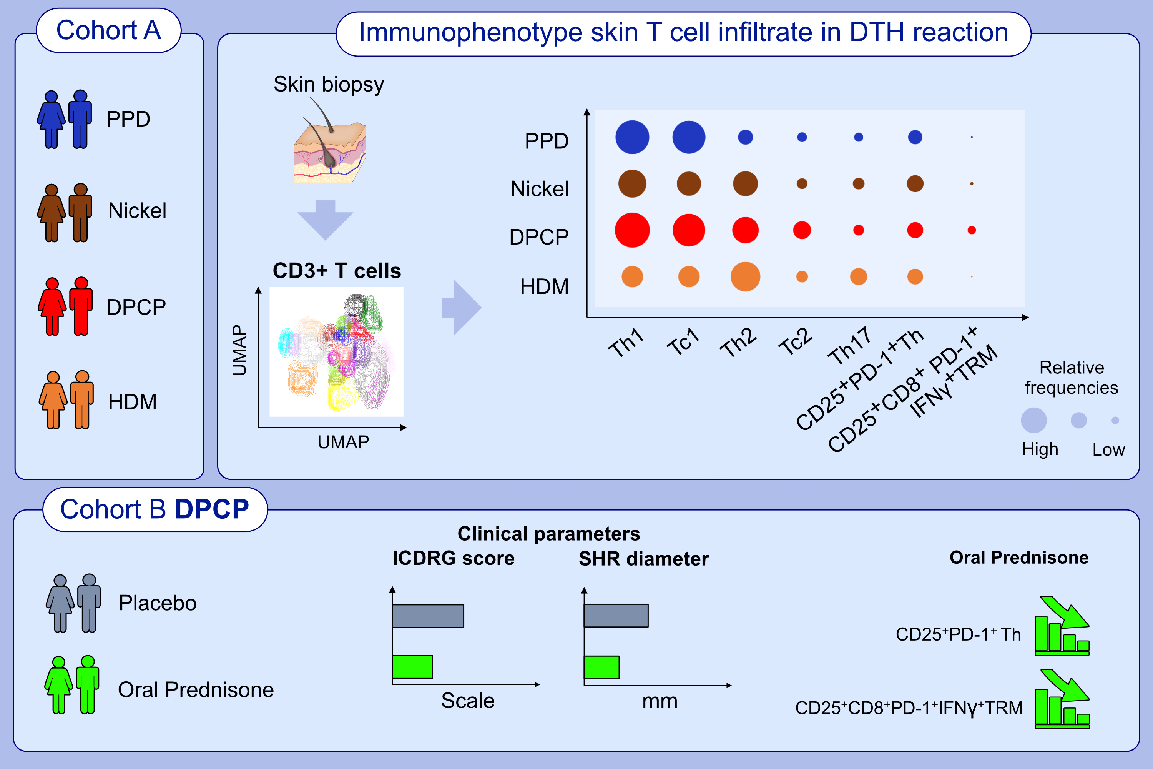
Oral prednisone regulates human skin T cells in delayed-type hypersensitivity reaction elicited by diphencyprone
Heena Mehta, Carolyn Jack, Catherine Maari, Étienne Saint-Cyr Proulx, Robert Bissonnette, et al.
Allergy. 2023; pages:2255-2265
https://doi.org/10.1111/all.15764
© 2019 EAACI and John Wiley and Sons A/S. Published by John Wiley and Sons Ltd.
Notes:
HIGHLIGHTS
PPD predominantly elicited Th1 and Tc1 responses, HDM triggered Th2 and Th17 responses, while nickel induced a broad range of cytokine responses but at lower frequencies than DPCP during a DTH reaction.
DPCP induced the broadest skin Th1/Th2/Th17, Tc1, Treg, and TRM responses.
Oral prednisone decreased SHR diameter, ICDRG score, and skin CD25⁺PD-1⁺ Th and CD25⁺CD8⁺IFNγ⁺PD-1⁺ TRM post-DPCP.
Abbreviations: DTH, delayed-type hypersensitivity; DPCP, diphencyprone; HDM, house dust mite; ICDRG, international contact dermatitis research group; PPD, purified protein derivative; SHR, secondary hypersensitivity reaction; Th, T helper cells; Treg, regulatory T cell; TRM, tissue resident memory; UMAP, Uniform Manifold Approximation and Projection

