Slide 1
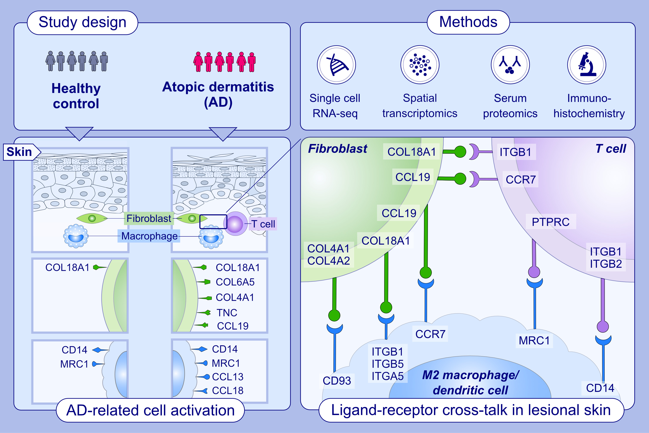
Spatial transcriptomics combined with single-cell RNA-sequencing unravels the complex inflammatory cell network in atopic dermatitis
Yasutaka Mitamura, Matthias Reiger, Juno Kim, Yi Xiao, Damir Zhakparov, , et al.
Allergy. 2023; pages: 2215-2231
https://doi.org/10.1111/all.15781
© 2019 EAACI and John Wiley and Sons A/S. Published by John Wiley and Sons Ltd.
Notes:
HIGHLIGHTS
Single-cell RNA- and spatial RNA-seq identified complex cellular interactions in lesional skin of AD.
COL18A1⁺ fibroblasts express COL6A5, COL4A1, TNC, and CCL19 and interact with CCR7 positive LAMP3 ⁺ dendritic cells and T cells.
CCL13 ⁺ and CCL18 ⁺ M2 macrophages show an interaction with T cells by MRC1-PTPRC and CD14-ITGB1/2. The serum level of TNC and CCL18 shows a positive correlation with AD severity.
Abbreviations: AD, atopic dermatitis; CCL, C-C motif chemokine ligand; CCR, C-C motif chemokine receptor; COL, collagen; ITGB, integrin beta; LAMP3, lysosome-associated membrane glycoprotein 3; MRC, mannose receptor C; PTPRC, protein tyrosine phosphatase receptor; TNC, tenascin C.

