Slide 1
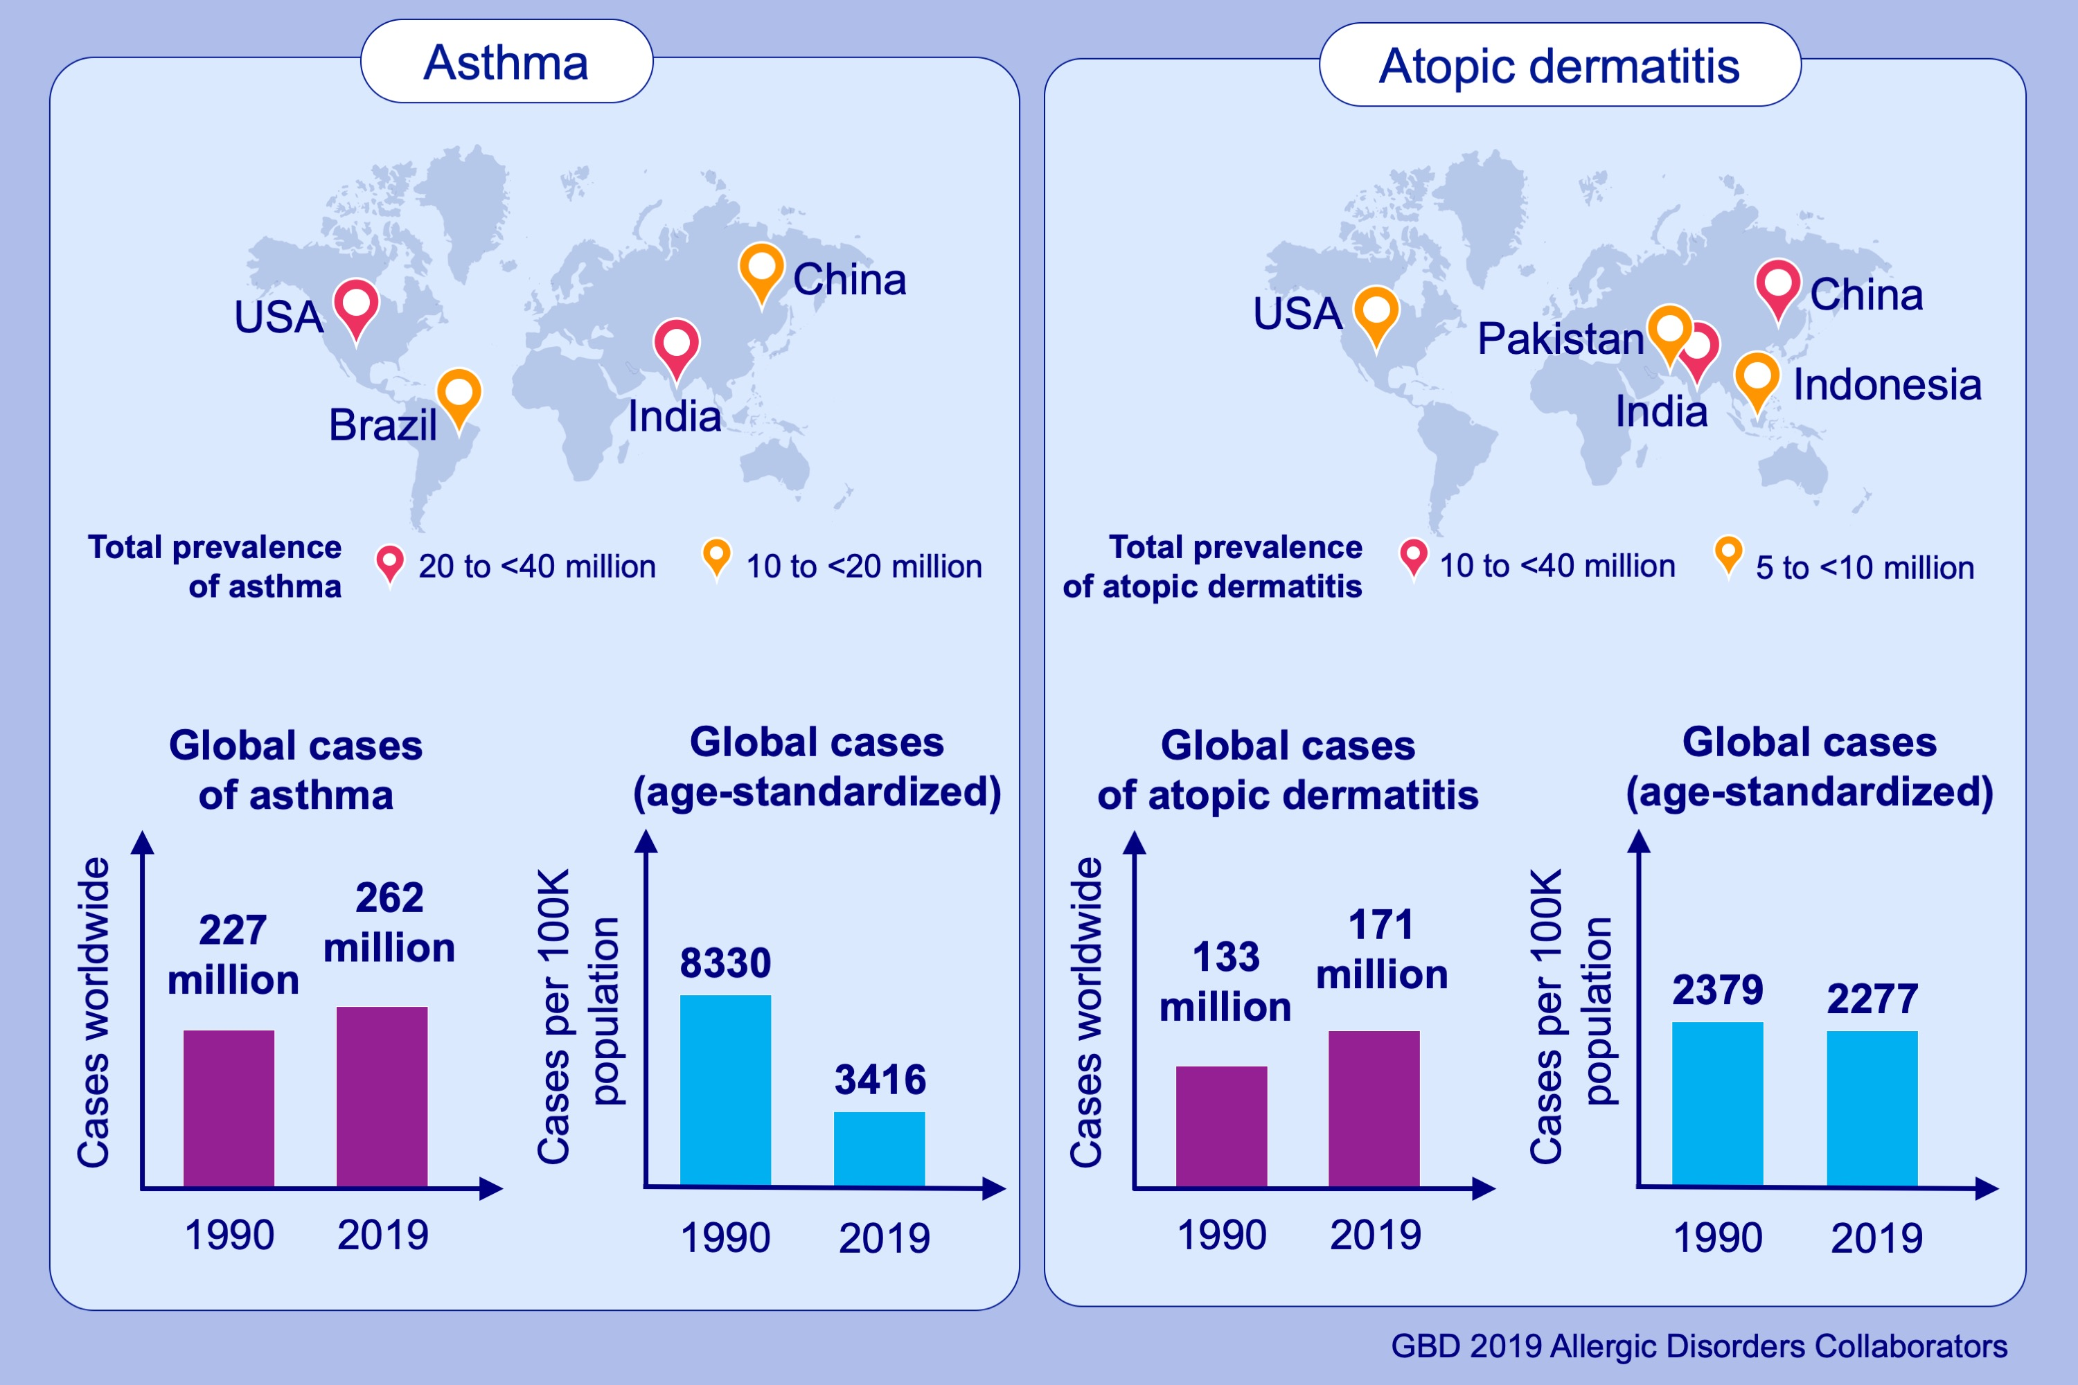
Global, regional, and national burden of allergic disorders & their risk factors in 204 countries and territories, from 1990 to 2019: a systematic analysis for the Global Burden of Disease Study 2019
Youn Ho Shin, Jimin Hwang, Rosie Kwon, Seung Won Lee, Min Seo Kim, , et al.
Allergy. 2023; pages: 2232-2254
https://doi.org/10.1111/all.15807
© 2019 EAACI and John Wiley and Sons A/S. Published by John Wiley and Sons Ltd.
Notes:
HIGHLIGHTS
Using data from the GBD 2019 study, we assessed the total cases and age-standardized prevalence of both asthma and atopic dermatitis in 204 countries and territories from 1990 to 2019.
In 2019, there were a total of 262 million [95% UI: 224–309 million] cases of asthma and 171 million [95% UI: 165–178 million] total cases of AD globally; age-standardized prevalence rates were 3,416 [95% UI: 2,899–4,066] and 2,277 [95% UI: 2,192–2,369] per 100,000 population for asthma and atopic dermatitis, respectively, a 24.1% [95% UI: -27.2 to -20.8] decrease for asthma and a 4.3% [95% UI: 3.8–4.8] decrease for atopic dermatitis compared to baseline in 1990.
Asthma and atopic dermatitis continue to cause significant morbidity worldwide, having increased in total prevalence and incidence cases worldwide, but having decreased in age-standardized prevalence rates from 1990 to 2019.
Abbreviations: GBD, Global Burden Disease; UI, uncertainty interval.

