Slide 1
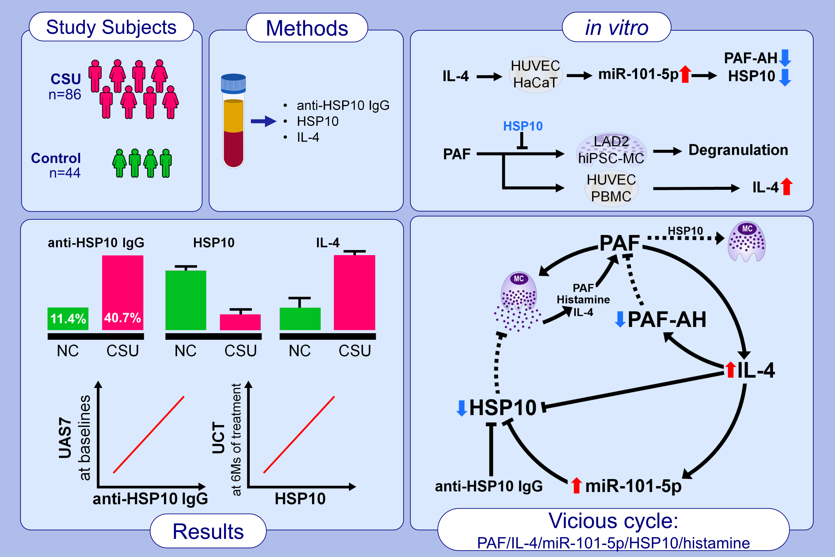
Anti-Heat Shock Protein 10 IgG in Chronic Spontaneous Urticaria: Relation With miRNA-101-5p and Platelet-Activating Factor
Bo Youn Choi, Eun-Mi Yang, Hae-Won Jung, Min-Kyoung Shin, Junghyun Jo, et al.
Allergy. 2023; pages: 3166-3177
https://doi.org/10.1111/all.15810
© 2019 EAACI and John Wiley and Sons A/S. Published by John Wiley and Sons Ltd.
Notes:
HIGHLIGHTS
In patients with CSU, the positivity of anti-HSP10 IgG was increased and associated with urticaria severity. Additionally, HSP10 levels were decreased and correlated with UCT scores after 6-month treatment in CSU patients.
Serum IL-4 levels were elevated in CSU patients, and treatment with IL-4 in HUVECs and HaCaT cells resulted in a reduction in HSP10, which was caused by the upregulation of miR-101-5p in these cells.
Increased IL-4 production was observed from PBMCs of CSU patients and HUVECs upon PAF stimulation, and HSP10 was found to prevent PAF-induced mast cell degranulation.
Abbreviations: AH, platelet-activating factor-acetylhydrolase; CSU, chronic spontaneous urticaria; HaCaT, human keratinocyte cell line; hiPSC-MC, human induced pluripotent stem cell-derived mast cells; HSP10, heat shock protein 10; HUVEC, human umbilical vein endothelial cell; miR, microRNA; NC, healthy normal control; PAF, platelet-activating factor; PAF-UCT, urticaria control test; PBMC, peripheral blood mononuclear cells; UAS7, urticaria activity score over 7 days.

