Slide 1
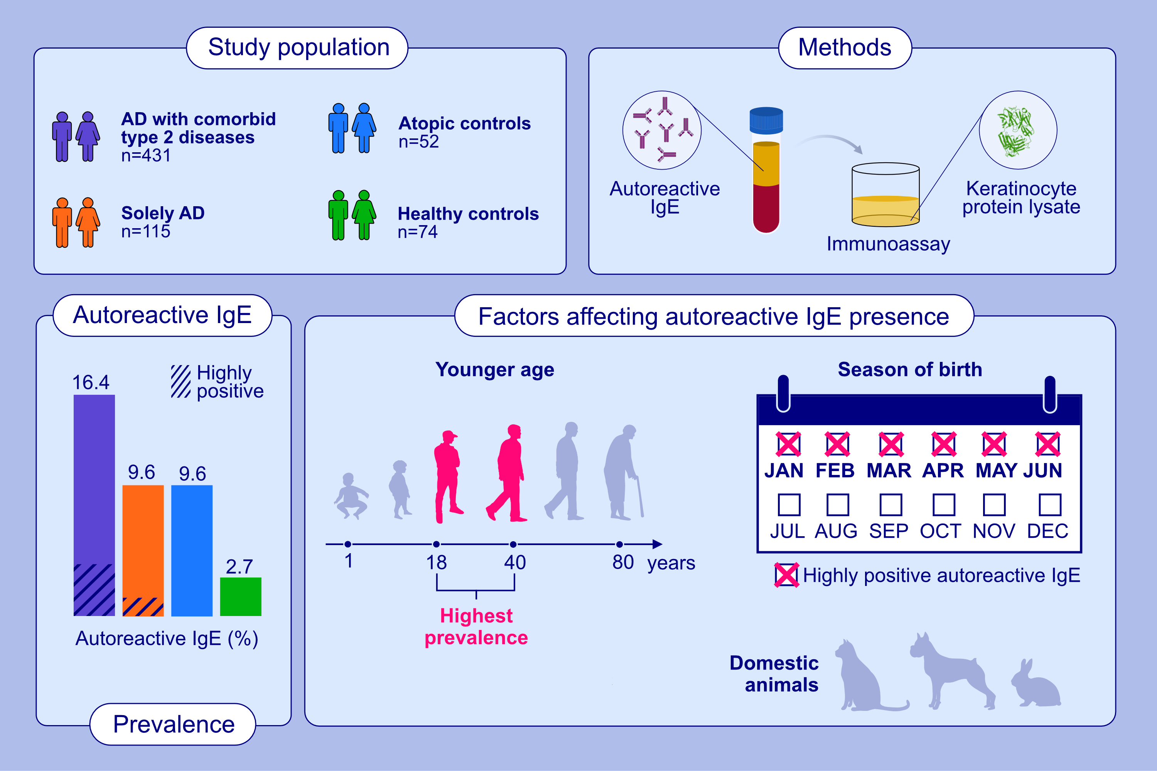
Immunoglobulin E autoantibodies in atopic dermatitis associates with Type-2 comorbidities and the atopic march
Inge Kortekaas Krohn, Fariza Mishaal Saiema Badloe, Nadine Herrmann, Laura Maintz, Shauni De Vriese ,et al.
Allergy. 2023; pages:3178-3192
https://doi.org/10.1111/all.15822
© 2019 EAACI and John Wiley and Sons A/S. Published by John Wiley and Sons Ltd.
Notes:
HIGHLIGHTS
This study investigates the prevalence of IgE-mediated autoreactivity in serum samples from a well-characterized large cohort of AD patients and controls and their correlation with clinical characteristics and environmental factors potentially related to the development of IgE autoantibodies in AD.
IgE autoantibodies in AD associate with the presence of atopic comorbidities and the atopic march. AD-patients with IgE autoantibodies were younger than those without and higher total serum IgE levels were found.
Environmental factors that affected IgE autoantibodies were birth between January and June, c-section and diversity of domestic pets.
Abbreviations: AD, atopic dermatitis; IgE, immunoglobulin E

