Slide 1
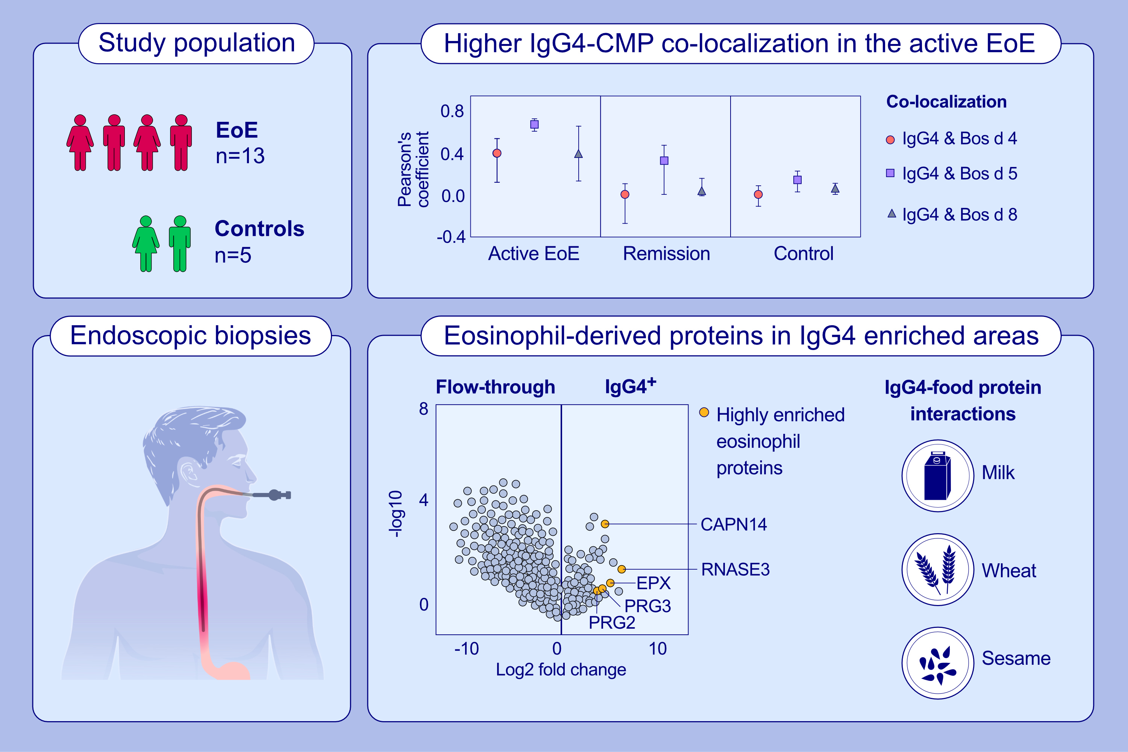
Immunoglobulin G4 in Eosinophilic Esophagitis: Immune Complex Formation
and Correlation with Disease Activity
Jonathan G. Medernach, Rung-Chi Li, Xiao-Yu Zhao, Bocheng Yin, Emily A. Noonan, Elaine F. Etter,et al.
Allergy. 2023; pages: 3193-3203
https://doi.org/10.1111/all.15826
© 2019 EAACI and John Wiley and Sons A/S. Published by John Wiley and Sons Ltd.
Notes:
HIGHLIGHTS
We assessed co-localization of IgG4 and cow’s milk proteins in paired active disease and remission esophageal biopsy samples from EoE patients.
IgG4-milk co-localization was higher in the active EoE group compared to paired remission samples.
Using a novel technique, autoSTOMP, IgG4 enriched areas were found to contain a high abundance of eosinophil associated proteins and food peptides.
Abbreviations: autoSTOMP, automated Spatially Targeted Optical MicroProteomics; CAPN14, calpain 14; CMP, cow’s milk protein; EoE, eosinophilic esophagitis; EPX, eosinophil peroxidase; IgG4, immunoglobulin G4; PRG, proteoglycan; RNASE3, ribonuclease A family member 3.

