Slide 1
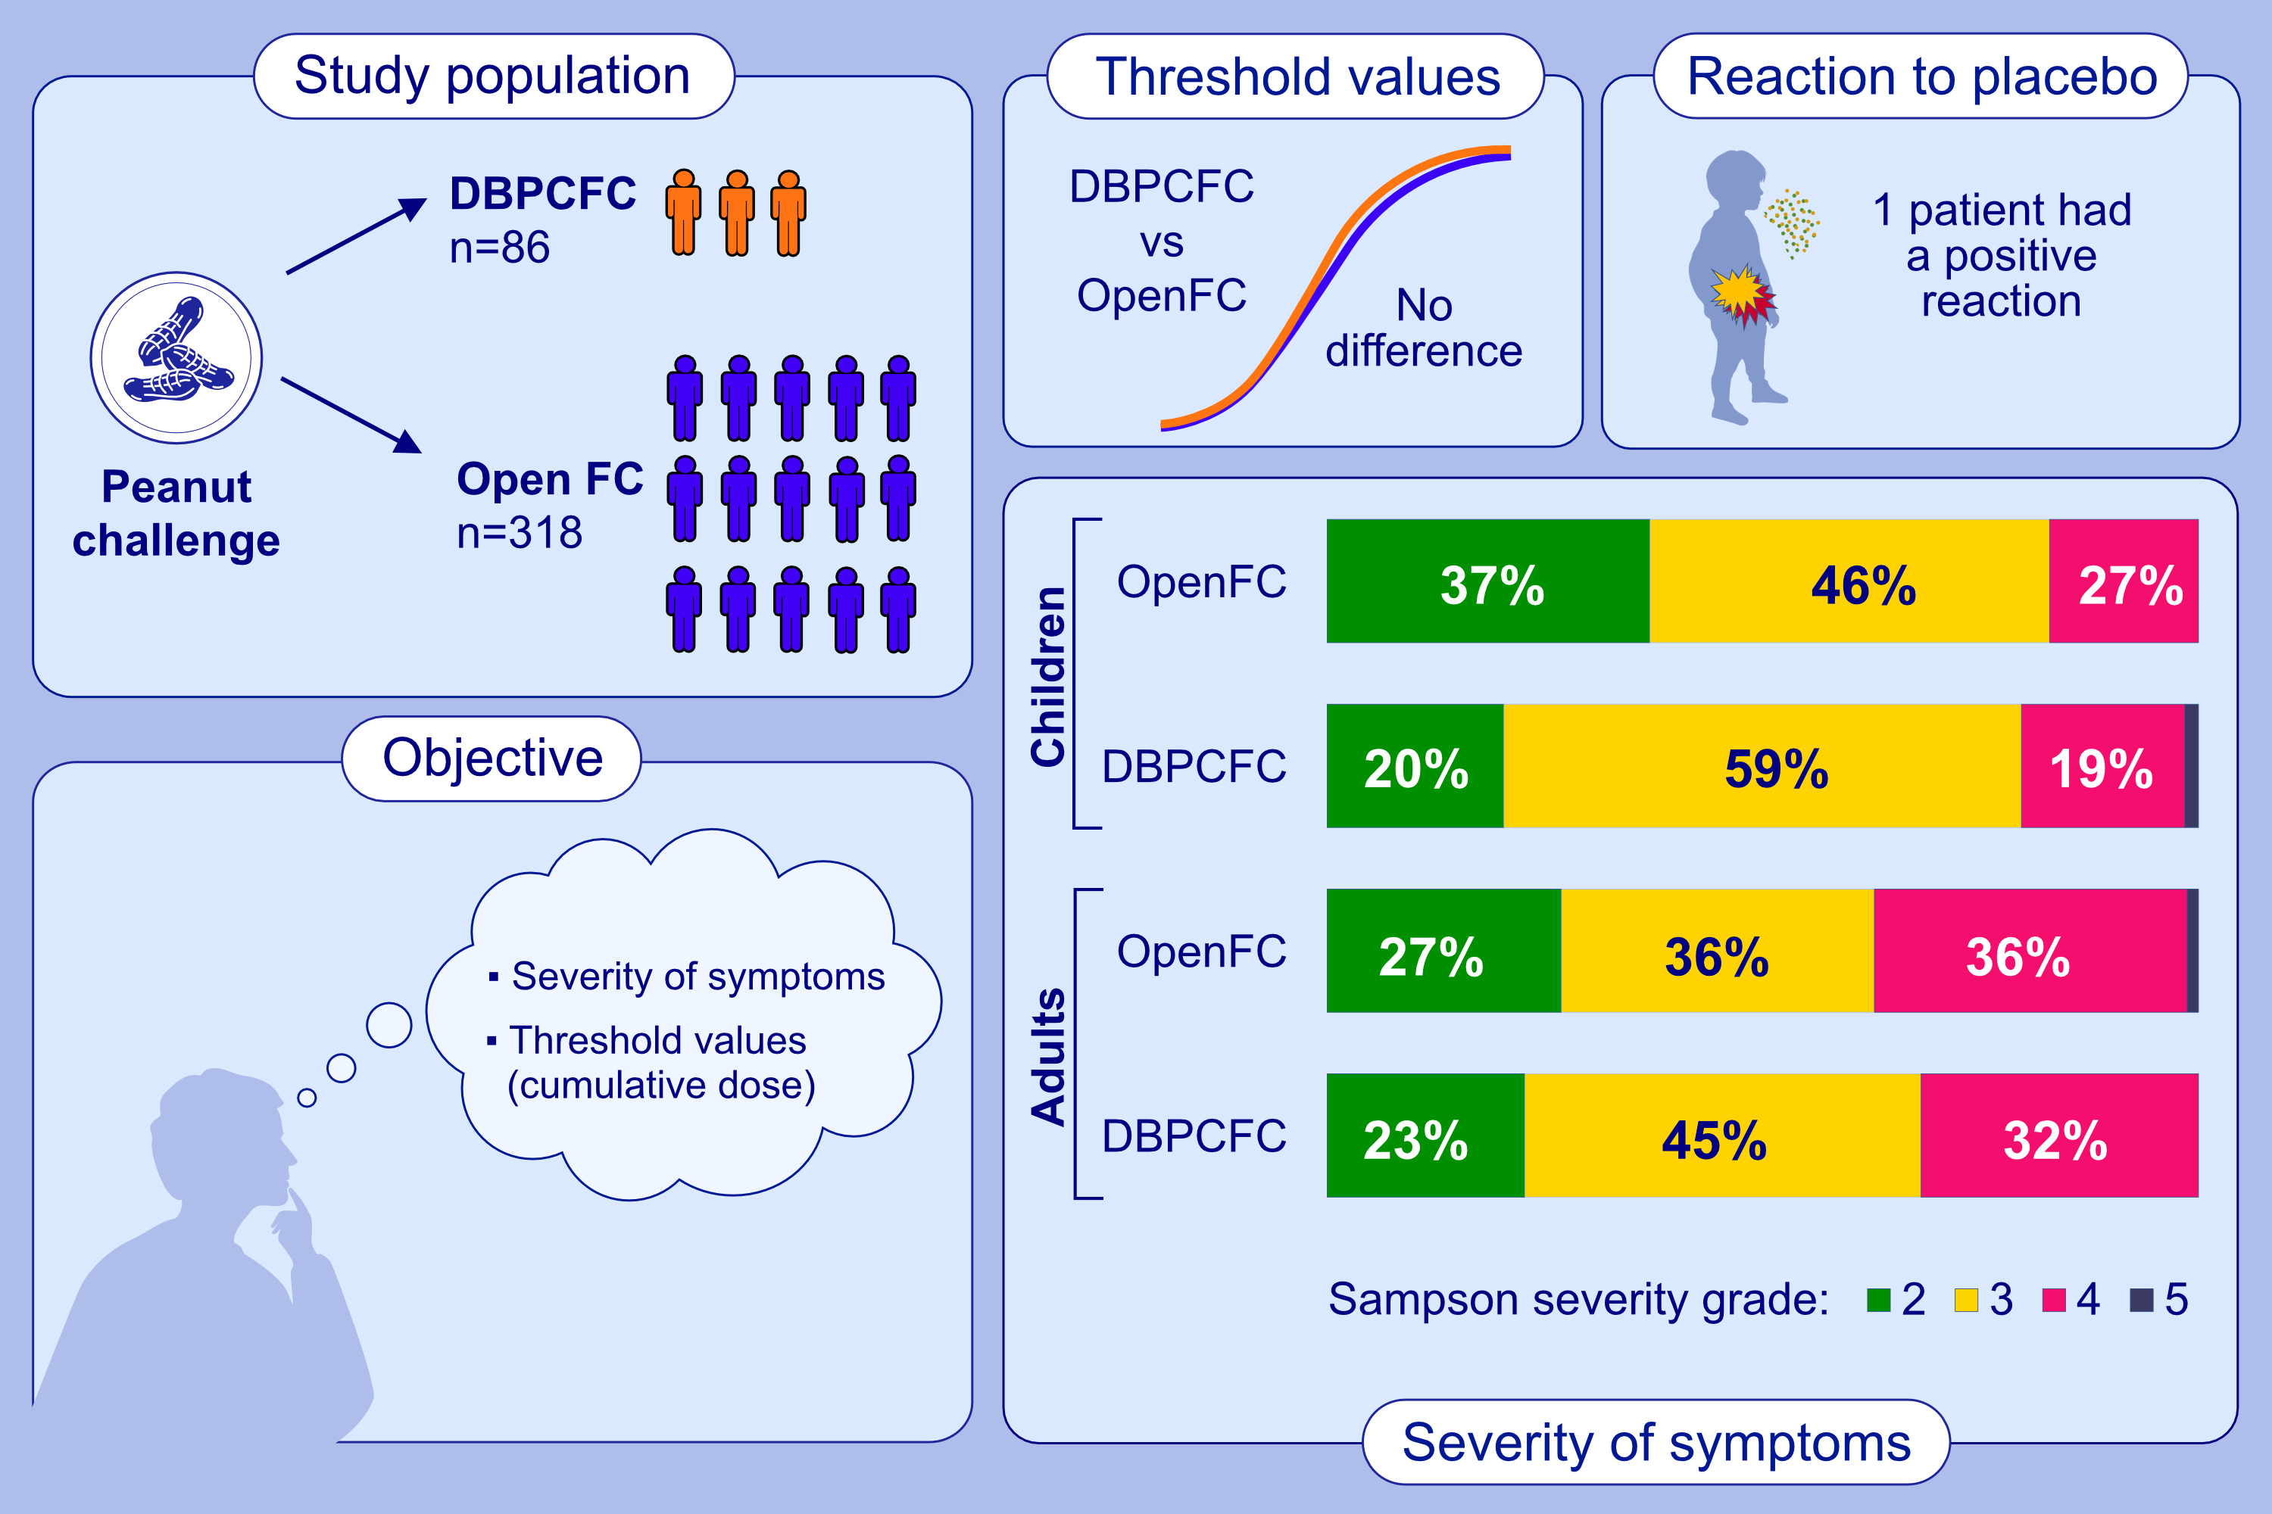
A comparison of double-blind, placebo-controlled food challenge and open food challenge
Frederik Bloch Jessen, Charlotte G. Mortz, Esben Eller, Julie H. Gudichsen, Emil A. Baekdal, Carsten Bindslev-Jensen
Allergy. 2023; pages: 32043211
https://doi.org/10.1111/all.15834
© 2019 EAACI and John Wiley and Sons A/S. Published by John Wiley and Sons Ltd.
Notes:
HIGHLIGHTS
This retrospective study compares severity of symptoms and threshold values in children and adults with peanut allergy, challenged in OpenFC and/or DBPCFC.
One patient had a positive reaction to a placebo challenge.
We found no difference in threshold values overall neither in children nor in adults. There was no difference when comparing mild and severe symptoms at all ages, but a higher proportion of children experienced grade three symptoms in the double-blind group.
Abbreviations: DBPCFC, double-blind placebo-controlled food challenge; OpenFC, open food challenge.

