Slide 1
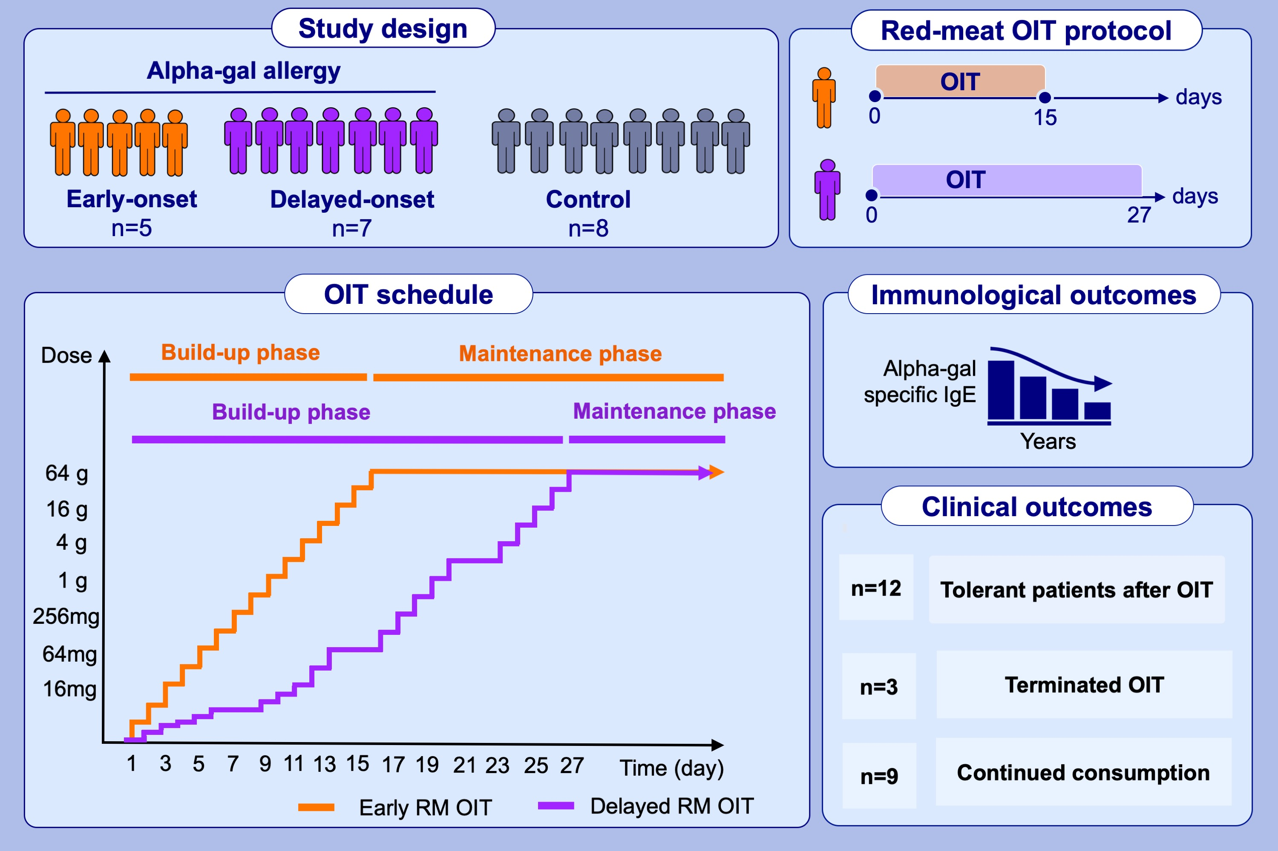
Oral immunotherapy in alpha-gal red meat allergy: Could specific IgE be a potential biomarker in monitoring management?
D. Ünal, D. Eyice-Karabacak, A. Kutlu, S. Demir, C. Tüzer, A. F. Arslan, S. R. Işık, A. Gelincik
Allergy. 2023; pages: 3241-3251
https://doi.org/10.1111/all.15840
© 2019 EAACI and John Wiley and Sons A/S. Published by John Wiley and Sons Ltd.
Notes:
HIGHLIGHTS
In patients with confirmed IgE-mediated galactose-alpha-1,3-galactose (alpha-gal) allergy a 2-hour cut-off for early-onset and delayed-onset alpha-gal allergy discremination was used for the classification of the food hypersensivity reactions.
15- and 27-day red meat oral immunotheraphy (RM OIT) for early-onset and delayed-onset alpha-gal allergy were administered, respectively.
12 patients underwent RM OIT and all patients became tolerant to RM after OIT however, three patients had to terminate OIT. The median alpha-gal sIgE level gradually decreased in the follow-up in the OIT group.
Abbreviations: Alpha-gal: galactose-alpha-1,3-galactose, IgE: immunoglobulin E, RM: red meat, OIT: oral immunotheraphy

