Slide 1
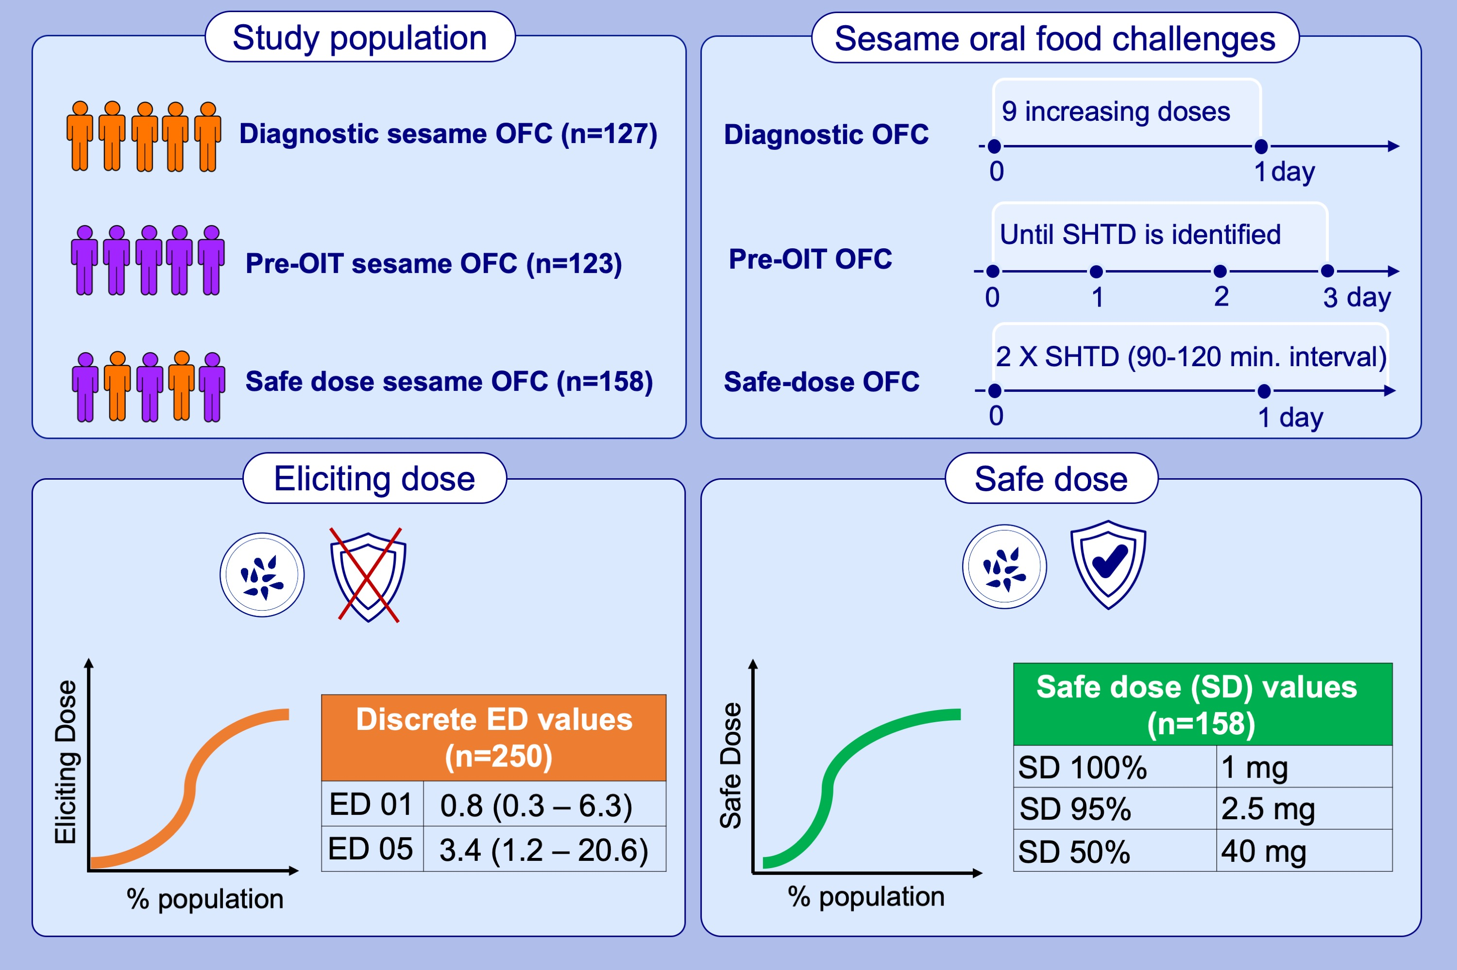
Sesame Eliciting and Safe Doses in a Large Sesame Allergic Population
Liat Nachshon, Joost Westerhout, W. Marty Blom, Benjamin Remington, Michael B. Levy,et al.
Allergy. 2023; pages: 3212-3220
https://doi.org/10.1111/all.15863
© 2019 EAACI and John Wiley and Sons A/S. Published by John Wiley and Sons Ltd.
Notes:
HIGHLIGHTS
250 patients underwent sesame OFCs (diagnostic, n=127; pre-OIT, n=123). Safe-dose (based on identified SHTD) challenges with 90-120 minute-intervals were analyzed in a sub-group of 158 patients.
The discrete ED01 and ED05 of the entire cohort were 0.8 mg and 3.4 mg, respectively, and estimated values of discrete ED01 and ED05 from safe-dose OFCs were similar.
Importantly, no objective reaction was documented to a dose of ≤1 mg sesame protein.
Abbreviations: ED01/05, eliciting dose in 1% and 5% of patients, respectively; OFC, oral food challenge; OIT, oral immunotherapy; SHTD, single highest tolerated dose; Min, minutes

