Slide 1
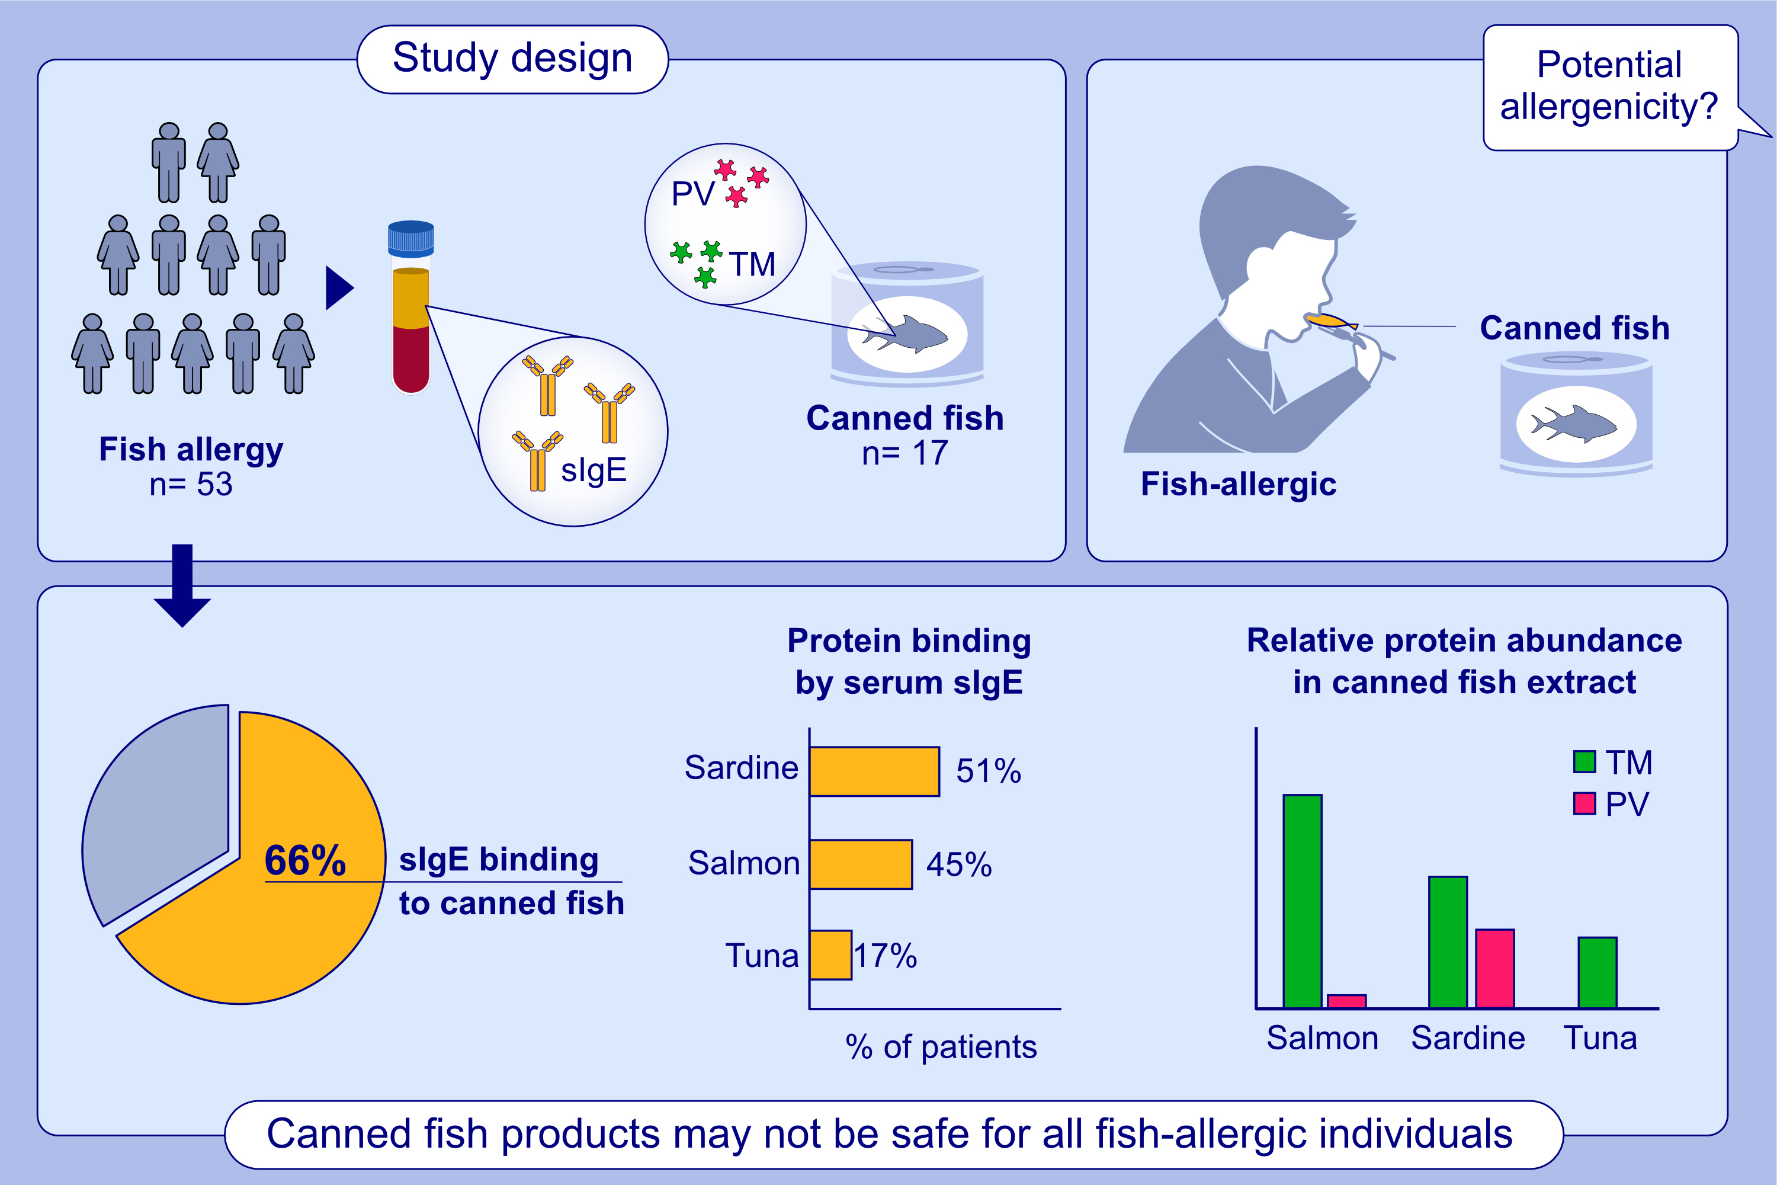
The potential risk of thermostable allergens in canned fish for fish allergy sufferers
Aya C. Taki, Thimo Ruethers, Roni Nugraha, Shaymaviswanathan Karnaneedi, Nicholas A. Williamson, et al.
Allergy. 2023; pages: 3221-3234
https://doi.org/10.1111/all.15864
© 2019 EAACI and John Wiley and Sons A/S. Published by John Wiley and Sons Ltd.
Notes:
HIGHLIGHTS
This is the first study that comprehensively examines the in vitro immunogenicity of canned fish, employing a cohort of fish allergic patients (n=53; largest to date).
Canned fish contains thermostable proteins, including major fish allergens (parvalbumin and tropomyosin), which bind to the sIgE of fish-allergic patients.
66% of patients showed sIgE-binding to canned fish. Canned fish may not be safe for all fish-allergic patients.
Abbreviations: PV, parvalbumin; sIgE, specific immunoglobulin E; TM, tropomyosin.

