Slide 1
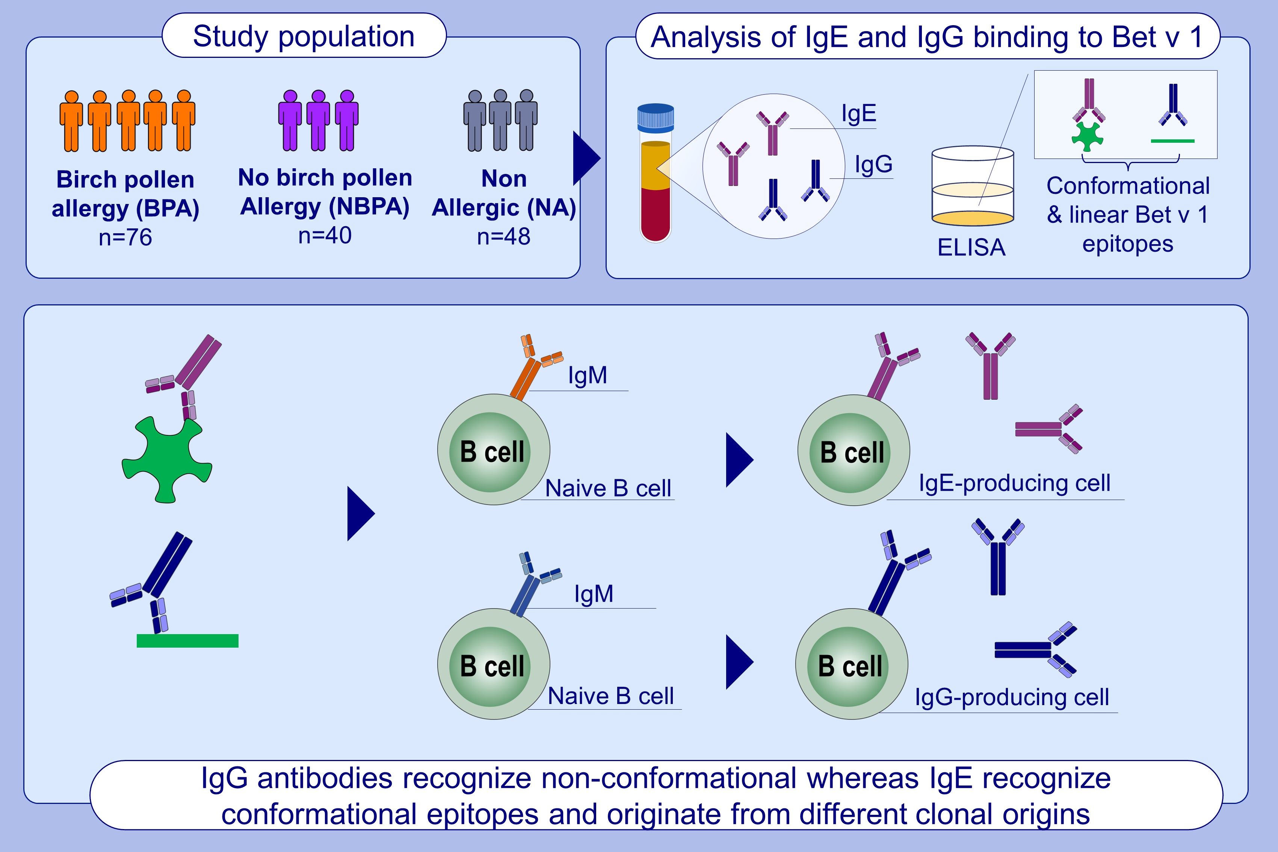
Natural human Bet v 1-specific IgG antibodies recognize non-conformational epitopes whereas IgE reacts with conformational epitopes
Georgii Brazhnikov, Evgenii Smolnikov, Alla Litovkina, Tianchi Jiang, Artem Shatilov, et al.
Allergy. 2023; pages: 3139-3153
https://doi.org/10.1111/all.15865
© 2019 EAACI and John Wiley and Sons A/S. Published by John Wiley and Sons Ltd.
Notes:
HIGHLIGHTS
The recognition of conformational and sequential epitopes of Bet v 1 in birch pollen allergic patients (BPA), non-birch pollen allergic patients (NBPA) and non-allergic subjects (NA) was analyzed.
IgE antibodies from BPA patients recognized only conformational epitopes. IgG antibodies from all individuals recognized sequential and conformational epitopes.
Bet v 1-specific IgE- and IgG-producing B cells may have different clonal origins.
Abbreviations: BPA, Birch pollen allergic patients; ELISA, Enzyme-linked immunoassay; IgE, Immunoglobulin E; IgG, Immunoglobulin G; IgM, Immunoglobulin M; NBPA, Allergic patients without birch pollen allergy; NA, Non-allergic individuals.

