Slide 1
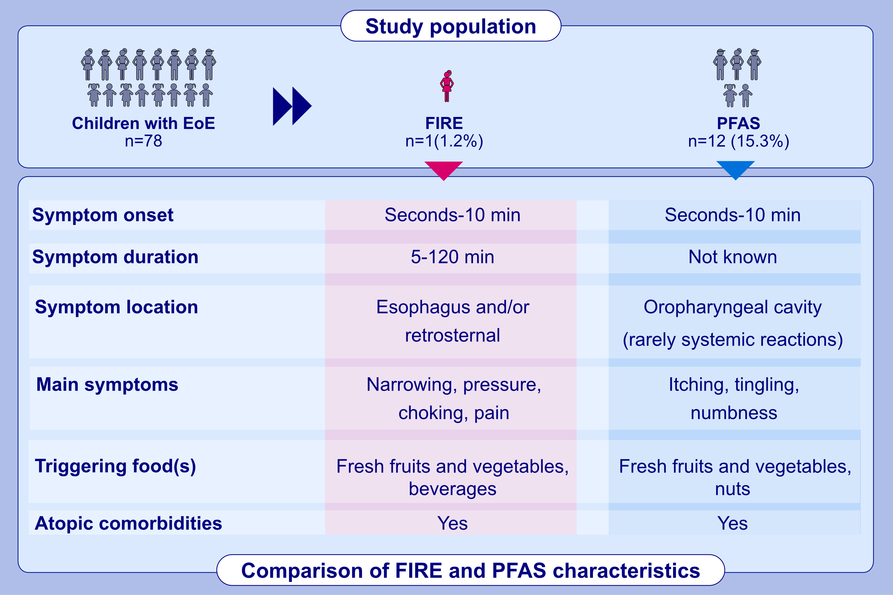
,et al.
Allergy. 2023; pages:
© 2019 EAACI and John Wiley and Sons A/S. Published by John Wiley and Sons Ltd.
Notes:
HIGHLIGHTS

