Slide 1
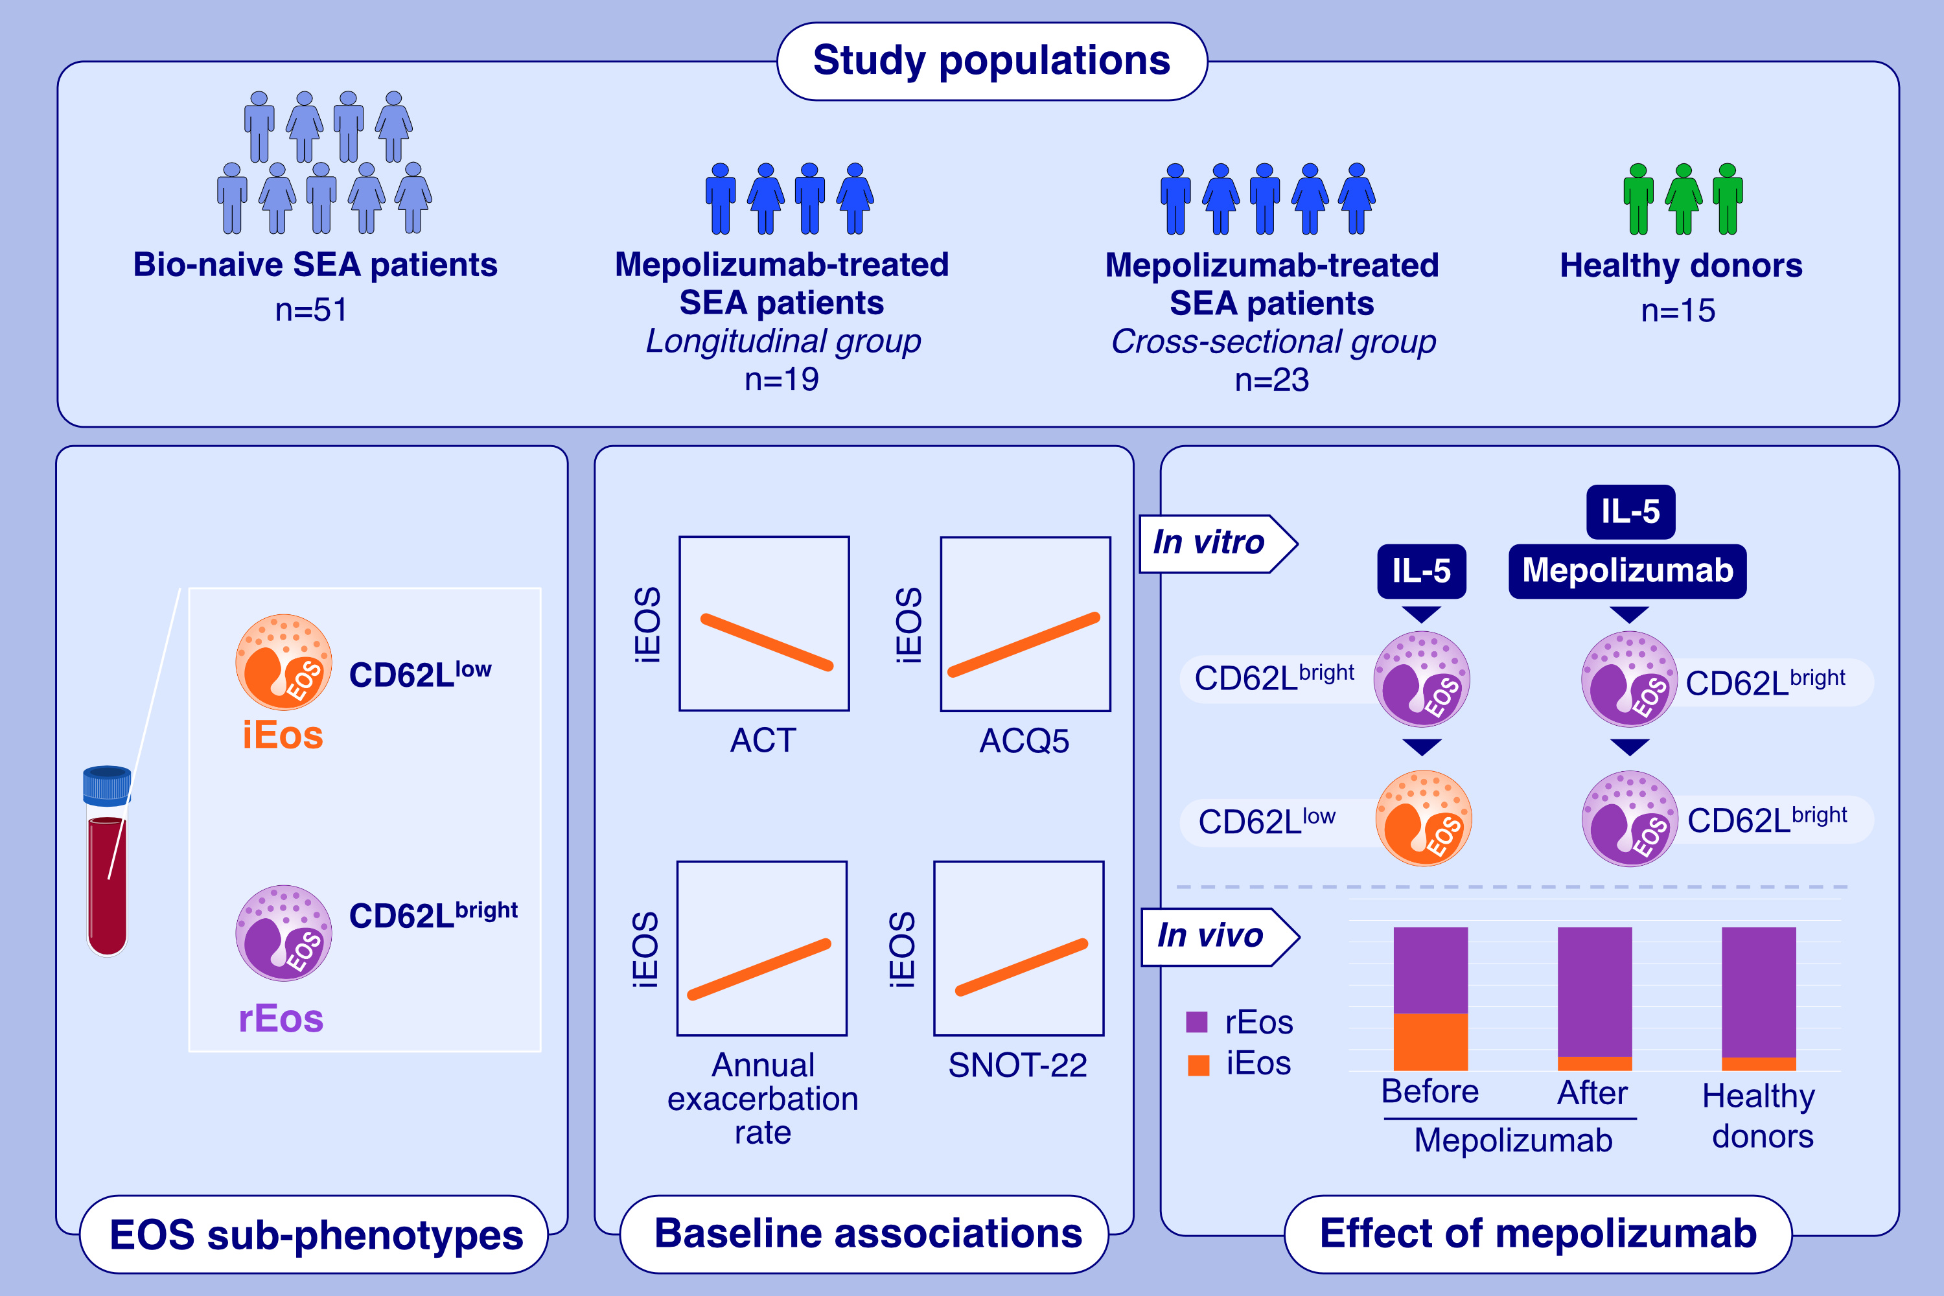
Blood CD62L low inflammatory eosinophils are related to the severity of asthma and reduced by mepolizumab
Alessandra Vultaggio, Matteo Accinno, Emanuele Vivarelli, Valentina Mecheri, Giandomenico Maggiore,et al.
Allergy. 2023; pages: 3154-3165
https://doi.org/10.1111/all.15909
© 2019 EAACI and John Wiley and Sons A/S. Published by John Wiley and Sons Ltd.
Notes:
HIGHLIGHTS
The study investigates the correlation between blood CD62L low iEos and clinical severity of SEA and evaluates the impact of mepolizumab on iEos.
Circulating CD62L^{low} eosinophils correlate with clinical severity of SEA and CRSwNP.
Treatment with mepolizumab restores the balance between CD62L^{low} and CD62L^{bright} eosinophils in SEA patients. Mepolizumab inhibits in vitro IL-5-induced CD62L^{low} eosinophils expansion.
Abbreviations: ACT, asthma control test; ACQ-5, asthma control questionnaire-5; CRSwNP, chronic rhinosinusitis with nasal polyps; iEos, inflammatory eosinophils; rEos, regulatory eosinophils; SEA, severe eosinophilc asthma; SNOT-22, sinunasal outcome test-22

