Slide 1
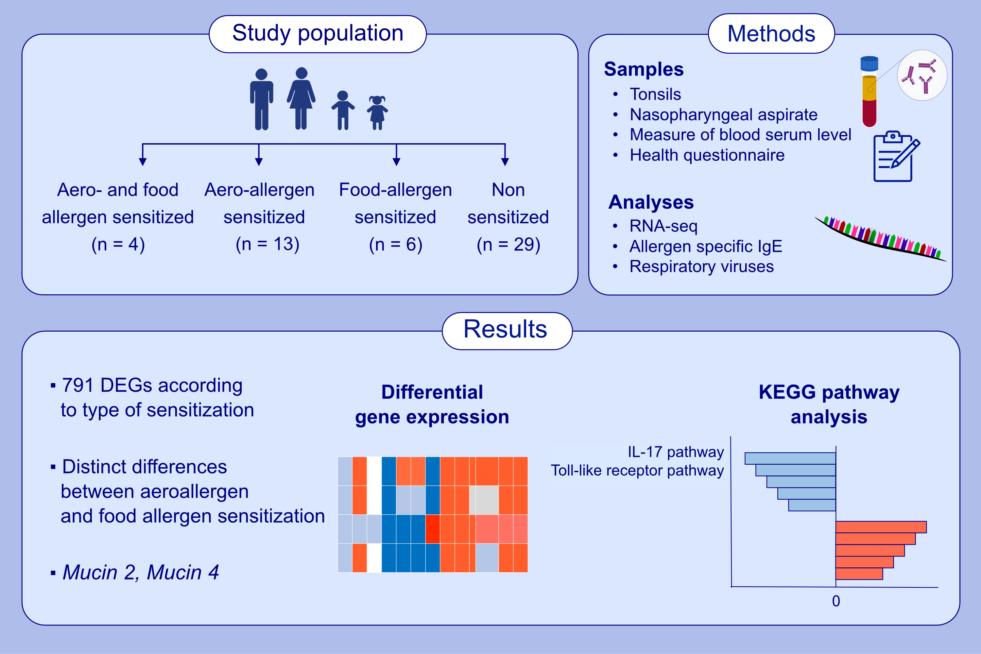
Tonsillar transcriptional profiles in atopic and non-atopic subjects
Tanzeela Hanif, Lotta E. Ivaska, Freed Ahmad, Ge Tan, Emilia Mikola, et al.
Allergy. 2023; pages:522-536
https://doi.org/10.1111/all.15458
© 2019 EAACI and John Wiley and Sons A/S. Published by John Wiley and Sons Ltd.
Notes:
HIGHLIGHTS
This is the first study to assess differences in gene expression in the level of local lymph node tissue according to sensitization status.
Our data shows a large number of differentially expressed genes on tonsil tissue sensitization subgroups. These overrepresented genes were consisted of chemokines (CXCL2, CXCL8, CXCL10, CXCL11) and genes from MUC-family (MUC1, MUC4, MUC20).
Interestingly, aeroallergen versus food-allergen sensitized subjects showed 63% distinctively different genes. Aeroallergen sensitized subjects had more prominent immune responses including gene expression for IL-17 pathway and Toll-like receptor signaling pathway.
Abbreviations: CXCL, C-X-C motif ligand; DEG, differentially regulated genes; IL, interleukin; KEGG, Kyoto Encyclopedia of Genes and Genomes; MUC, mucin; RNA-seq, RNA sequencing

