Slide 1
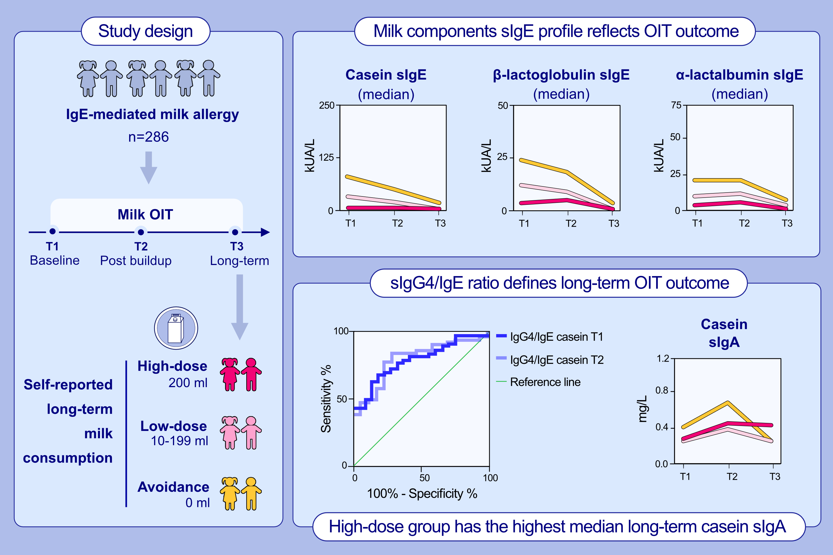
Long-Term Changes in Milk Molecule Immunoglobulins Reflect Milk Oral Immunotherapy Outcomes in Finnish Children
Tiina Kaisa Kauppila, Victoria Hinkkanen, Terhi Savinko, Piia Karisola, Anna Kaarina Kukkonen, et al.
Allergy. 2023; pages: 454-463
https://doi.org/10.1111/all.15479
© 2019 EAACI and John Wiley and Sons A/S. Published by John Wiley and Sons Ltd.
Notes:
HIGHLIGHTS
This long-term open-label follow-up study evaluates the differences in the milk allergen component-specific Ig levels relative to the long-term outcomes of milk OIT.
The baseline Ig profiles and responses to milk OIT differ depending on long-term milk consumption; lower casein sIgE levels are associated with better outcome.
sIgG4/IgE ratio distinguishes the long-term OIT outcome at early timepoints. Higher casein IgA is associated with high-milk dose in the long-term phase.
Abbreviations: OIT, oral immunotherapy; Ig, immunoglobulin; sIg, specific immunoglobulin; kUA/L, kilounits of allergen-specific IgE per liter; T, timepoint

