Slide 1
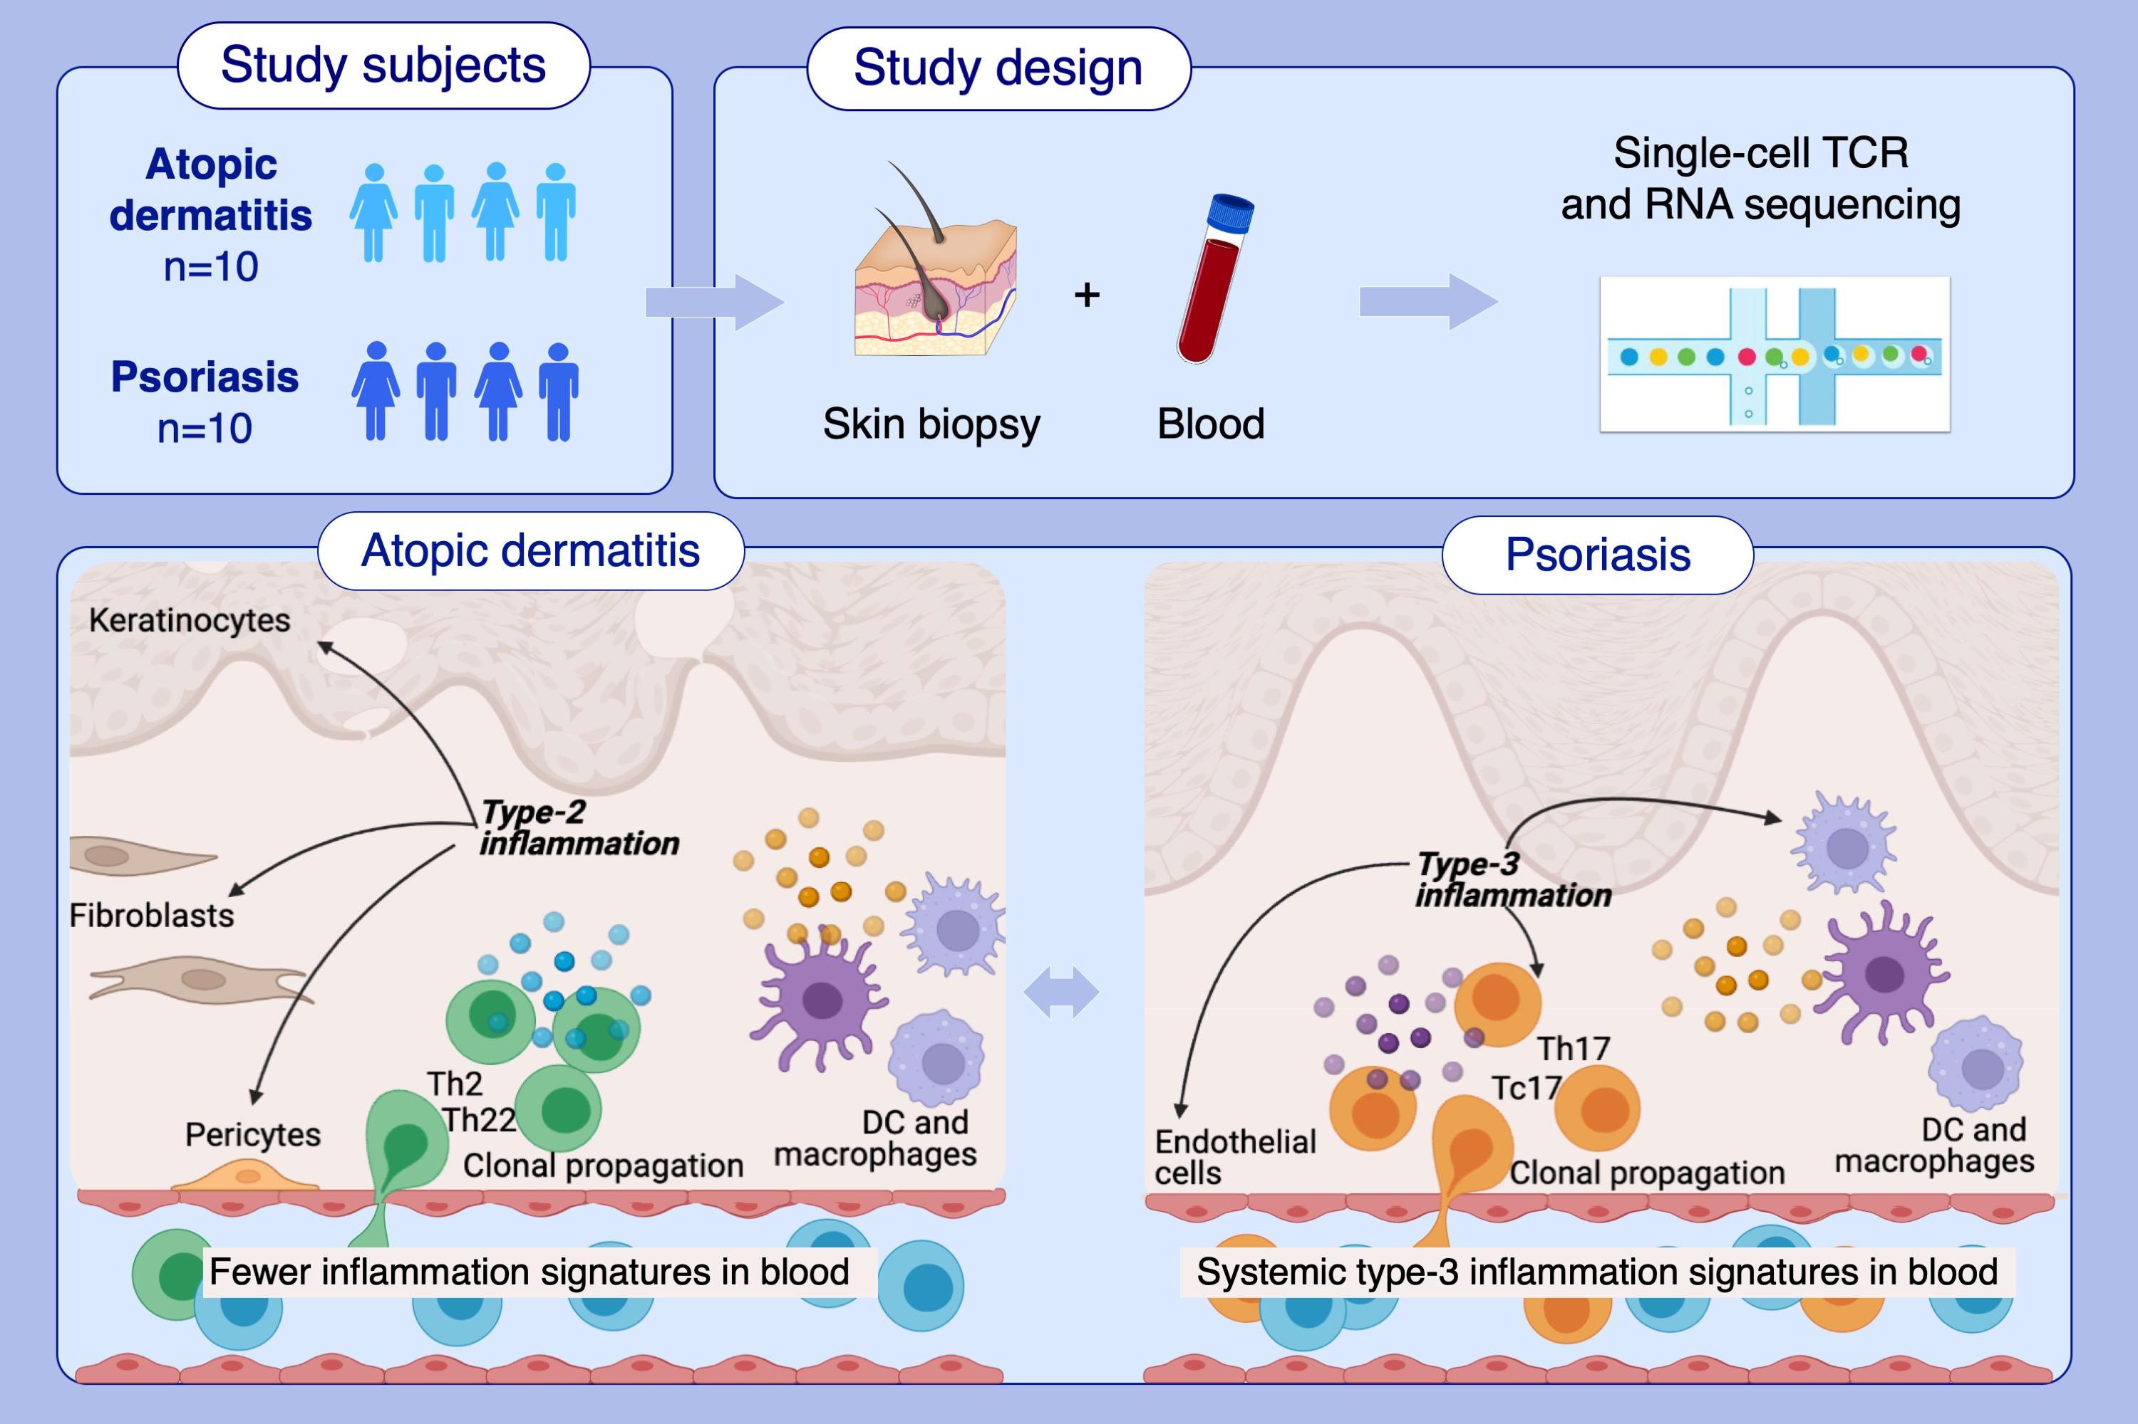
Single-cell profiles reveal distinctive immune response in atopic dermatitis in contrast to psoriasis
Bowen Zhang, Lennart M. Roesner, Stephan Traidl, Valerie A. C. M. Koeken, Cheng-Jian Xu,et al.
Allergy. 2023; pages: 439-453
https://doi.org/10.1111/all.15486
© 2019 EAACI and John Wiley and Sons A/S. Published by John Wiley and Sons Ltd.
Notes:
HIGHLIGHTS
We applied single-cell RNA and TCR sequencing on immune-cells enriched from skin biopsies and matched blood samples of atopic dermatitis and psoriasis patients.
We uncovered disease specific Th2/Th22 and Th17/Tc17 sub-populations in atopic dermatitis and psoriasis, respectively, and associated their numbers with severity scores in both diseases.
The disease specific signatures contributed to the hallmarks of type-2 and type-3 inflammatory signatures and were associated with disease activities.
Abbreviations: DC, dendritic cell; TCR, T cell receptor; Th, T-helper cell; Tc17, T-cytotoxic 17 cell

