Slide 1
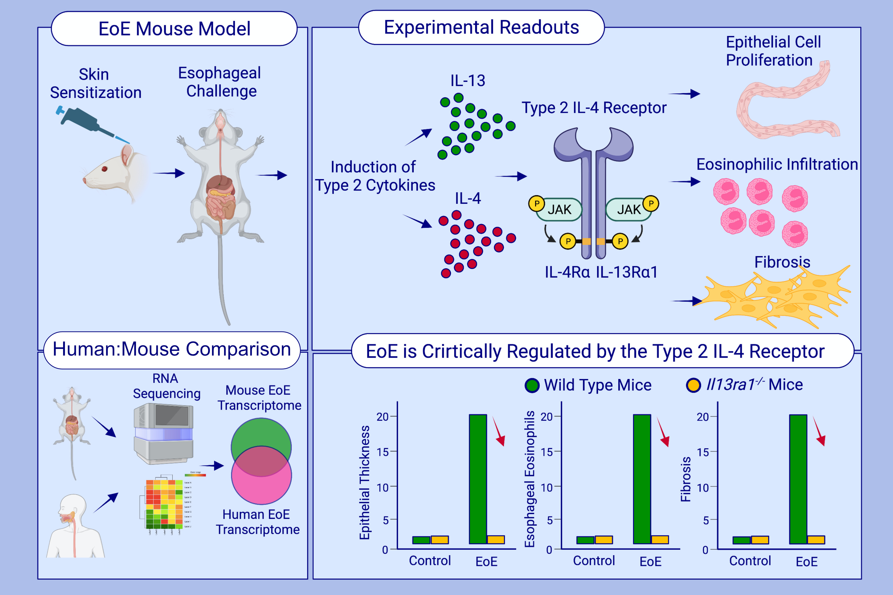
Epithelial cell-expressed type II IL-4 receptor mediates eosinophilic esophagitis
Shmulik Avlas, Guy Shani, Natalie Rhone, Michal Itan, Avishay Dolitzky et al.
Allergy. 2023; pages: 464-476
https://doi.org/10.1111/all.15510
© 2019 EAACI and John Wiley and Sons A/S. Published by John Wiley and Sons Ltd.
Notes:
HIGHLIGHTS
This study described the development of an experimental model for EoE using skin sensitization followed by intra-esophageal challenges of oxazolone.
Experimental EoE recapitulates the major clinical features of human disease, including epithelial cell proliferation, intraepithelial eosinophilia, fibrosis and marked transcriptional resemblance to human EoE.
Il13ra1^{-/-} mice are completely protected from EoE demonstrating that the type 2 IL-4 receptor (i.e., IL-13Rα1) has a critical role in the pathogenesis of EoE.
Abbreviations: EoE, eosinophilic esophagitis; IL-4Rα, interleukin 4 receptor α; IL-13α1, interleukin 13 receptor α1; JAK, Janus kinase

