Slide 1
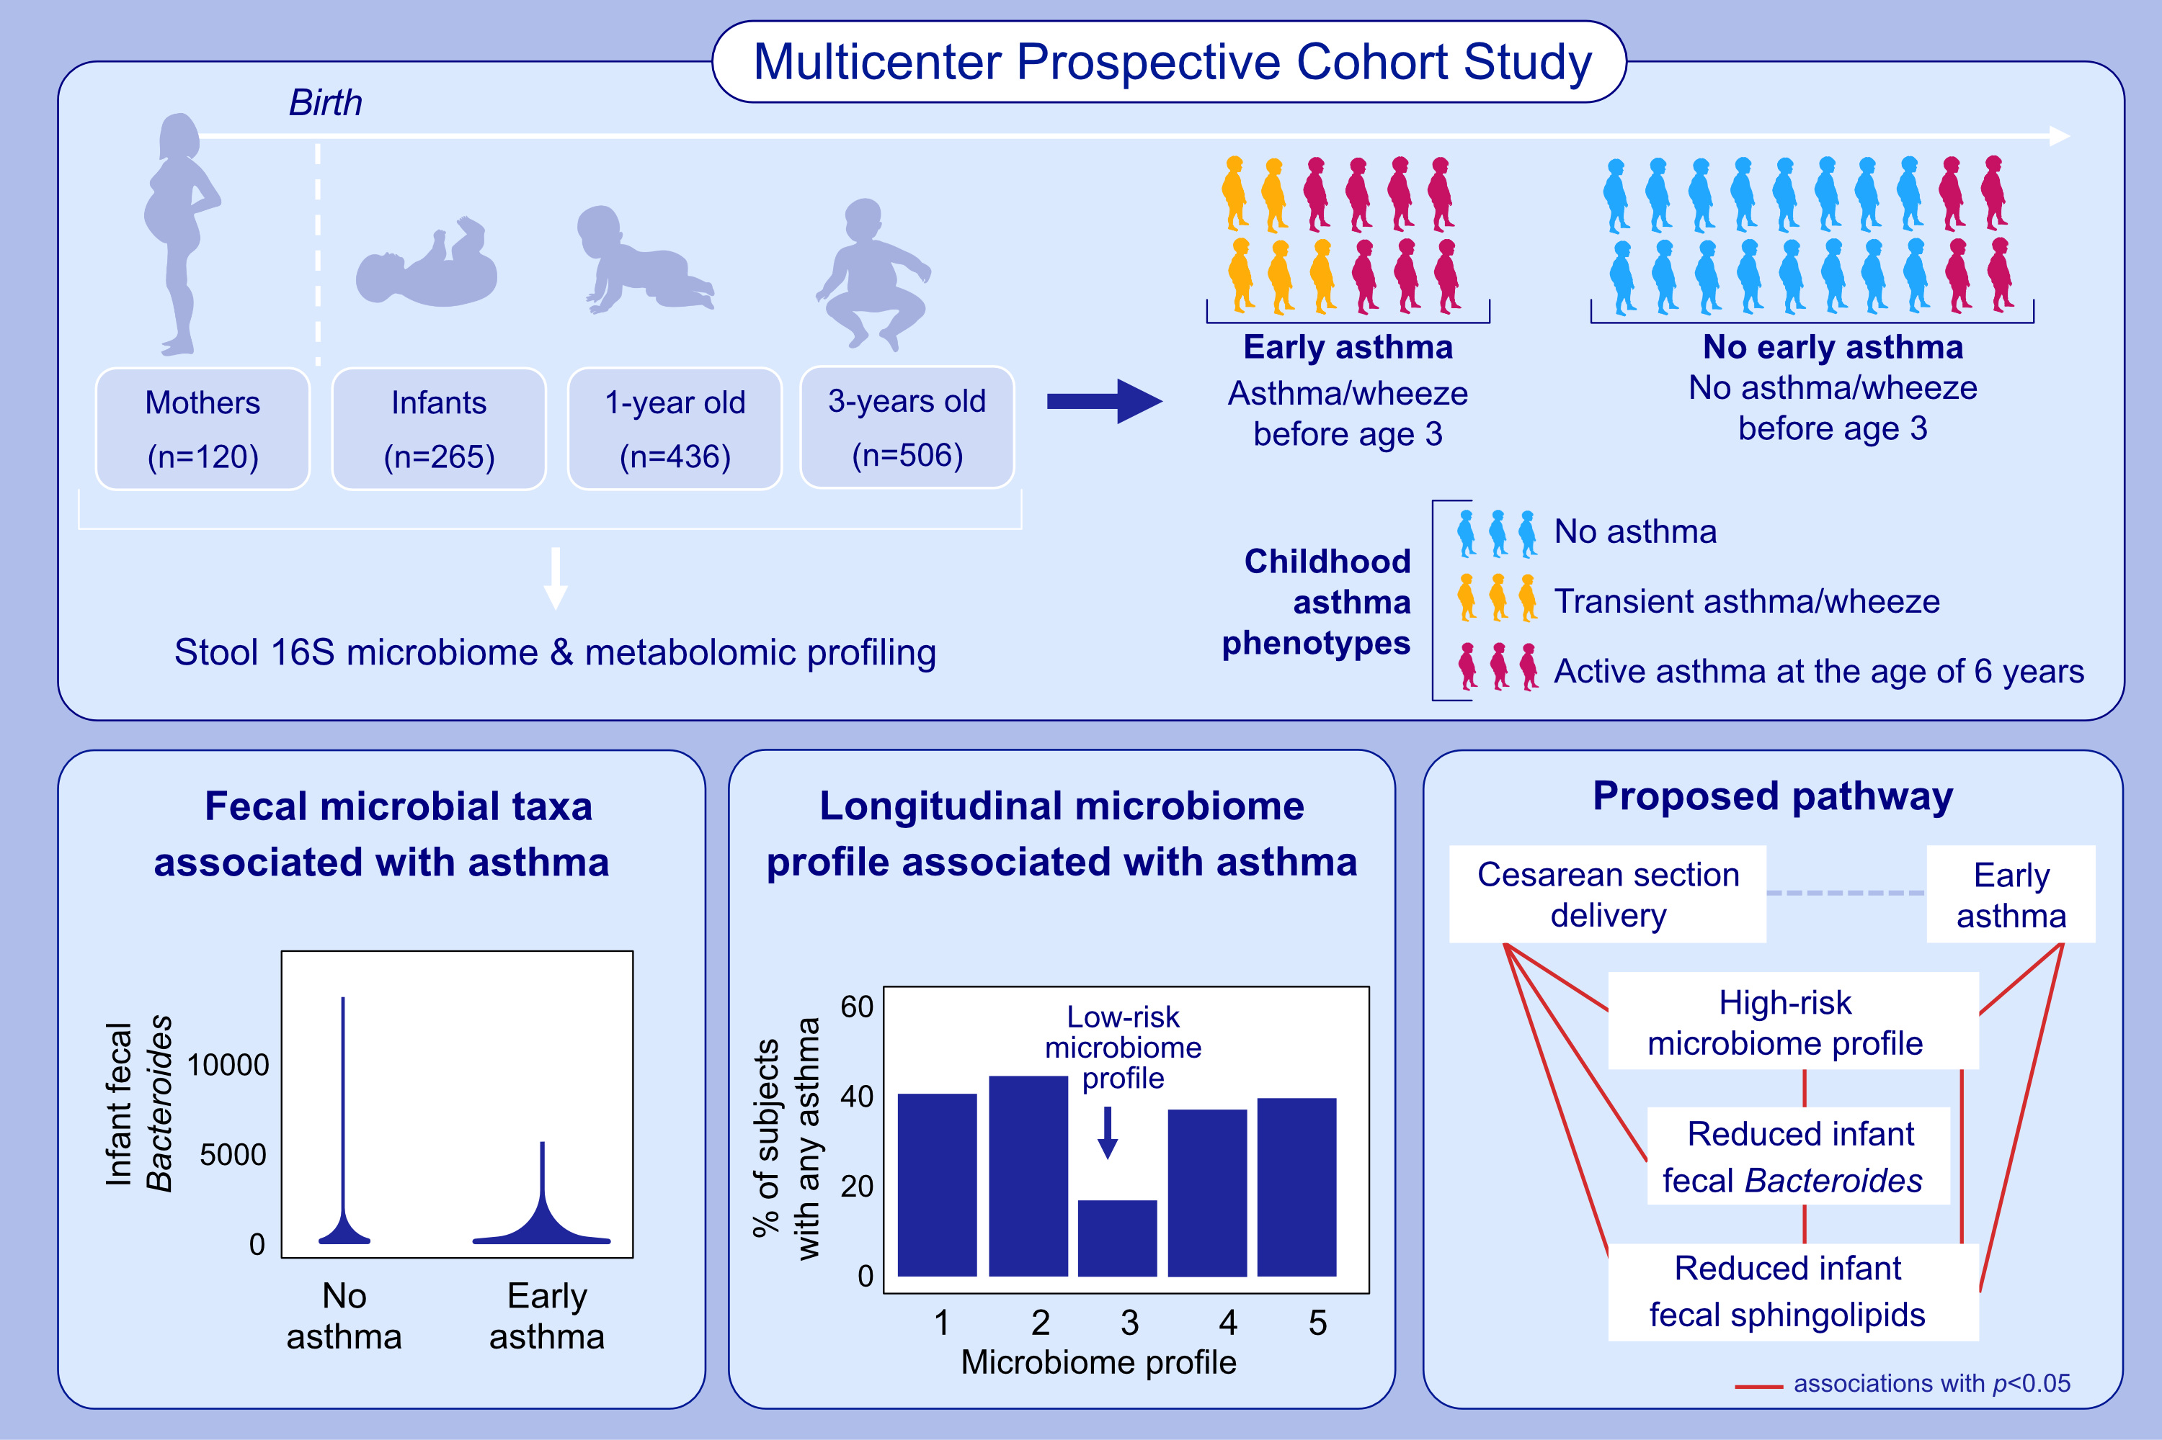
The Maternal Prenatal and Offspring Early-Life Gut Microbiome of Childhood Asthma Phenotypes
Kathleen A. Lee-Sarwar, Yih-Chieh Chen, Yuan Yao Chen, Anita L. Kozyrskyj, Piush J. Mandhane, et al.
Allergy. 2023; pages:418-428
https://doi.org/10.1111/all.15516
© 2019 EAACI and John Wiley and Sons A/S. Published by John Wiley and Sons Ltd.
Notes:
HIGHLIGHTS
This analysis identified associations between the fecal microbiome of mothers during pregnancy and offspring at ages 3-6 months, 1 and 3 years with childhood asthma phenotypes.
Associations were identified between maternal microbiome diversity and taxa with offspring asthma.
Results suggest that dysbiosis associated with cesarean section birth increases early asthma risk.

