Slide 1
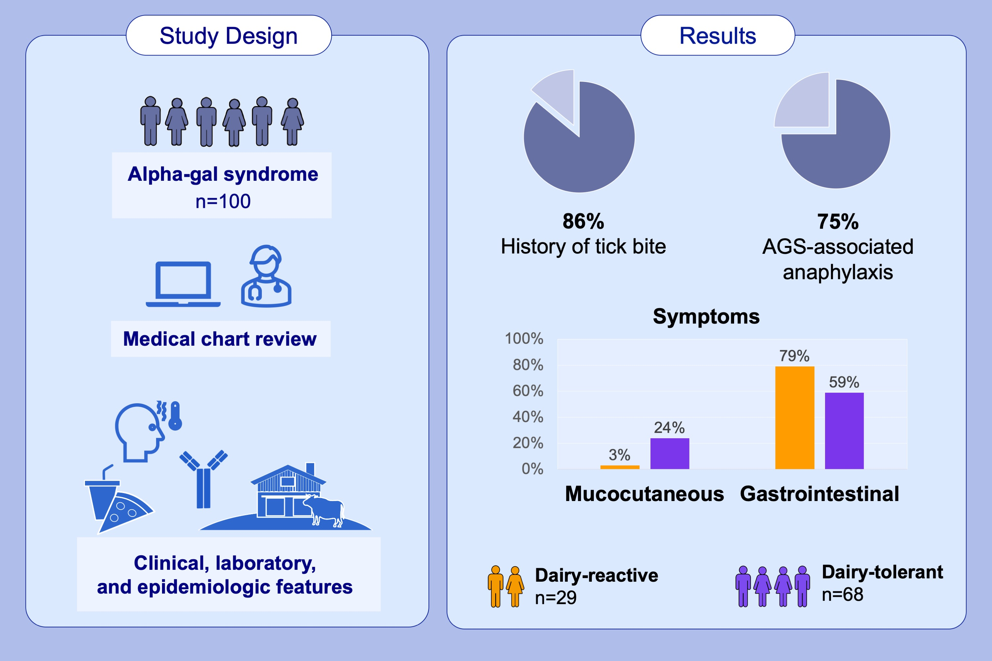
Clinical and Laboratory Features of Patients Diagnosed with Alpha-gal Syndrome — 2010–2019
Alison M. Binder, Dena Cherry-Brown, Brad J. Biggerstaff, Emma S. Jones, Claire L. Amelio, et al.
Allergy. 2023; pages:477-487
https://doi.org/10.1111/all.15539
© 2019 EAACI and John Wiley and Sons A/S. Published by John Wiley and Sons Ltd.
Notes:
HIGHLIGHTS
This report provides a comprehensive description of the epidemiology, clinical presentation, and laboratory testing trends among large cohort of patients diagnosed with alpha-gal syndrome in the United States.
86% reported a history of tick bite, and 75% met criteria for anaphylaxis based on involvement of more than 2 organ systems.
Patients reporting dairy reactions were significantly less likely to report isolated mucocutaneous symptoms (3% vs 24%) than those who tolerated dairy, and were more likely to report gastrointestinal symptoms (79% vs 59.
Abbreviation: AGS, alpha-gal syndrome.

