Slide 1
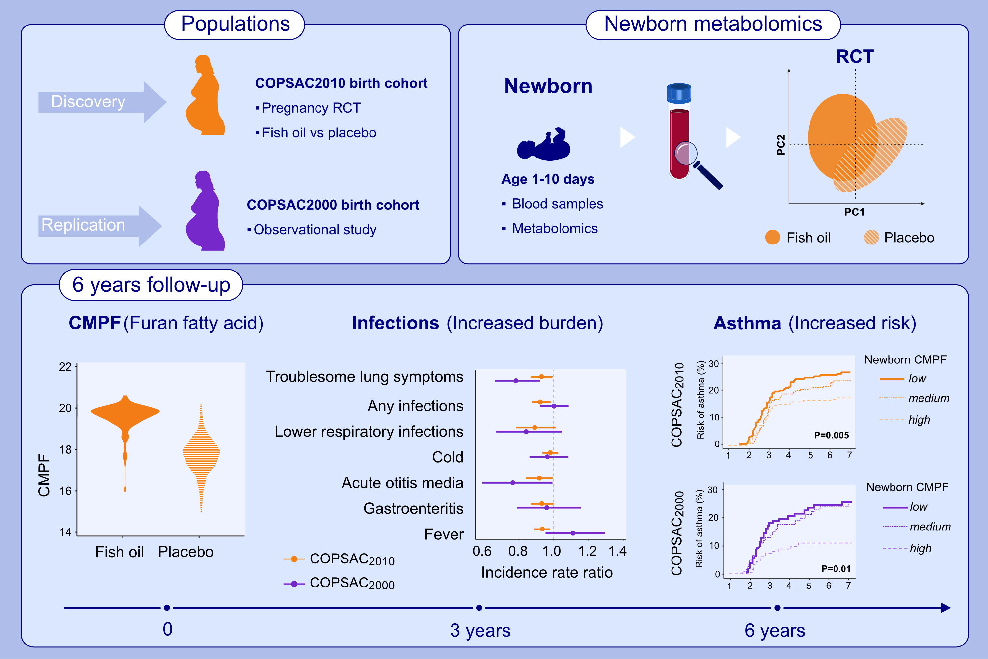
Furan fatty acid metabolites in newborns predict risk of asthma
Gözde Gürdeniz, Min Kim, Nicklas Brustad, Madeleine Ernst, Francesco Russo, , et al.
Allergy. 2023; pages:429-438
https://doi.org/10.1111/all.15554
© 2019 EAACI and John Wiley and Sons A/S. Published by John Wiley and Sons Ltd.
Notes:
HIGHLIGHTS
This study investigates the effect of fish-oil supplementation during pregnancy on newborn dry blood spot metabolomics profiles in the COPSAC birth cohorts.
The furan fatty acid metabolite CMPF was identified as top biomarker of the fish-oil supplementation.
Increasing newborn CMPF level was associated with decreased risk of infections and asthma in both cohorts.
Abbreviations: CMPF, 3-carboxy-4-methyl-5-propyl-2-furan propanoic acid; COPSAC, Copenhagen Prospective Studies of Asthma in Childhood; RTC, randomized controlled trial

