Slide 1
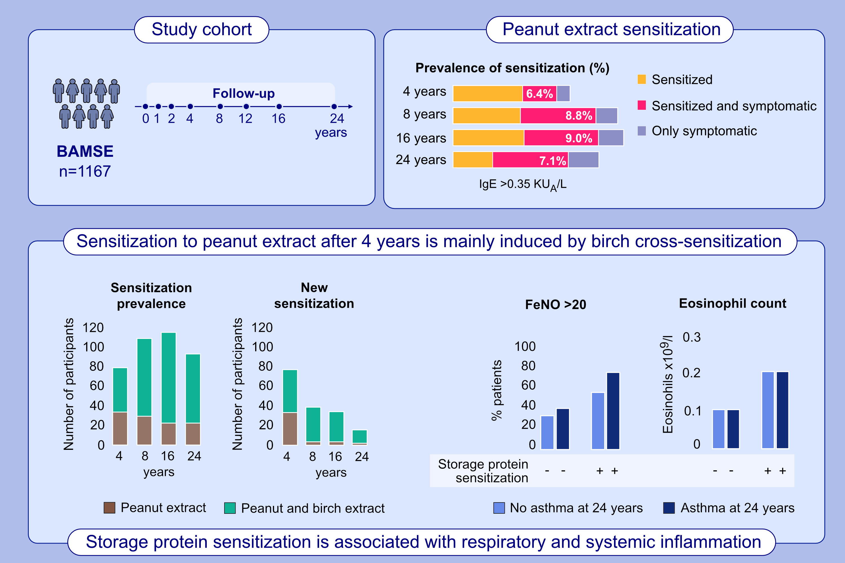
Development of sensitization to peanut and storage proteins and relation
to markers of airway and systemic inflammation – a 24 year follow up
Sandra G. Tedner, Susanna Klevebro, Anna Bergström, Inger Kull, Niklas Andersson, et al.
Allergy. 2023; pages:488-499
https://doi.org/10.1111/all.15568
© 2019 EAACI and John Wiley and Sons A/S. Published by John Wiley and Sons Ltd.
Notes:
HIGHLIGHTS
The prevalence of peanut extract sensitization, defined as IgE≥ 0.35 kUA/L, is 5.4%, 8.0%, 7.5% and 6.2% at 4, 8, 16 and 24 years of age, respectively.
Most individuals with peanut sensitization at 24 years of age are sensitized to peanut extract already at 4 and 8 years.
Individuals with sensitization to storage protein in peanut and/or tree nut at 24 years of age have higher levels of exhaled nitric oxide and blood eosinophils, both in asthmatics and non-asthmatics, compared to individuals with other types of sensitization.
Abbreviations: Ara h 2, Arachis hypogea 2, peanut allergen molecule; BAMSE, Barn/Children, Allergy, Milieu, Stockholm, Epidemiology; FeNo, exhaled nitric oxide; IgE, immunoglobulin E; kU_{A}/L, kilounits of allergen specific sIgE-ab per liter; MMP10, Matrix metalloproteinase-10; NPX, normalized protein expression; TNFRSF11, tumor necrosis factor receptor superfamily 11

