Slide 1
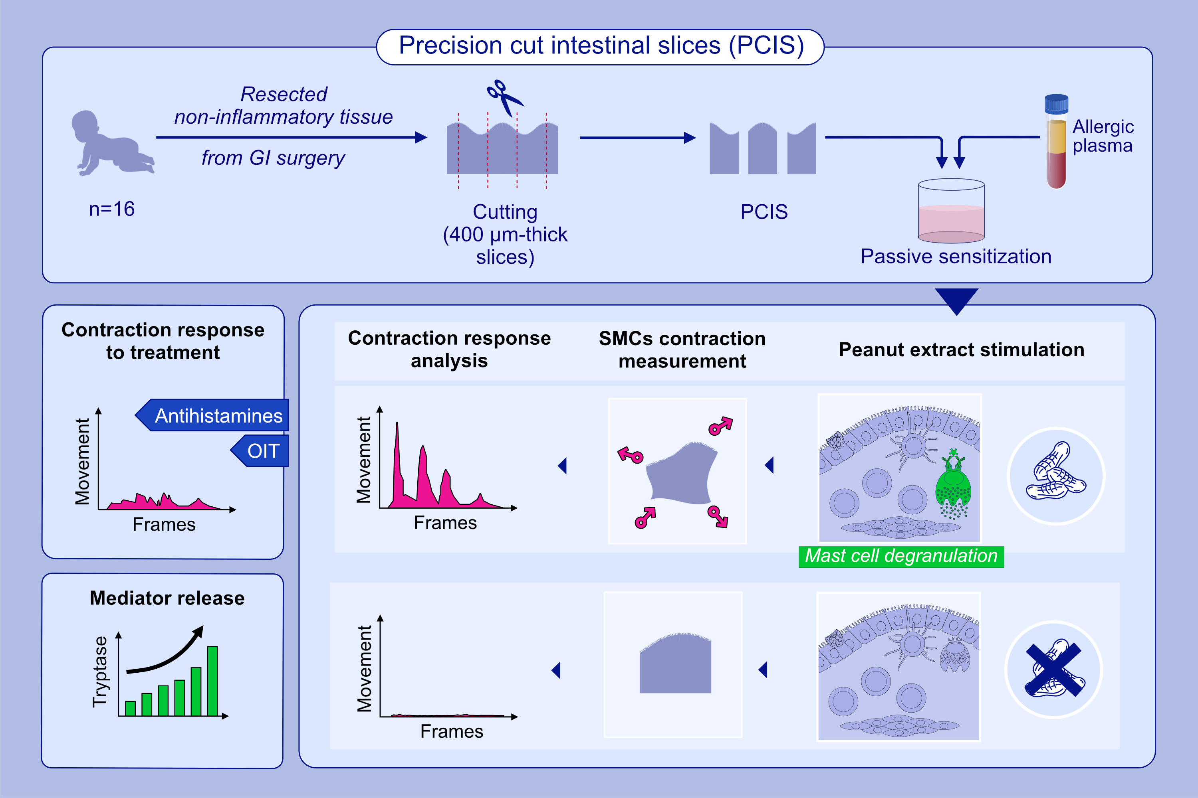
Precision cut intestinal slices, a novel model of acute food allergic reactions
Lisa Hung, Alper Celik, Xiaojun Yin, Kai Yu, Alireza Berenjy, et al.
Allergy. 2022; pages:500-511
https://doi.org/10.1111/all.15579
© 2019 EAACI and John Wiley and Sons A/S. Published by John Wiley and Sons Ltd.
Notes:
HIGHLIGHTS
PCIS generated using healthy, non-inflamed tissue from children that underwent clinically indicated GI surgery, remained viable for at least 24h with cellular diversity maintained.
Passively sensitized PCIS displayed allergen-specific responses including mediator release and smooth muscle contractions quantified using a novel video analysis software.
Contractions were suppressed by antihistamines and post-successful oral immunotherapy plasma.
Abbreviations: GI, gastrointestinal; OIT, oral immunotherapy; PCIS, precision cut intestinal slices; SMCs, smooth muscle cells.

