Slide 1
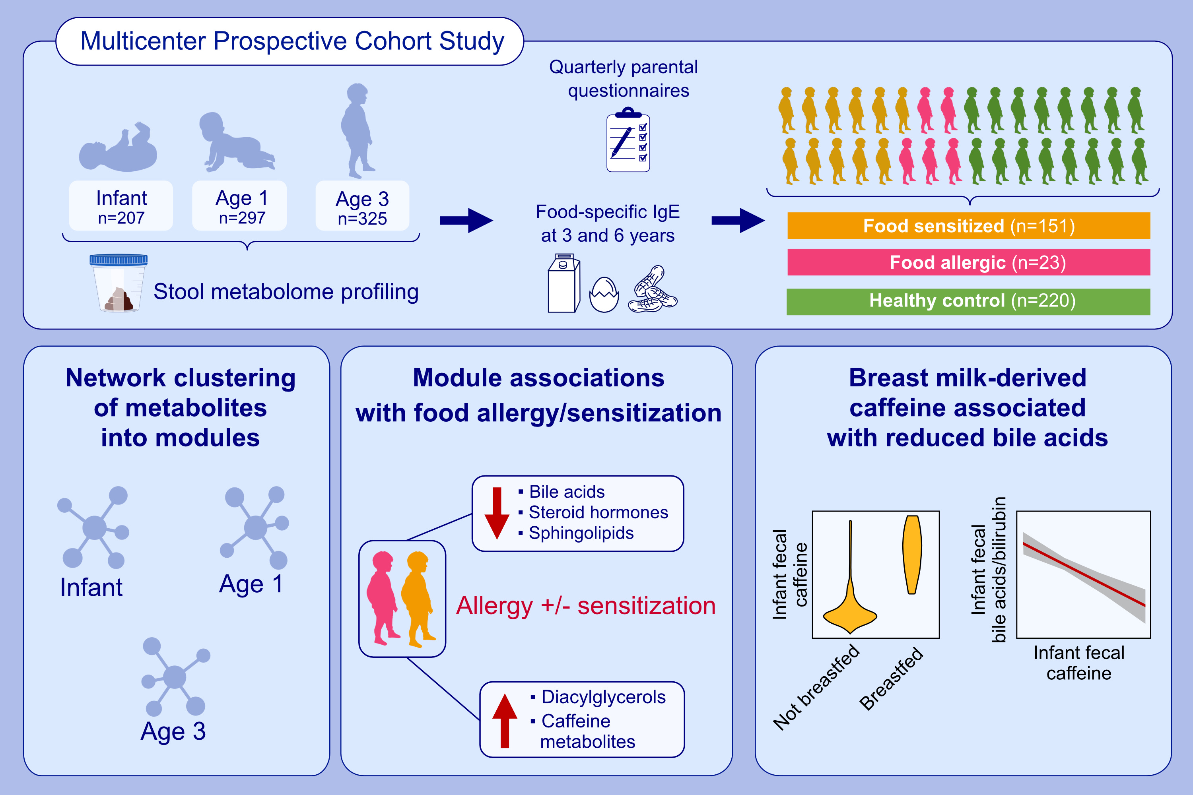
Early-life fecal metabolomics of food allergy
Kathleen A. Lee-Sarwar, Yih-Chieh Chen, Jessica Lasky-Su, Rachel S. Kelly, Robert S. Zeiger, et al.
Allergy. 2022; pages:512-521
https://doi.org/10.1111/all.15602
© 2019 EAACI and John Wiley and Sons A/S. Published by John Wiley and Sons Ltd.
Notes:
HIGHLIGHTS
This analysis identifies associations between the fecal metabolome at ages 3-6 months, 1 and 3 years with food allergy and/or sensitization.
Fecal metabolites including bile acids, sphingolipids and caffeine metabolites are associated with food allergy/sensitization.
Results suggest that breast-milk derived intestinal caffeine may impact other fecal metabolites and thereby be associated with risk of food allergy/sensitization.

