Slide 1
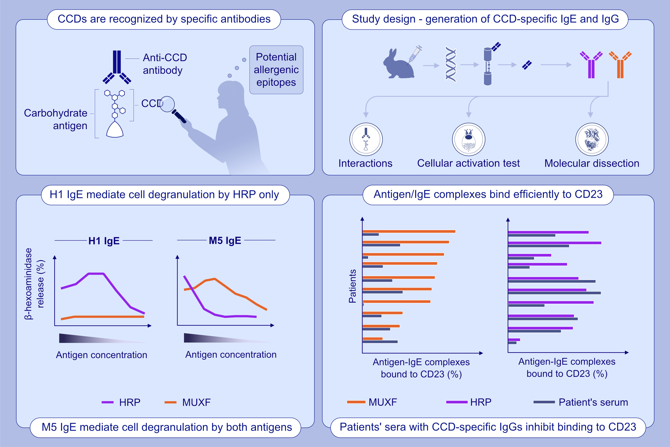
Structural and functional analyses of antibodies specific for modified core N-glycans suggest a role in TH2 responses
Melanie Plum, Luna Tjerrild, Tim Raiber, Frank Bantleon, Sara Bantleon, et al.
Allergy. 2023; pages: 121-130
https://doi.org/10.1111/all.15417
© 2019 EAACI and John Wiley and Sons A/S. Published by John Wiley and Sons Ltd.
Notes:
HIGHLIGHTS
Monoclonal antibody fragments with specificity for CCD structure were generated.
Derived CCD-specific IgE detect CCD-carrying allergens and are capable of mediating effector cell activation and facilitated allergen binding.
A Fab in complex with an epitope surrogate provides direct insights into the binding mode of CCDs.
Abbreviations: CCD, cross-reactive carbohydrate determinant; Fab, fragment antigen binding; HRP, horseradish peroxidase; MUXF, the N-glycan from bromelain

