Slide 1
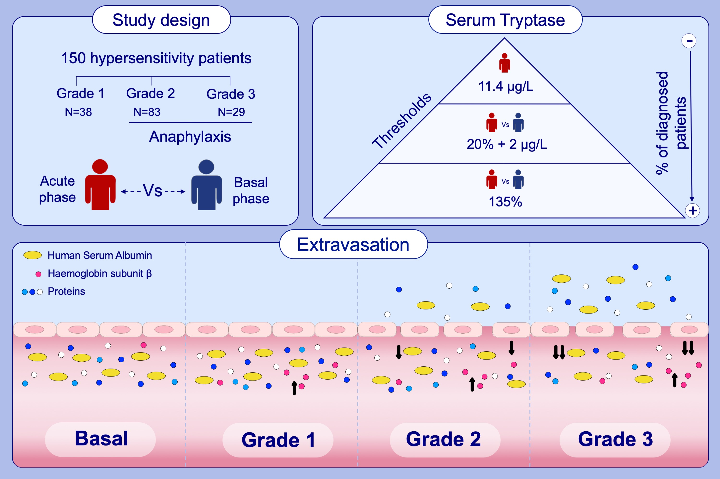
Personalized diagnostic approach and indirect quantification of extravasation in human anaphylaxis
Emilio Nuñez-Borque, Diana Betancor, Carlos Pastor-Vargas, Sergio Fernández-Bravo, Ariadna Martin-Blazquez et al.
Allergy. 2023; pages: 202-213
https://doi.org/10.1111/all.15443
© 2019 EAACI and John Wiley and Sons A/S. Published by John Wiley and Sons Ltd.
Notes:
HIGHLIGHTS
This study aimed to assess the extravasation underlying anaphylaxis reactions and propose new theragnostic approaches.
Acute and baseline serum samples were obtained from 150 patients with hypersensitivity reactions.
The diagnostic capacity of tryptase improved with thresholds considering the patient's baseline status. Protein and HSA levels decreased in anaphylaxis reactions according to their severity. HBB levels increased in all hypersensitivity reactions.
Abbreviations: HBB, haemoglobin subunit β; HSA, human serum albumin

