Slide 1
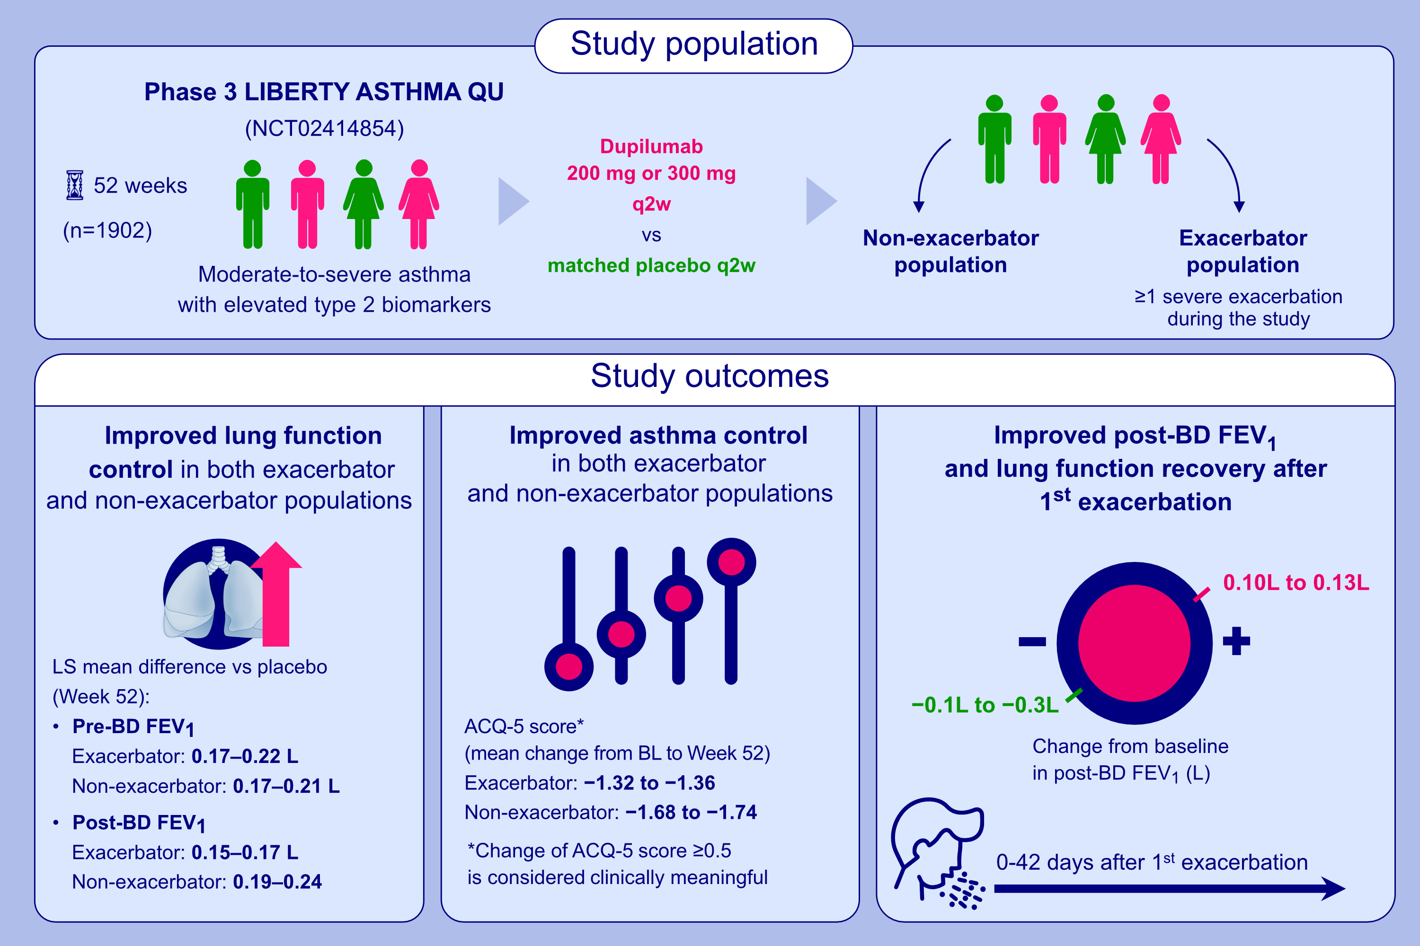
Dupilumab reduced the impact of severe exacerbations on lung function
in patients with moderate-to-severe type 2 asthma
Alberto Papi, Jonathan Corren, Mario Castro, Christian Domingo, Linda Rogers, et al.
Allergy. 2023; pages: 233-243
https://doi.org/10.1111/all.15456
© 2019 EAACI and John Wiley and Sons A/S. Published by John Wiley and Sons Ltd.
Notes:
HIGHLIGHTS
This analysis assessed the effect of dupilumab on FEV₁ in QUEST patients with moderate-to-severe asthma and elevated type 2 biomarkers.
Dupilumab significantly increased FEV₁, regardless of number of severe exacerbations; FEV₁ recovery was more rapid in dupilumab- vs placebo-treated patients.
Dupilumab produced rapid and sustained improvement in lung function, including in patients experiencing severe exacerbations.
Abbreviations: ACQ-5, 5-item Asthma Control Questionnaire; BD, bronchodilator; BL, baseline; FeNO, fractional exhaled nitric oxide; FEV₁, forced expiratory volume in 1 second; LS, least squares; q2w, every 2 weeks

