Slide 1
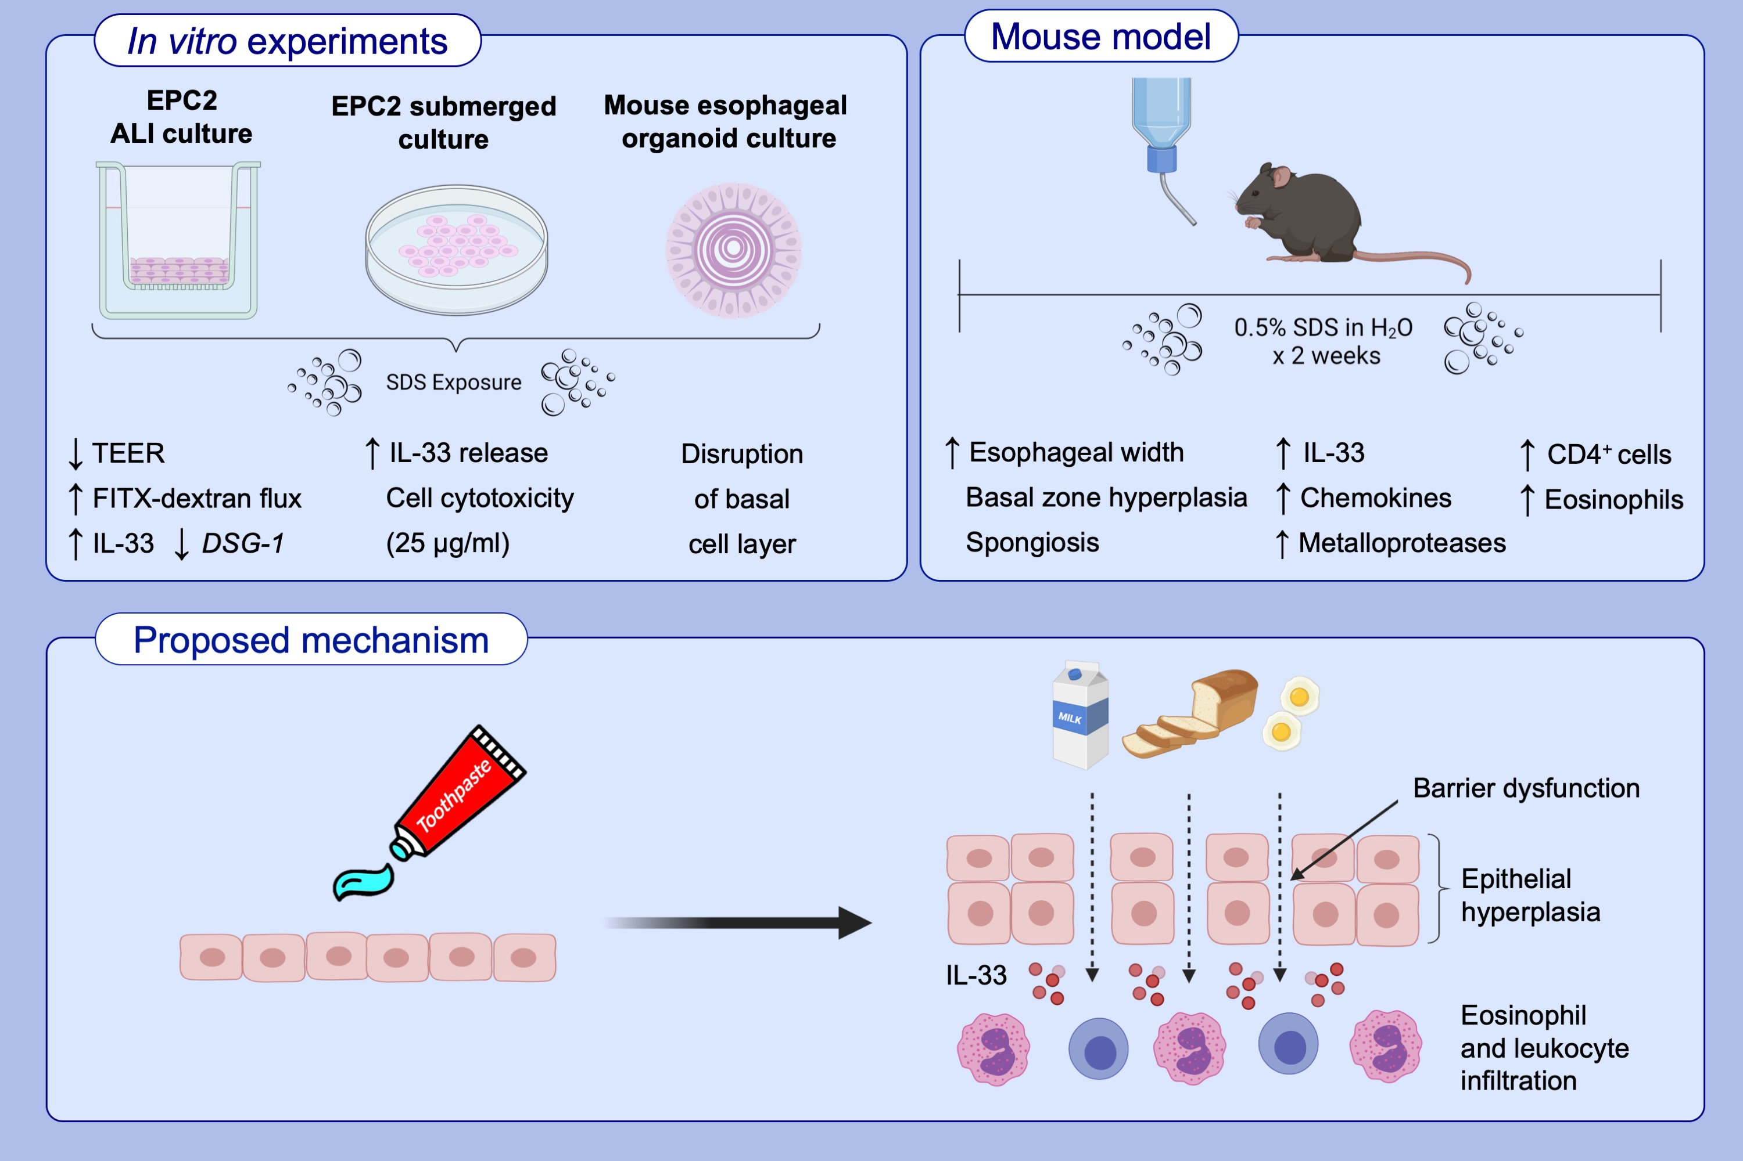
Detergent exposure induces epithelial barrier dysfunction and eosinophilic inflammation in the esophagus
Alfred D. Doyle, Mia Y. Masuda, Grace C. Pyon, Huijun Luo, Arina Putikova, et al.
Allergy. 2023; pages:192-201
https://doi.org/10.1111/all.15457
© 2019 EAACI and John Wiley and Sons A/S. Published by John Wiley and Sons Ltd.
Notes:
HIGHLIGHTS
Household products (e.g., toothpaste) contain detergents [e.g., sodium lauryl sulfate, also known as sodium dodecyl sulfate (SDS)].
SDS induces IL-33 production and alters esophageal epithelial integrity, associated with remodeling and eosinophilic inflammation.
Detergents may serve as key environmental exposures contributing to increases in eosinophilic esophagitis.
Abbreviations: ALI, air-liquid interface; DSG-1, desmoglein 1; EPC2, esophageal epithelial cells; FITC, fluorescein isothiocyanate; SDS, sodium dodecyl sulfate; TEER, transepithelial electrical resistance

