Slide 1
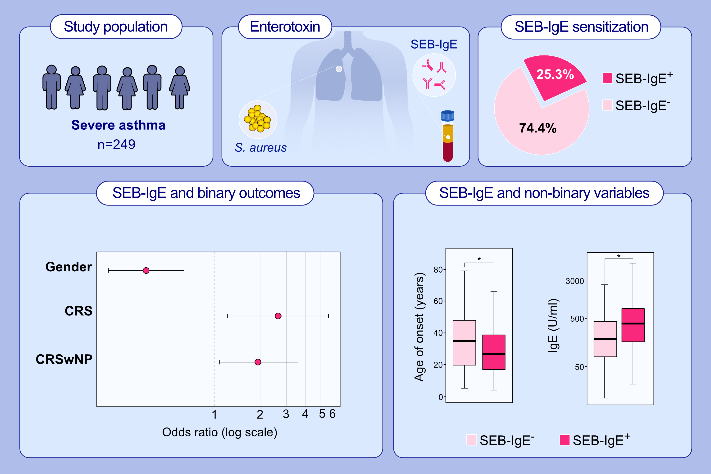
Different aspects of severe asthma in real life: role of Staphylococcus aureus enterotoxins and correlation to comorbidities and disease severity
Cristiano Caruso, Stefania Colantuono, Gabriele Ciasca, Umberto Basile, Riccardo Di Santo, et al.
Allergy. 2023; pages: 131-140
https://doi.org/10.1111/all.15466
© 2019 EAACI and John Wiley and Sons A/S. Published by John Wiley and Sons Ltd.
Notes:
HIGHLIGHTS
This retrospective study evaluates the prevalence of SE-IgE sensitization in a multicentric Italian cohort of severe asthmatic patients.
Out of 249 patients, 25.3% were SEB-IgE positive.
There was a significant association [OR=0.35 95%CI 0.20-0.62] between gender (female versus male) and SEB-IgE; a positive association was also measured between SEB-IgE sensitization and CRS [OR=2.65 95%CI 1.22-5.71] and between SEB-IgE sensitization and CRSwNP [OR=1.98 95%CI 1.08-3.52].
Abbreviations: CI, confidence interval; CRS, chronic rhinosinusitis; CRSwNP, chronic rhinosinusitis with nasal polyps; IgE, immunoglobulin E; OR, odds ratio; SEB, staphylococcal enterotoxin B

