Slide 1
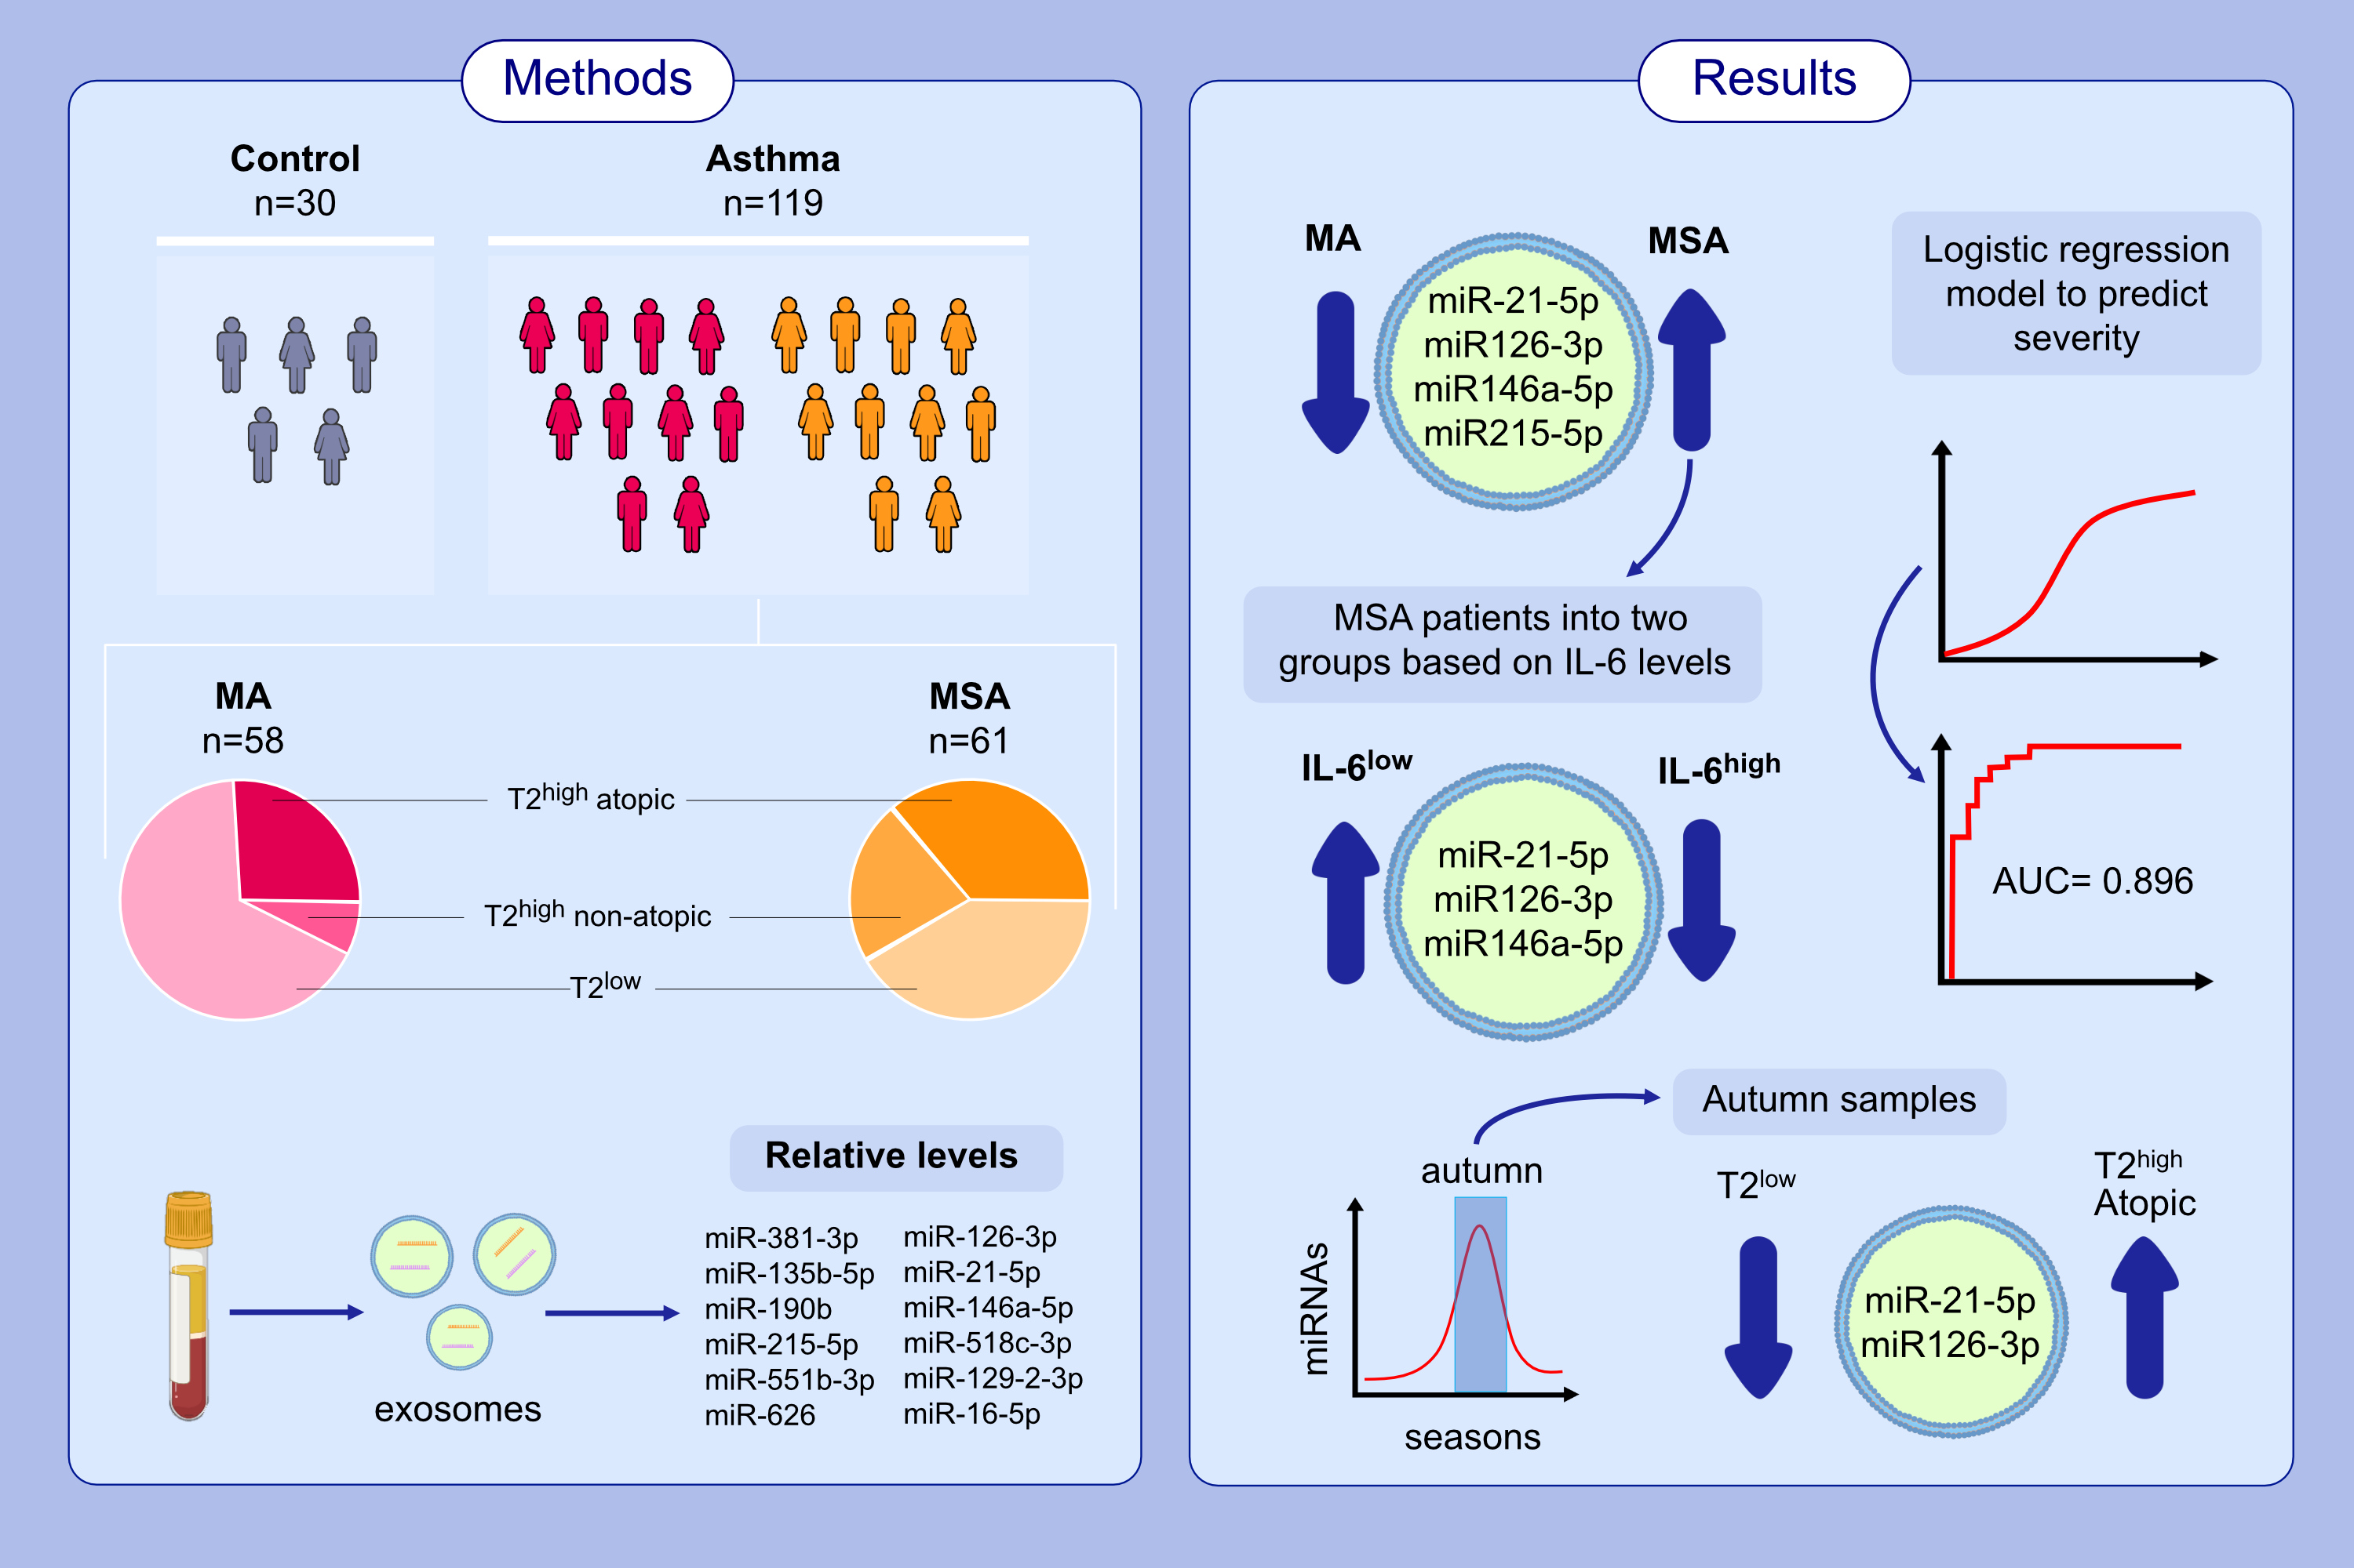
Serum exosome inflamma-miRs are surrogate biomarkers for asthma phenotype
and severity
Sara Vázquez-Mera, Laura Martelo-Vidal, Pablo Miguéns-Suárez, Paula Saavedra-Nieves, Pilar Arias, et al.
Allergy. 2023; pages:141-155
https://doi.org/10.1111/all.15480
© 2019 EAACI and John Wiley and Sons A/S. Published by John Wiley and Sons Ltd.
Notes:
HIGHLIGHTS
We measured the levels of several inflamma-miRs in serum exosomes from 30 healthy and 119 asthmatic donors with different phenotypes and severities.
miR-21-5p, miR-126-3p, miR146a-5p, and miR-215-5p increased in MSA vs. MA and a logistic regression model was fitted (AUC=0.896).
miR-21-5p and miR-126-3p increased in T2high-Atopic asthma, whereas miR-21-5p, miR-126-3p, and miR-146a-5p levels were downregulated in IL-6high MSA patients.
Abbreviations: AUC, area under the curve; MA, mild asthma; miRNA, microRNA; MSA, moderate-severe asthma

