Slide 1
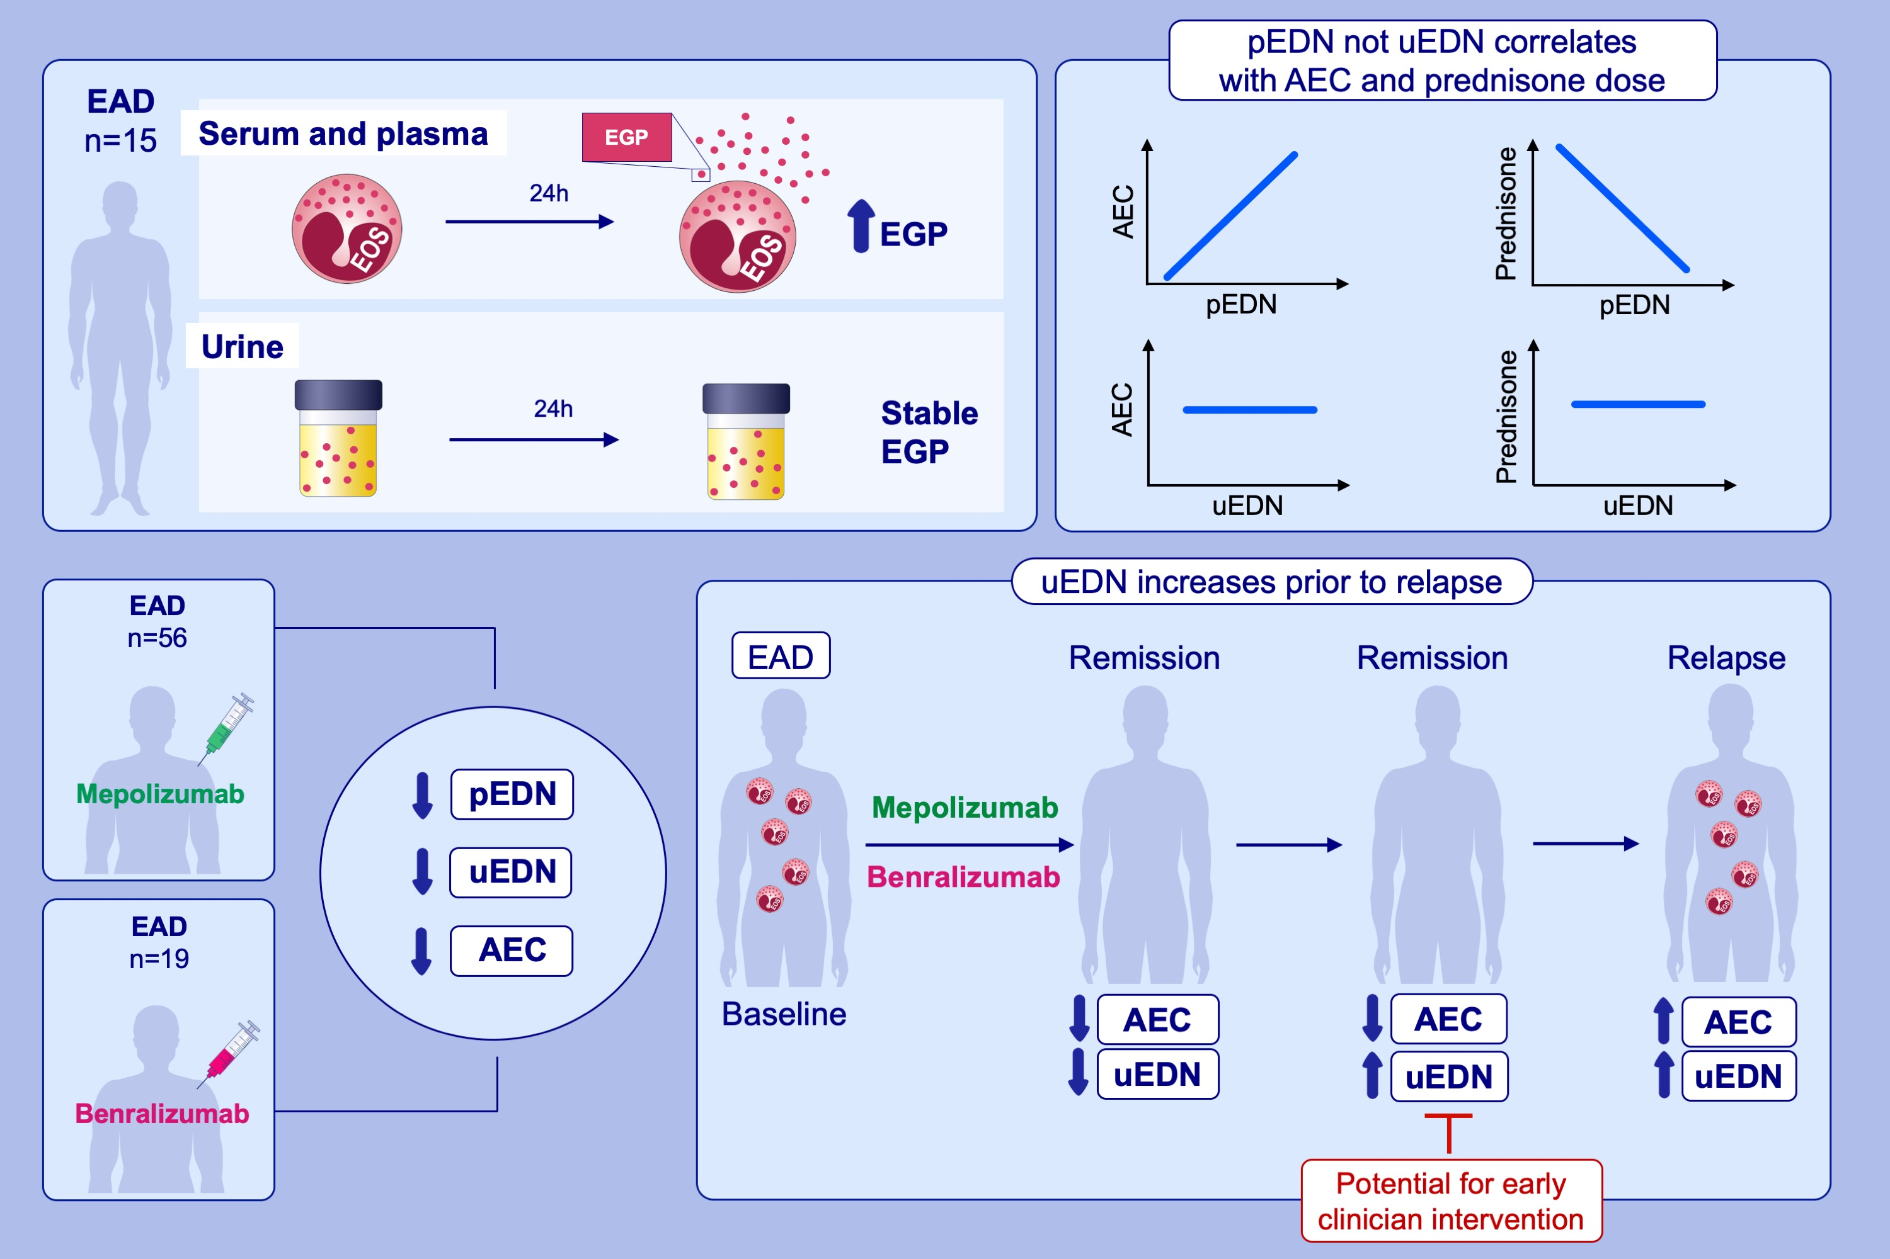
Urine eosinophil-derived neurotoxin: a potential marker of activity in select eosinophilic disorders
Michelle A. Makiya, Paneez Khoury, Fei Li Kuang, Alexis Dominique Mata, Sana Mahmood,, et al.
Allergy. 2023; pages:258-269
https://doi.org/10.1111/all.15481
© 2019 EAACI and John Wiley and Sons A/S. Published by John Wiley and Sons Ltd.
Notes:
HIGHLIGHTS
This study compares the reliability and utility of plasma and urine EGP measurements for the assessment of disease activity across a diverse group of EAD and evaluates the usefulness of EGP measurements for the assessment of disease activity in patients with EAD treated with targeted therapeutics.
Urine EDN is a stable measure of eosinophilic disease activity that does not correlate with aboslule eosinophil count or prednisone dose.
uEDN decreases in response to treatment with mepolizumab and benralizumab but increases prior to AEC and the onset of clinical symptoms in most EAD patients who relapse.
Abbreviations: AEC, absolute eosinophil count; EAD, eosinophil-associated diseases; EDN, eosinophil-derived neurotoxin; EGP, eosinophil granule proteins; pEDN, plasma EDN; uEDN, urine EDN

