Slide 1
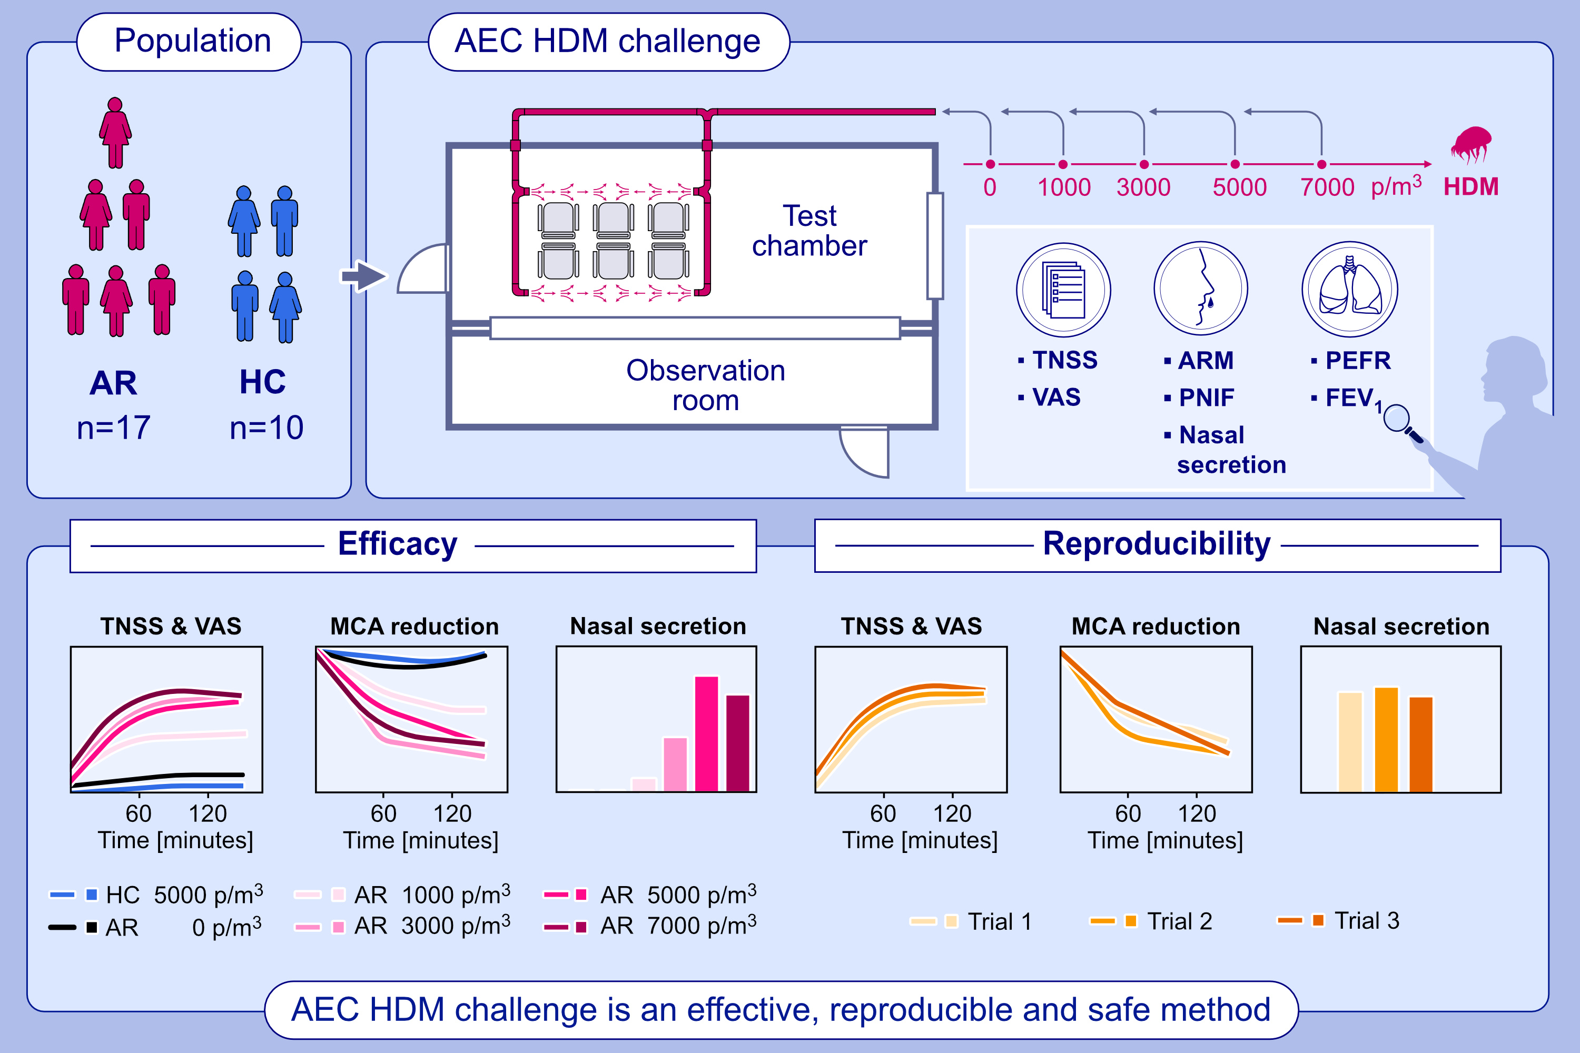
Validated allergen exposure chamber is plausible tool for assessment of house dust mite-triggered allergic rhinitis
Magdalena Zemelka-Wiacek, Anna Kosowska, Ewa Winiarska, Ewa Sobanska, Marek Jutel
Allergy. 2023; pages: 168-177
https://doi.org/10.1111/all.15485
© 2019 EAACI and John Wiley and Sons A/S. Published by John Wiley and Sons Ltd.
Notes:
HIGHLIGHTS
AR patients triggered by HDM were challenged in an AEC.
The symptom severity (TNSS, VAS) and objective parameters (acoustic rhinometry and PNIF) were reproducible and correlated with HDM particle concentration.
AEC challenge is a useful tool for evaluation of HDM allergic rhinitis and possible patient stratification for clinical research.
Abbreviations: AEC, allergen exposure chamber; AR, allergic rhinitis; ARM, acoustic rhinometry; FEV₁, forced expiratory volume in the first second; HC, healthy control; HDM, house dust mite; p/ m³, particles/cubic meter; MCA, minimal cross-sectional area; PEFR, peak expiratory flow rate; PNIF, peak nasal inspiratory flow; TNSS, total nasal symptom score; VAS, visual analogue scale

