Slide 1
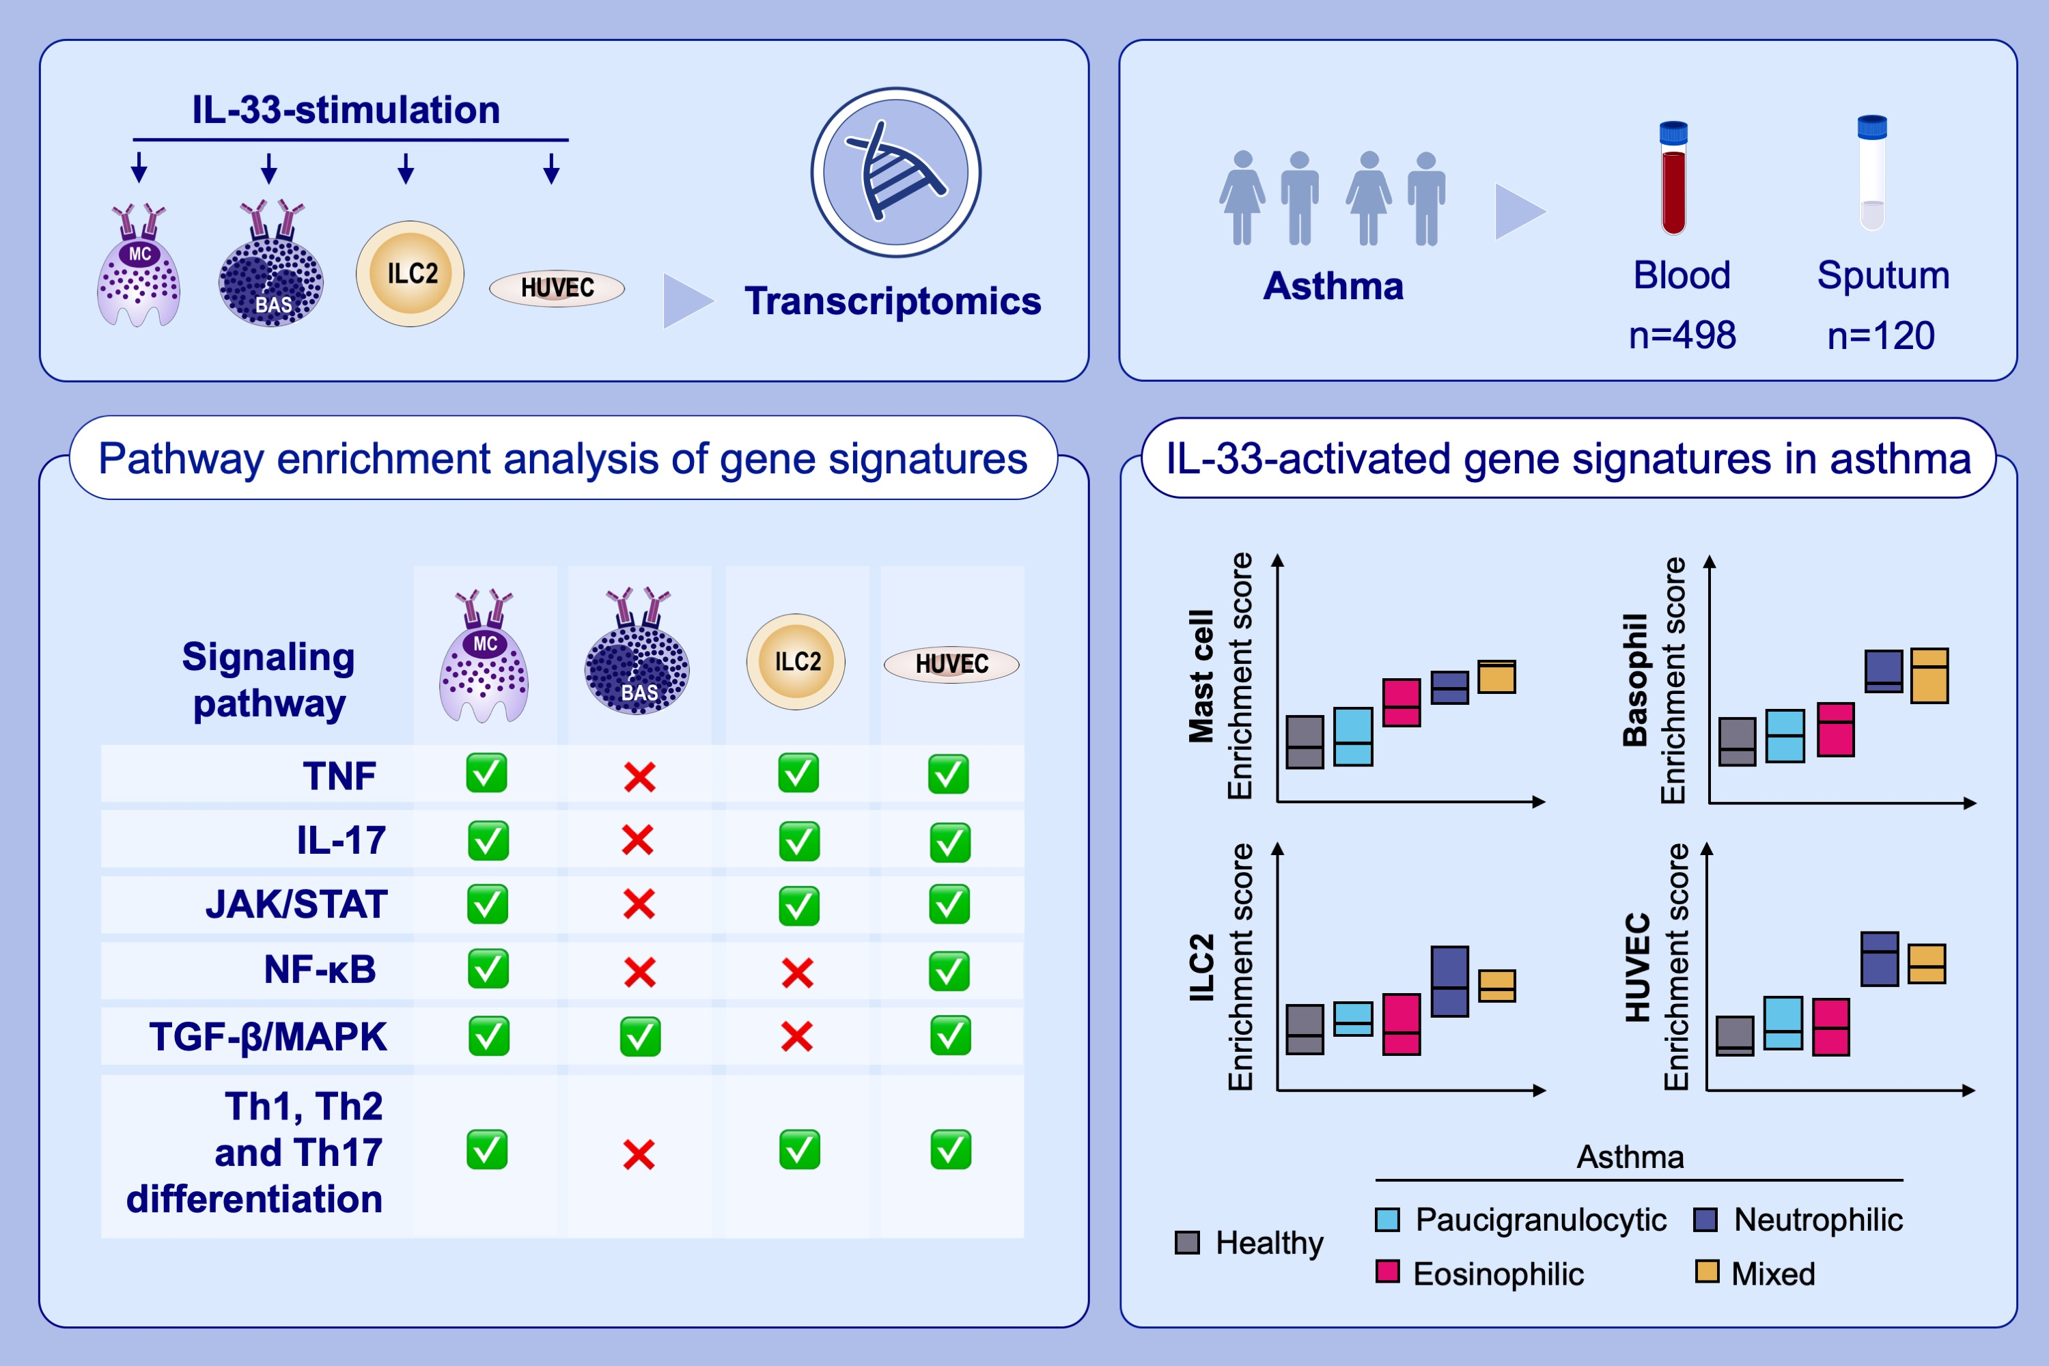
IL1RAP expression and the enrichment of IL-33 activation signatures in severe neutrophilic asthma
Yusef Eamon Badi, Barbora Salcman, Adam Taylor, Batika Rana, Nazanin Zounemat Kermani, et al.
Allergy. 2023; pages: 156-167
https://doi.org/10.1111/all.15487
© 2019 EAACI and John Wiley and Sons A/S. Published by John Wiley and Sons Ltd.
Notes:
HIGHLIGHTS
This study elucidates the type of asthma driven by IL-33 and its interaction with its heteromeric receptor by generating IL-33-activated gene signatures in mast cells, basophils, ILCs and HUVECs.
Pathway analysis of each cell-specific IL-33-activated up-regulated gene signature reveals extensive enrichment of various signaling pathways, including TNF, IL-17, JAK/STAT as well as Th1, Th2 and Th17 differentiation pathways in mast cells, ILC2 and HUVEC signatures.
Enrichment scores for IL-33-activated gene signatures are significantly enriched in asthmatic sputum, particularly in patients with neutrophilic and mixed granulocytic asthma, and correspond with IL1RAP co-receptor expression.
Abbreviations: BAS, basophil; HUVECs, human umbilical vein endothelial cells; IL, interleukin; ILC2, type 2 innate lymphoid cell; IL1RAP, IL-1 receptor accessory protein;
JAK, Janus kinase; MC, mast cell; STAT, signal transducer and activator of transcription; Th, T helper; TNF, tumor necrosis factor

