Slide 1
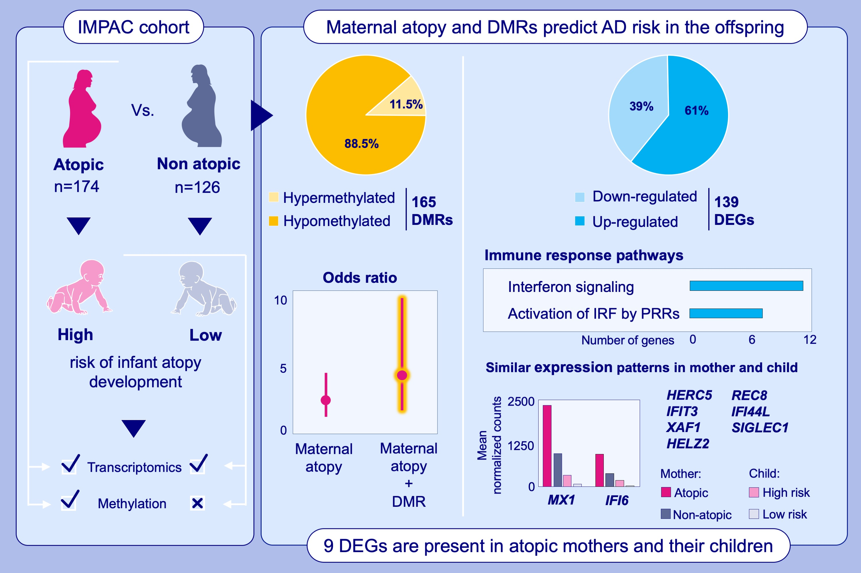
Molecular networks in atopic mothers impact the risk of infant atopy
Michaela Schedel, Sonia M. Leach, Matthew J. Strand, Thomas Danhorn, Morgan MacBeth, et al.
Allergy. 2023; pages: 244-257
https://doi.org/10.1111/all.15490
© 2019 EAACI and John Wiley and Sons A/S. Published by John Wiley and Sons Ltd.
Notes:
HIGHLIGHTS
This study assessed the influence of molecular risk factors in atopic mothers on their infants’ susceptibility to an atopic disease.
DMRs distinguished atopic from non-atopic mothers. Inclusion of maternal DMRs further increased the risk in the offspring to develop AD conferred by maternal atopy alone.
Transcriptomic analyses identified DEGs in atopic compared to non-atopic mothers with shared DEGs in high-risk relative to low-risk children.
Abbreviations: DEG, differentially expressed gene; DMR, differentially methylated region; HELZ2, helicase with zinc finger 2; HERC5, HECT and RLD domain containing E3 ubiquitin protein ligase 5; IFI6, interferon α inducible protein 6; IFI44L, interferon induced protein 44 like; IFIT3, interferon-induced protein with tetratricopeptide repeats 3; IMPAC, Impact of Parental risk factors on Atopy in Children; MX1, MX dynamin like GTPase 1; REC8, REC8 meiotic recombination protein; SIGLEC1, sialic acid binding Ig like lectin 1; XAF1, XIAP associated factor 1

