Slide 1
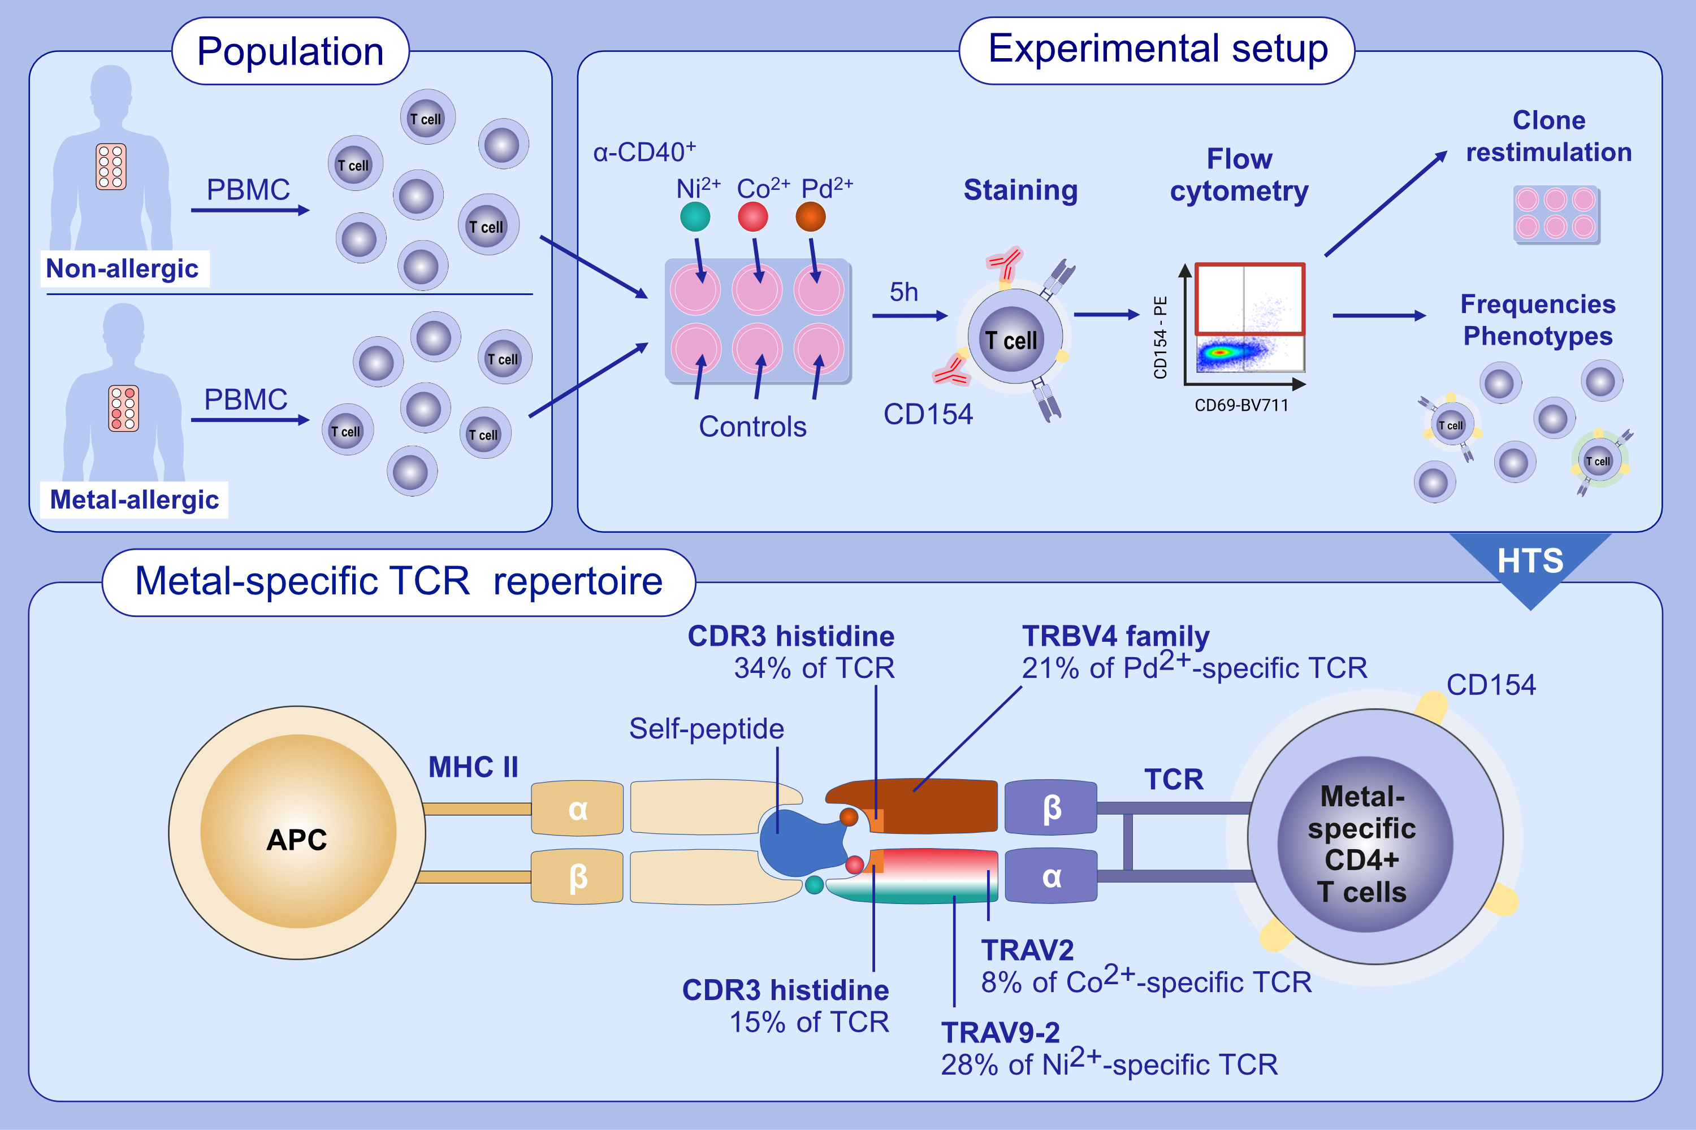
Unique and common TCR repertoire features of Ni²⁺-, Co²⁺- and Pd²⁺-specific human CD154+CD4+ T cells
Franziska Riedel, Marina Aparicio-Soto, Caterina Curato, Lucas Münch, Amro Abbas, et al.
Allergy. 2023; pages:270-282
https://doi.org/10.1111/all.15494
© 2019 EAACI and John Wiley and Sons A/S. Published by John Wiley and Sons Ltd.
Notes:
HIGHLIGHTS
Ni²⁺-, Co²⁺- and Pd²⁺-specific CD4+ T cells can be detected by a short-term CD154 upregulation assay.
Overrepresentation of certain individual gene segments or a CDR3 histidine represent distinct TCR repertoire characteristics that underlie metal ion binding and cross-reactivity.
Frequent metal-specific T cell activation in allergic and non-allergic individuals challenges blood-based allergy detection in vitro.
Abbreviation: APC, antigen-presenting cells; CDR3, complementarity determining region 3; Co, cobalt; HTS, high-throughput sequencing; MHC, major histocompatibility complex; Ni, nickel; PBMC, peripheral blood mononuclear cells; Pd, palladium; TCR, T cell receptor; TRAV, TCR α-chain V-segment; TRBV, TCR β-chain V-segment.

