Slide 1
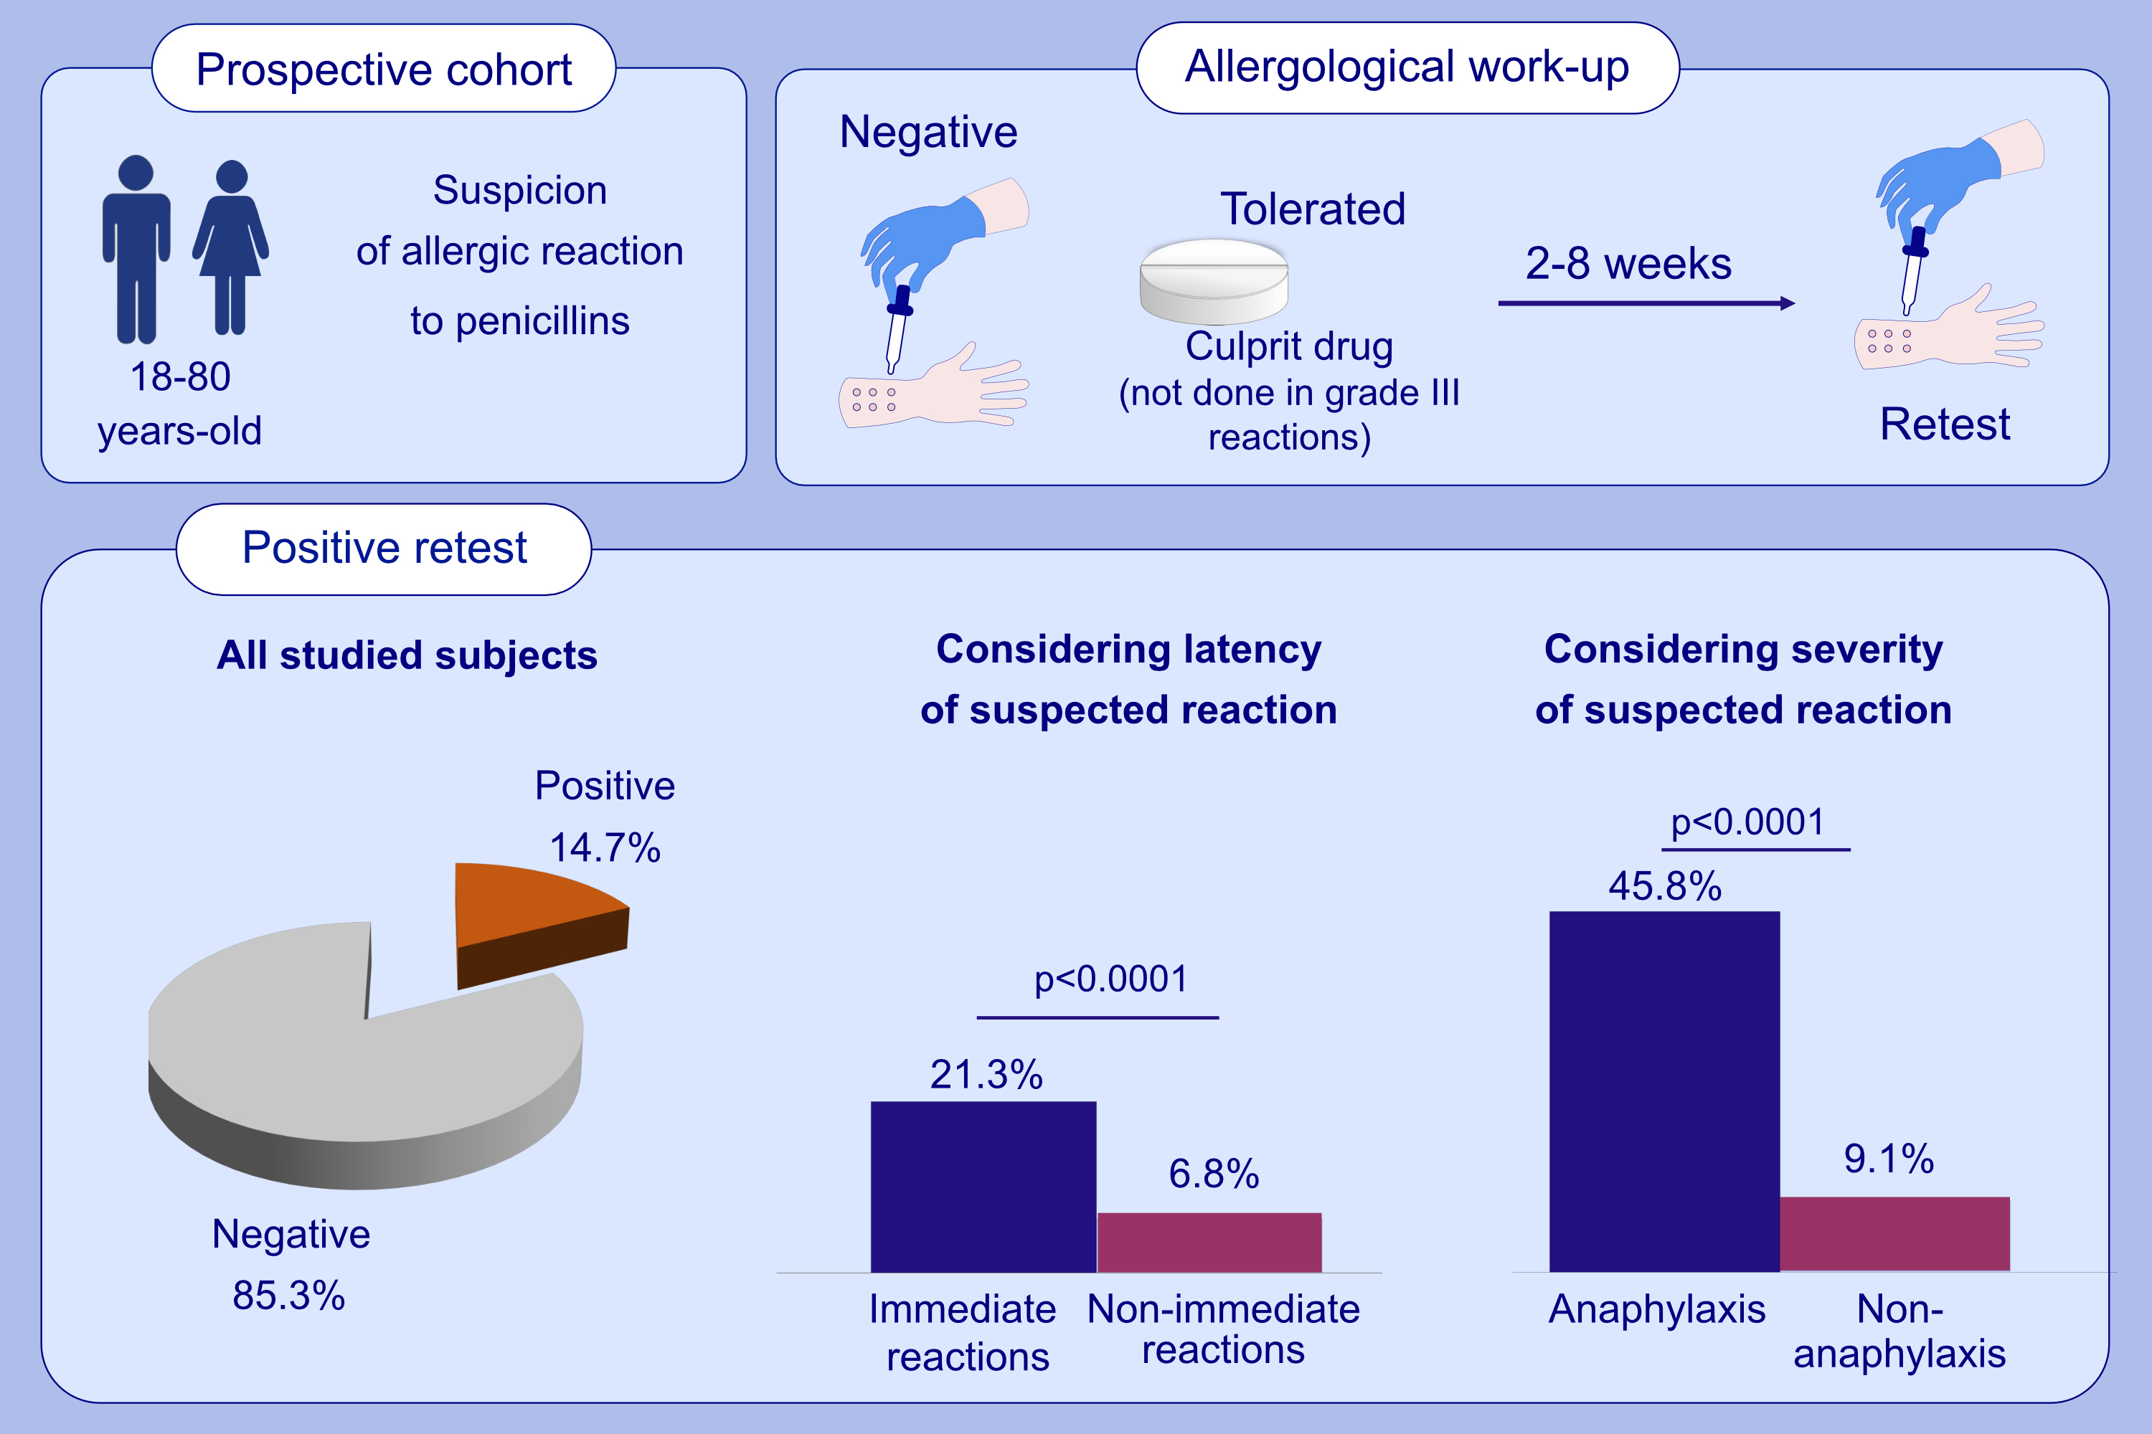
Resensitisation in suspected penicillin allergy
Inmaculada Doña, Lucia Guidolin, Gádor Bogas, Elisa Olivieri, Marina Labella, et al.
Allergy. 2023; pages:214-224
https://doi.org/10.1111/all.15508
© 2019 EAACI and John Wiley and Sons A/S. Published by John Wiley and Sons Ltd.
Notes:
HIGHLIGHTS
We demonstrate that 14.7% of patients with a suspicion of allergic reactions to penicillins and negative allergological study has positive retest.
The rate of resensitisation has shown to be higher in immediate and severe reactions.
Retest should be included in the diagnostic algorithm of allergic reactions to penicillins after an initial negative study before considering the patient as non-allergic.

