Slide 1
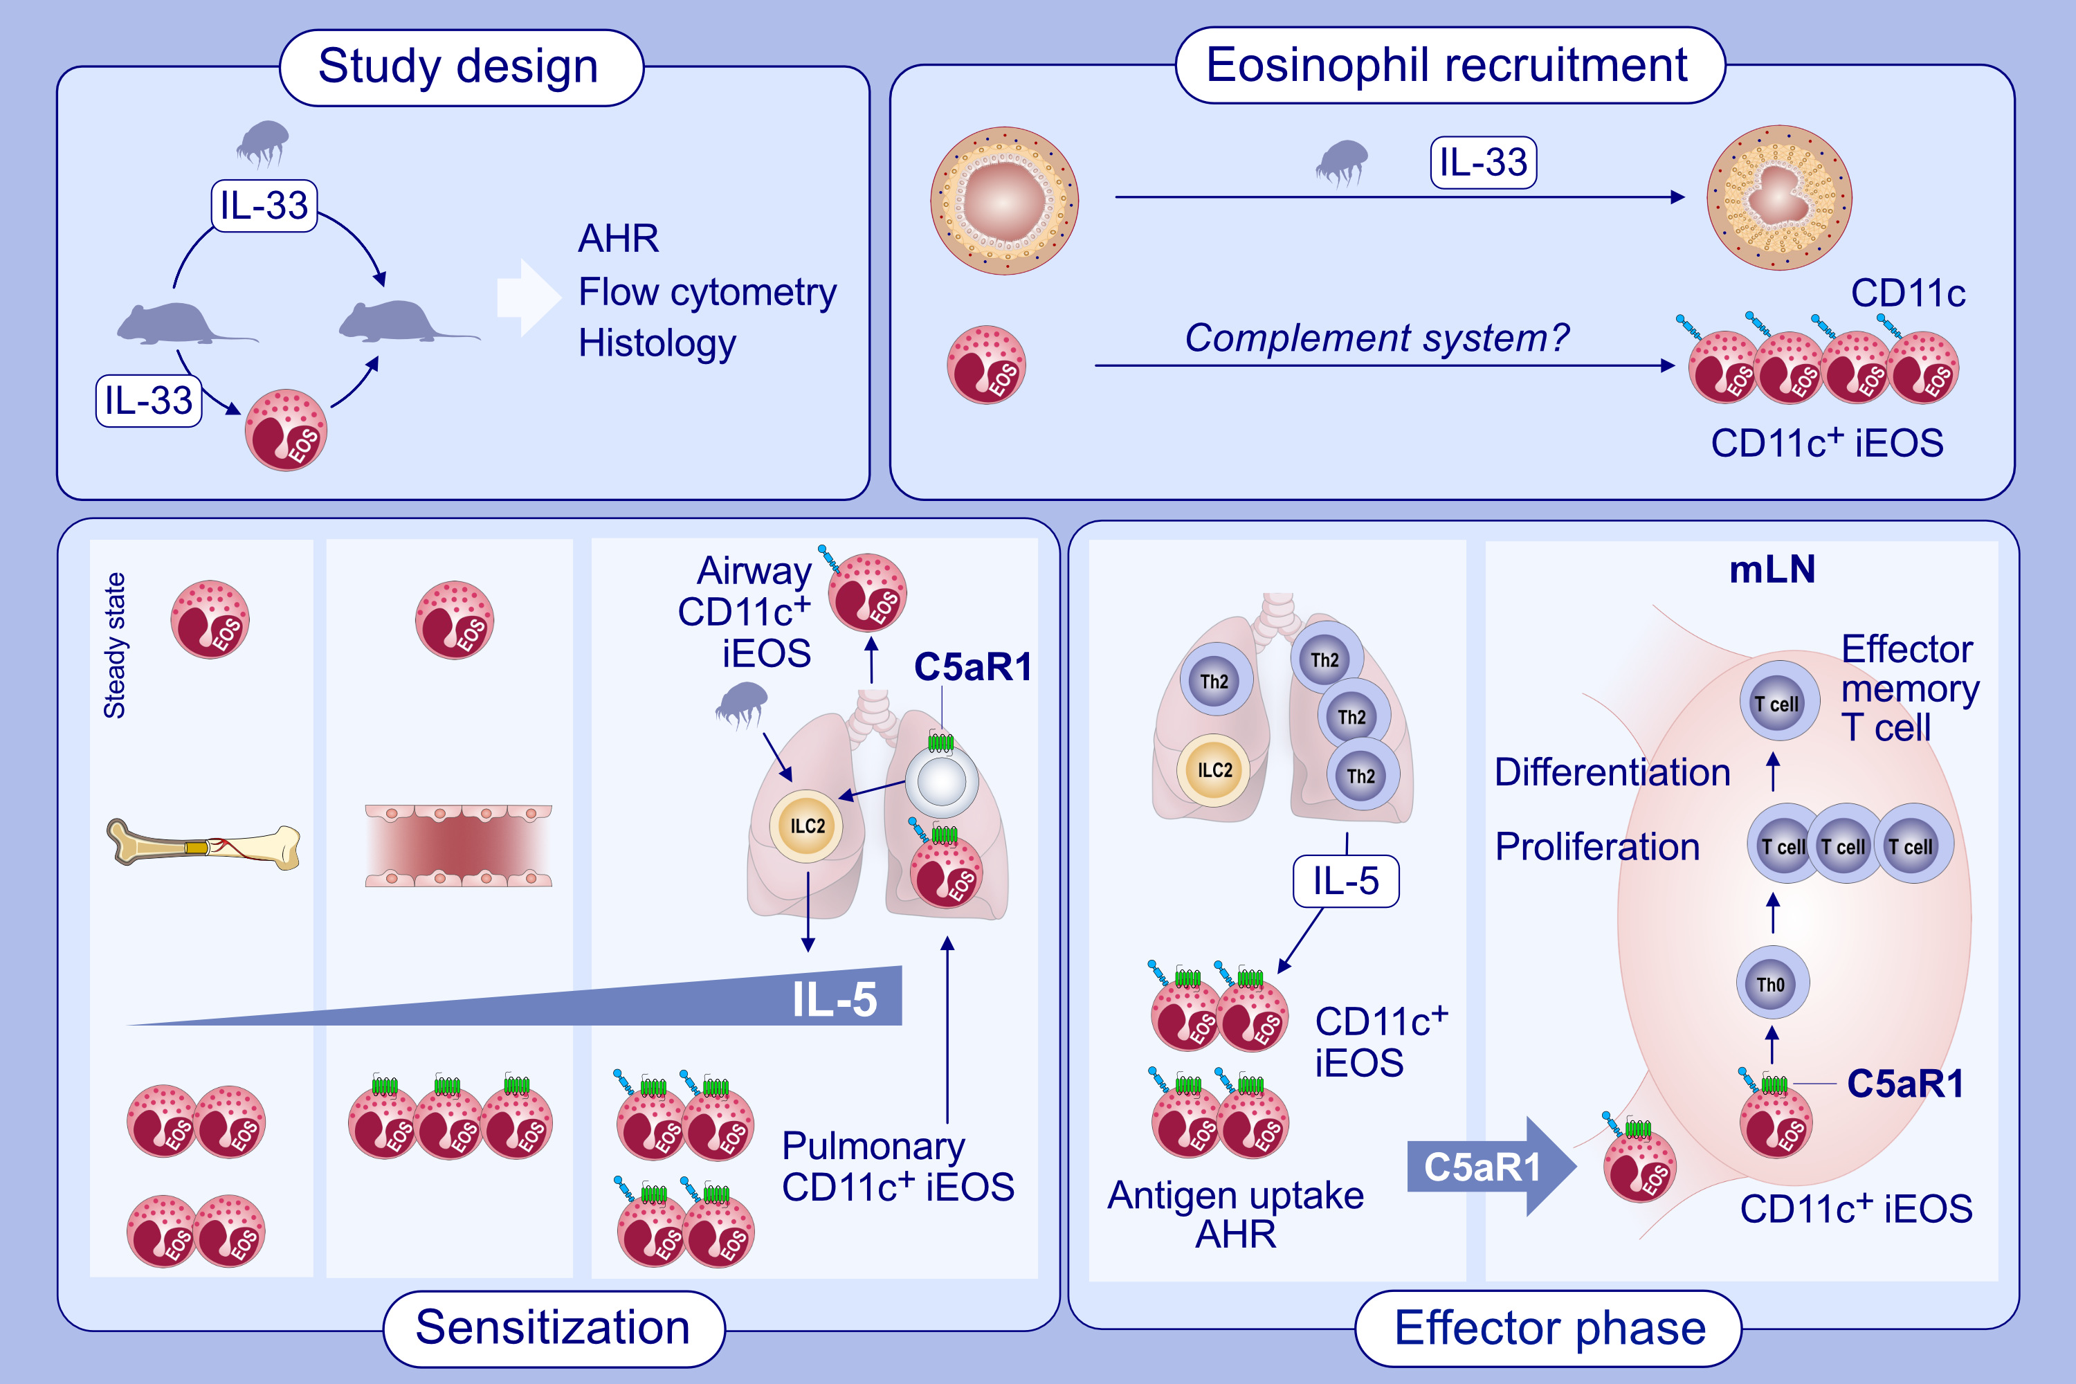
C5aR1 activation in mice controls inflammatory eosinophil recruitment and functions in allergic asthma
Anna V. Wiese, Jannis Duhn, Rabia Ülkü Korkmaz, Katharina M. Quell, Ibrahim Osman, et al.
Allergy. 2023; pages:1020-1035
https://doi.org/10.1111/all.15670
© 2019 EAACI and John Wiley and Sons A/S. Published by John Wiley and Sons Ltd.
Notes:
HIGHLIGHTS
Pulmonary allergen or IL-33 exposure drives CD11c⁺ iEOS recruitment.
C5aR1 promotes pulmonary iEOS recruitment through IL-5 production from ILC2 after initial allergen/IL-33 encounter. Activation of C5aR1 in pulmonary iEOS promotes AHR and degranulation, and is critical for their migration into draining mLN.
C5aR1 controls the potency of mLN-derived iEOS to drive T cell proliferation and effector memory T cell differentiation.
Abbreviation: AHR, airway hyperresponsiveness; C5aR1, C5a receptor 1; EOS, eosinophil; IL-5, interleukin 5; IL-33, interleukin 33; iEOS, inflammatory eosinophil; ILC2, type 2 Innate lymphoid cell; mLN, mediastinal lymph node; Th, T helper cell

