Slide 1
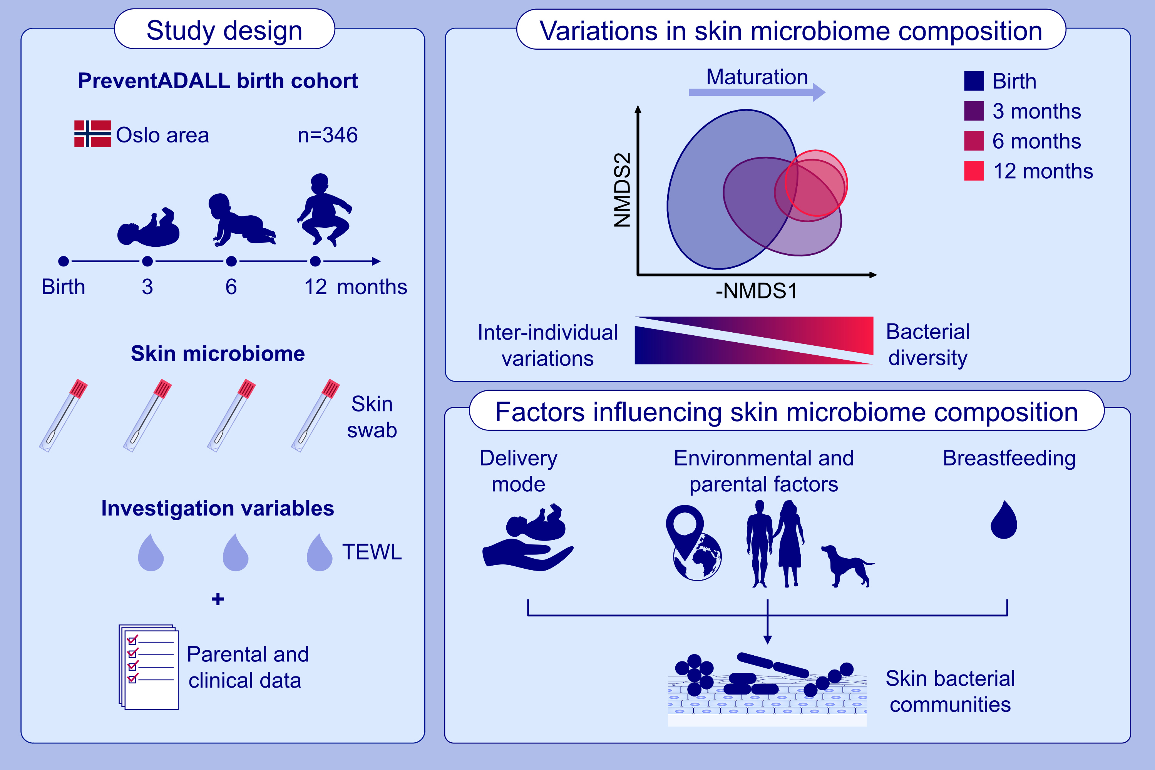
The skin microbiome in the first year of life and its association with atopic dermatitis
Alexis Rapin, Eva Maria Rehbinder, Matthew Macowan, Céline Pattaroni, Karin C. Lødrup Carlsen, et al.
Allergy. 2023; pages:
https://doi.org/10.1111/all.15671
© 2019 EAACI and John Wiley and Sons A/S. Published by John Wiley and Sons Ltd.
Notes:
HIGHLIGHTS
The skin bacterial community composition varies between individuals after birth, then progressively converges during the first year of life.
The skin microbiome composition and diversity at birth is associated with later onset of atopic dermatitis with associations found between skin barrier function, dry skin and bacterial communities.
Delivery mode and location are major determinants of the skin microbiome at birth.
Abbreviations: NMDS, non-metric multidimensional scaling; PreventADALL, Preventing Atopic Dermatitis and ALLergies in Children, TEWL, trans-epidermal water loss

