Slide 1
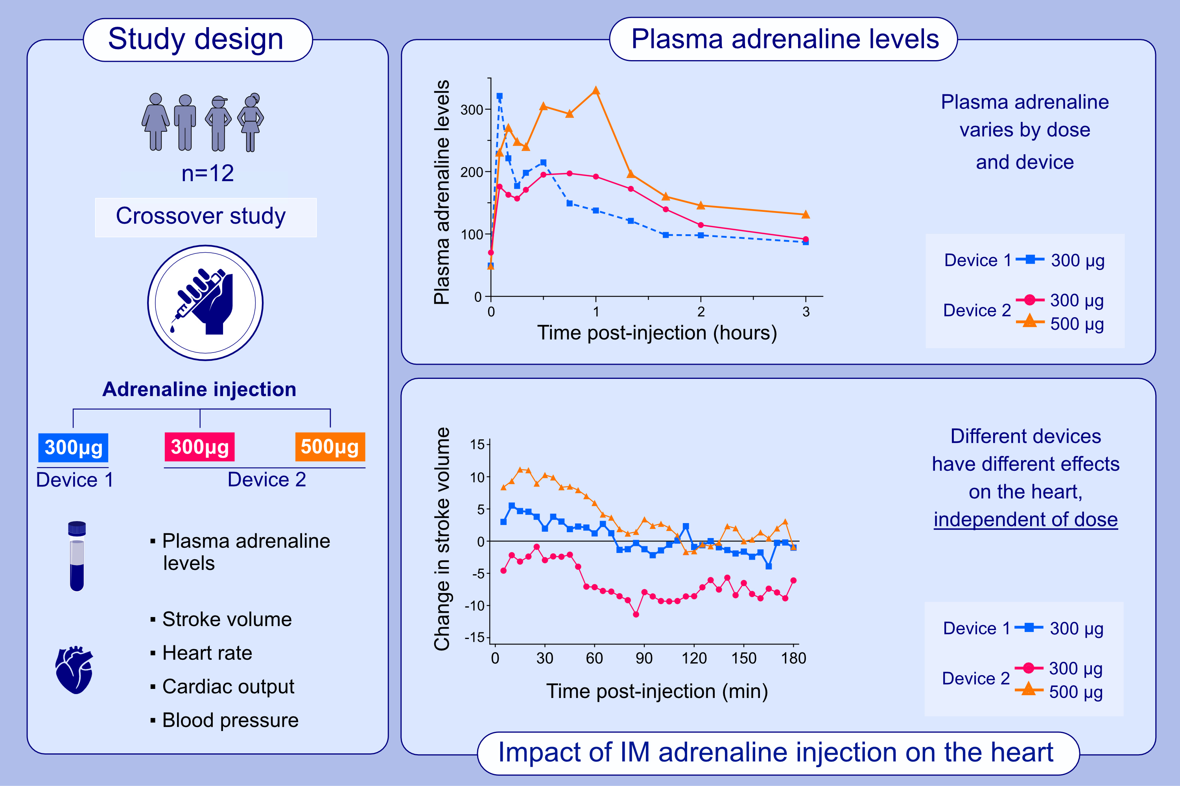
Optimal dose of adrenaline auto-injector for children and young people at risk of anaphylaxis: a phase IV randomized controlled crossover study
Nandinee Patel, Emily Isaacs, Bettina Duca, Nanthagopan Nagaratnam, Jackie Donovan, et al.
Allergy. 2023; pages:
https://doi.org/10.1111/all.15675
© 2019 EAACI and John Wiley and Sons A/S. Published by John Wiley and Sons Ltd.
Notes:
HIGHLIGHTS
This crossover study assesses the pharmacokinetics/pharmacodynamics of self-injection with 300μg or 500μg adrenaline in food-allergic teenagers at risk of anaphylaxis.
Our findings challenge the assumption that optimal cardiovascular effects are associated with the adrenaline autoinjector causing the fastest and highest peak in plasma adrenaline.
These data justify the global availability of adrenaline autoinjectors which deliver 500μg adrenaline for use in adolescents and adults over 40kg.
Abbreviations: IM, intramuscular; min, minutes

