Slide 1
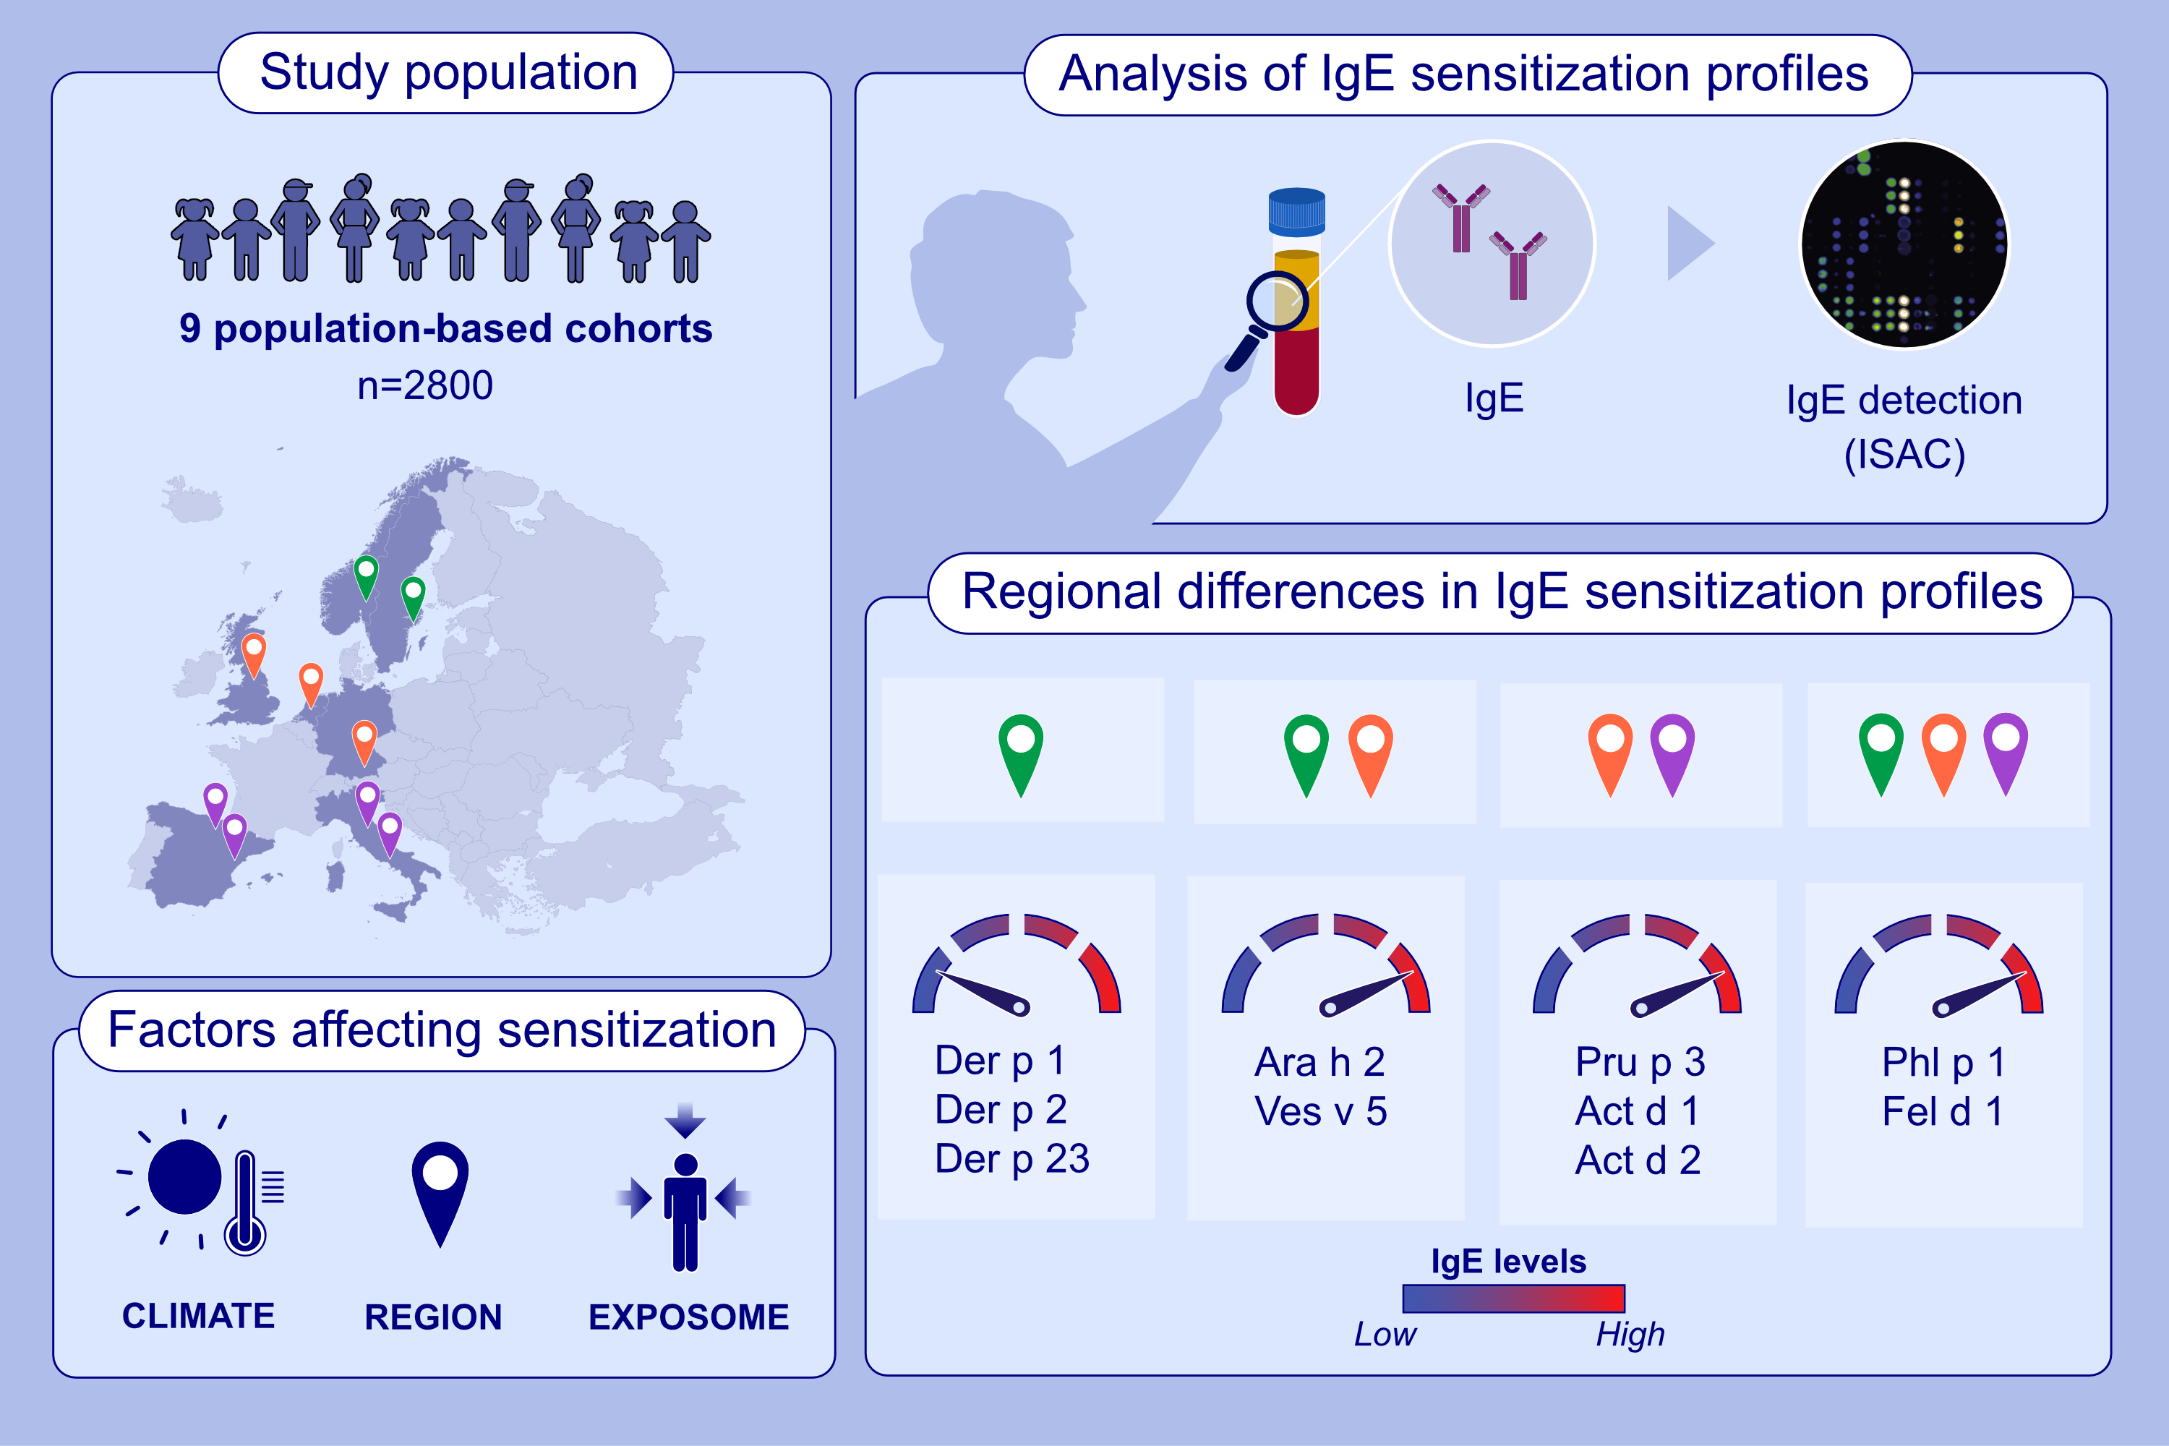
A molecular sensitization map of European children reveals exposome- and climate-dependent sensitization profiles
M. B. Gea Kiewiet, Christian Lupinek, Susanne Vrtala, Sandra Wieser, Alexandra Baar,, et al.
Allergy. 2023; pages:
https://doi.org/10.1111/all.15689
© 2019 EAACI and John Wiley and Sons A/S. Published by John Wiley and Sons Ltd.
Notes:
HIGHLIGHTS
Sera from nine population-based birth cohorts representing Northern, West/Central, and Southern Europe were analyzed for IgE to more than 170 micro-arrayed allergen molecules.
The sensitization map revealed exposome- and climate-dependent sensitization profiles, with strong regional differences
The results form a molecular basis for precision medicine-based approaches
for prevention and treatment of allergy.
Abbreviations: IgE, immunoglobulin E; ISAC, multiplex specific IgE test.

