Slide 1
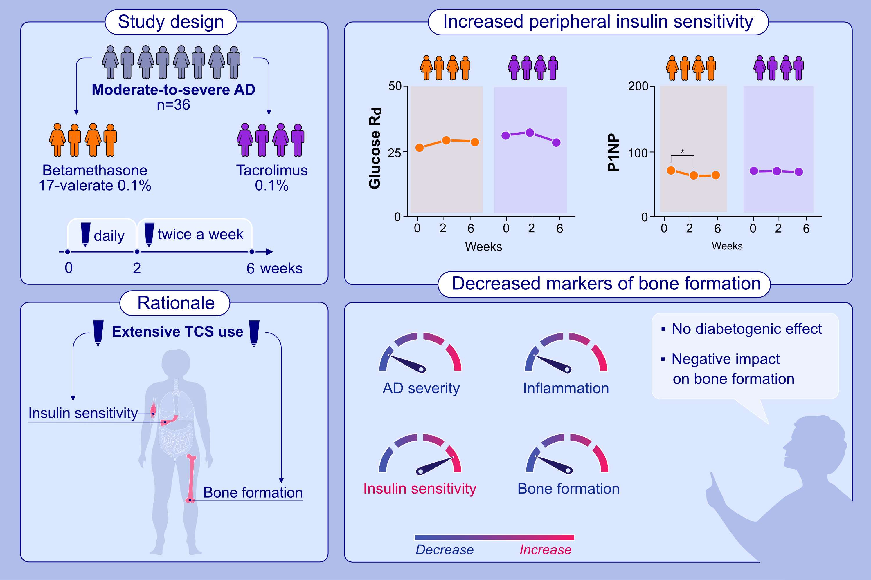
Effects of topical corticosteroid vs. tacrolimus on insulin sensitivity and bone homeostasis in adults with atopic dermatitis – a randomized controlled study
Lise Gether, Heidi Storgaard, Sanja Kezic, Ivone Jakasa, Bolette Hartmann, et al.
Allergy. 2023; pages:
https://doi.org/10.1111/all.15690
© 2019 EAACI and John Wiley and Sons A/S. Published by John Wiley and Sons Ltd.
Notes:
HIGHLIGHTS
This study examined whether intensive daily whole-body TCS treatment over 2 weeks followed by twice weekly application for 4 weeks could elicit insulin resistance and increase bone resorption in adults with AD.
Insulin sensitivity increased 12.6% after 2 weeks of betamethasone and 6.40% after 6 weeks. A slight increase in insulin sensitivity was found after two weeks of tacrolimus treatment. P1NP decreased significantly with 10.7% in the betamethasone group after 2 weeks.
AD severity improved with both treatments and systemic inflammation was reduced.
Abbreviations: AD, atopic dermatitis; P1NP, N-terminal propeptide of type I procollagen; R_{d}, rate of glucose disappearance; TCS, topical corticosteroids

