Slide 1
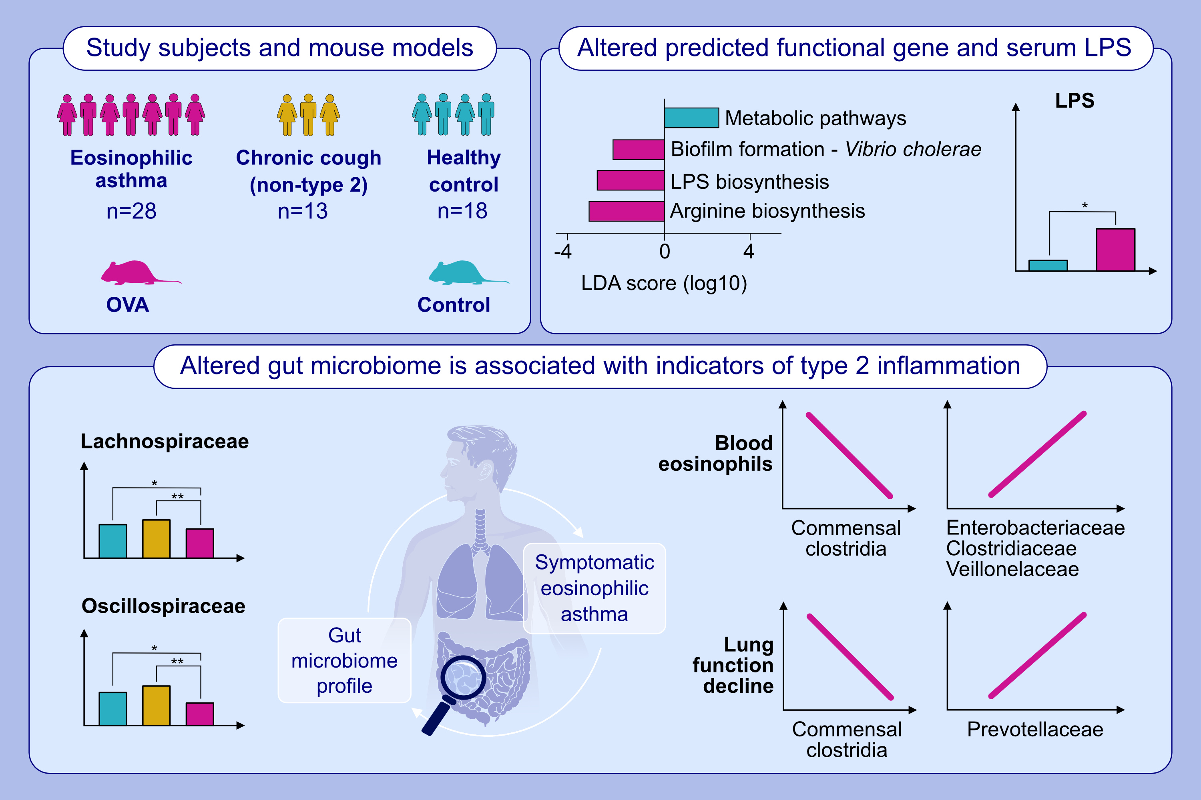
Adult asthma with symptomatic eosinophilic inflammation is accompanied
by alteration in gut microbiome
Bon-Hee Gu, Jun-Pyo Choi, Tansol Park, A-Sol Kim, Ho Young Jung, et al.
Allergy. 2023; pages:1020-1035
https://doi.org/10.1111/all.15691
© 2019 EAACI and John Wiley and Sons A/S. Published by John Wiley and Sons Ltd.
Notes:
HIGHLIGHTS
Type 2 asthma alters the composition of major taxa of the gut microbiome, especially causing a decrease in commensal clostridia.
Within type 2 asthma, Lachnospiraceae negatively correlates with indicators of type 2 inflammation and lung function decline. In contrast, pathobiont and Prevotella are positively associated, respectively.
According to functional gene predictions, microbial metabolites are diminished and LPS production increases.
Abbreviations: LDA, linear discriminant analysis; LPS, lipopolysaccharide; OVA, ovalbumin

