Slide 1
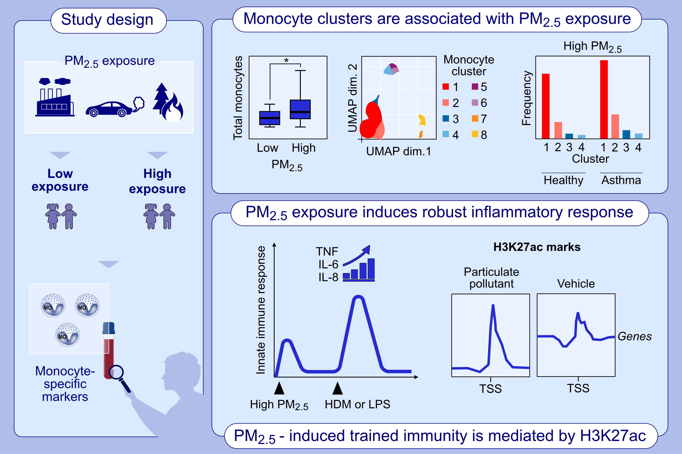
Proinflammatory polarization of monocytes by particulate air pollutants is mediated by induction of trained immunity in pediatric asthma
Hesam Movassagh, Mary Prunicki, Abhinav Kaushik, Xiaoying Zhou, Diane Dunham, et al.
Allergy. 2023; pages:
https://doi.org/10.1111/all.15692
© 2019 EAACI and John Wiley and Sons A/S. Published by John Wiley and Sons Ltd.
Notes:
HIGHLIGHTS
Exposure to air pollutants is associated with polarization of specific pro-inflammatory circulating monocytes in children with asthma.
Air pollutants induce innate trained immunity in monocytes characterized by the elevation of pro-inflammatory mediators upon stimulation with house dust mite or LPS.
Pollution-induced trained immunity in monocytes is epigenetically mediated via H3K27ac.
Abbreviations: dim., dimension; H3K27ac, acetylation of lysine 27 on histone H3 protein subunit; HDM, house dust mite; IL, interleukin; LPS, lipopolysaccharide; PM_{2.5}, particulate matter with aerodynamic diameter ≤ 2.5 μm; TNF, tumor necrosis factor; TSS, promoter-transcription start site; UMAP, Uniform Manifold Approximation and Projection

