Slide 1
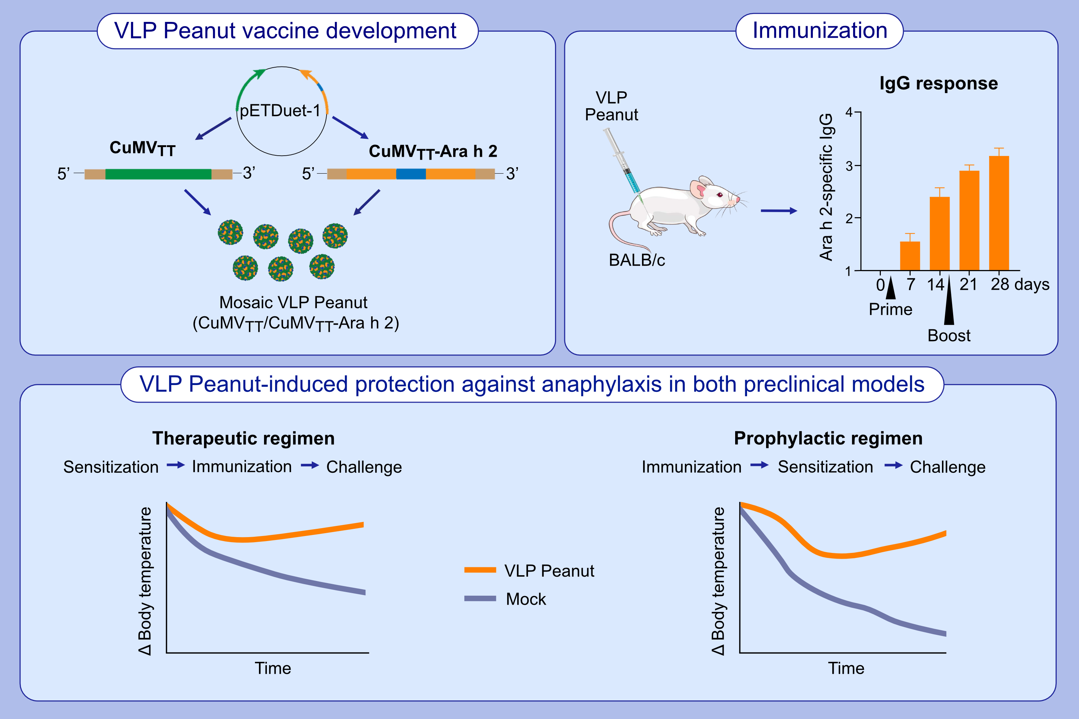
The next generation virus-like particle platform for the treatment of peanut allergy
Jan M. Sobczak, Pascal S. Krenger, Federico Storni, Mona O. Mohsen, Ina Balke,, et al.
Allergy. 2023; pages:
https://doi.org/10.1111/all.15704
© 2019 EAACI and John Wiley and Sons A/S. Published by John Wiley and Sons Ltd.
Notes:
HIGHLIGHTS
The vaccine candidate against peanut allergy described in the study consists of peanut allergen Ara h 2 genetically fused to the VLP subunits, which precludes the presence of free allergen in the vaccine formulation.
We demonstrate the vaccine-induced protection of peanut-sensitized mice after the therapeutic treatment and in the prophylactic regimen.
Thus, the here described VLP can be a potential breakthrough therapy for peanut allergy.
Abbreviations: CuMV_{TT}, Cucumber mosaic virus-derived VLPs engineered with a universal T cell epitope; IgG, Immunoglobulin G; pETDuet-1, bacterial vector for the co-expression of two genes; VLP, virus-like particle

