Slide 1
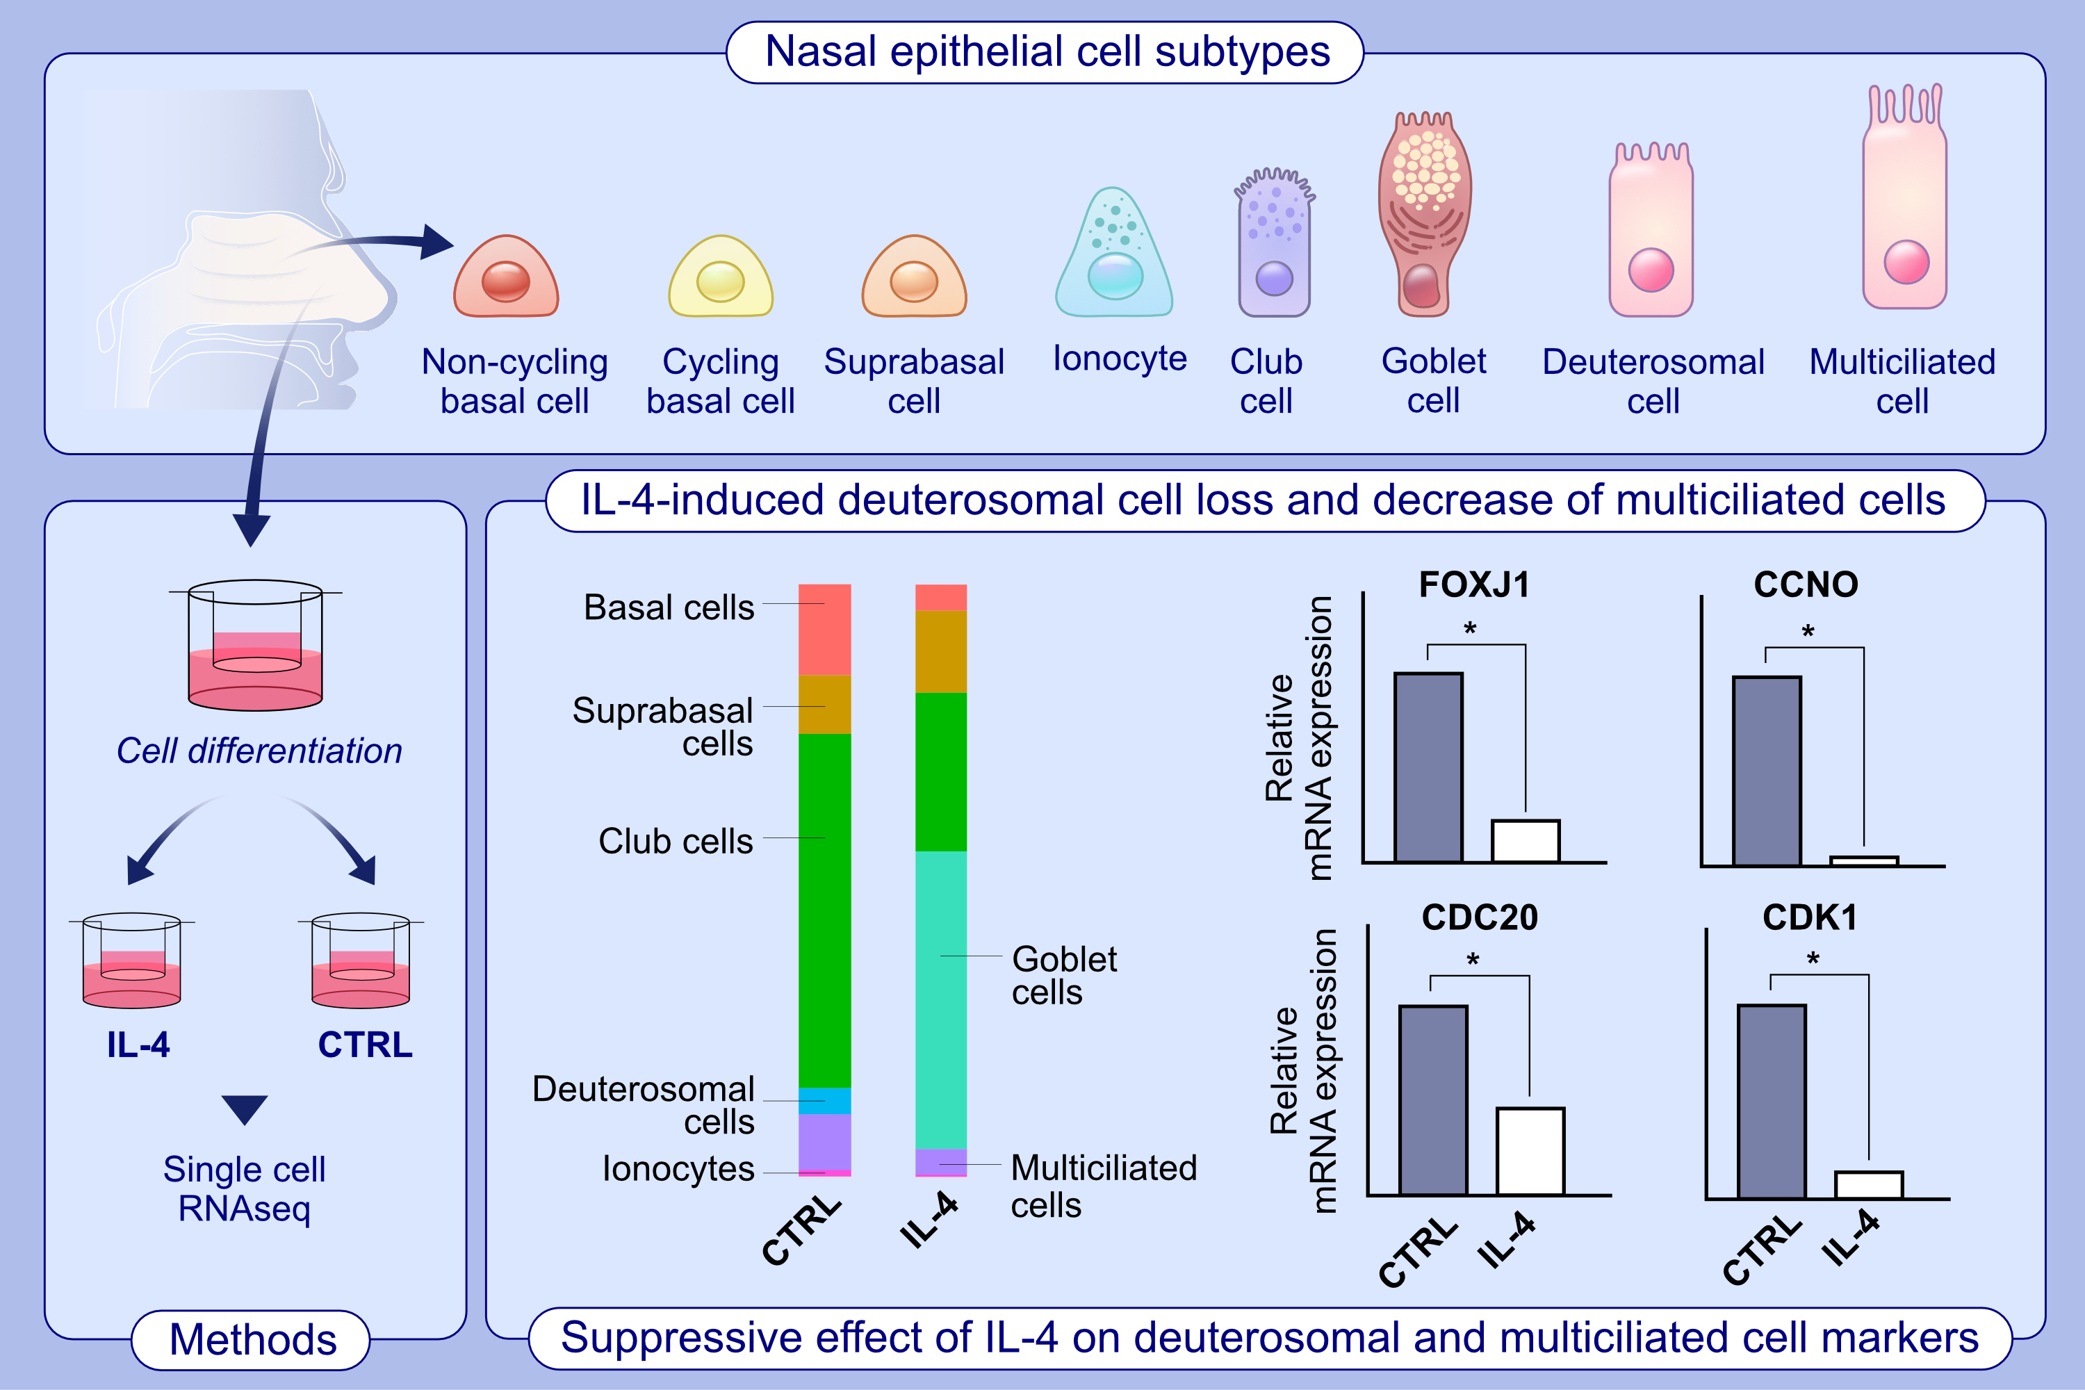
IL-4 drastically decreases deuterosomal and multiciliated cells via alteration in progenitor cell differentiation
Hyung-Ju Cho, Youn Wook Chung, Sungmin Moon, Ju Hee Seo, Miran Kang , et al.
Allergy. 2023; pages:
https://doi.org/10.1111/all.15705
© 2019 EAACI and John Wiley and Sons A/S. Published by John Wiley and Sons Ltd.
Notes:
HIGHLIGHTS
This study investigates the effect of allergic inflammation in nasal epithelial cell transcriptomes at the single-cell level.
The effects of IL-4 appear to be mediated through the loss of the deuterosomal population, resulting in the reduction of multiciliated cells. The trajectory analysis reveales deuterosomal cells as precursor cells of multiciliated cells.
Common ciliated cell marker (FOXJ1), multiciliated cell marker (CCNO), and deuterosomal cell markers (CDC20 and CDK1) are reduced by IL-4 treatment; IL-13 shows similar inhibitory effct.
Abbreviations: CCNO, cyclin O; CDC20, cell division cycle 20; CDK1, cyclin-dependent kinase 1; CTRL, control; FOXJ1, forkhead box J1; IL, interleukin; RNAseq, RNA sequencing.

