Slide 1
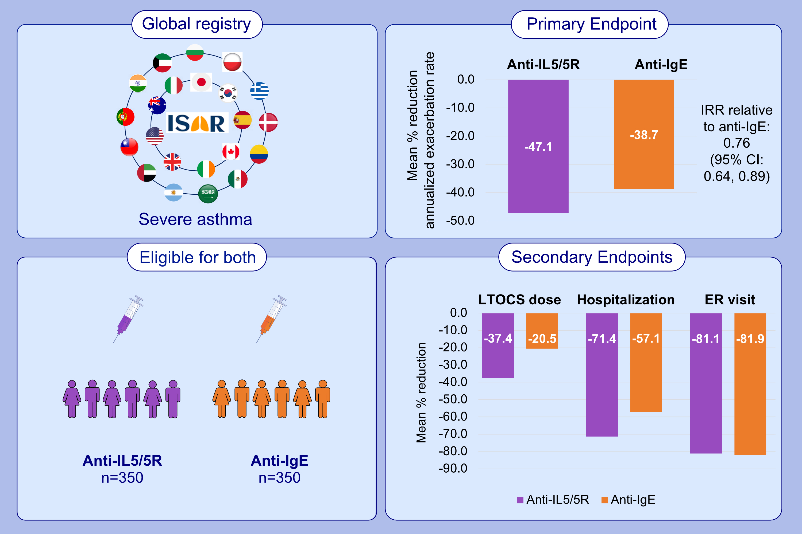
Comparative effectiveness of Anti-IL5 and Anti-IgE biologic classes in patients
with severe asthma eligible for both
Paul E. Pfeffer, Nasloon Ali, Ruth Murray, Charlotte Ulrik, Trung N. Tran, et al.
Allergy. 2023; pages:
https://doi.org/10.1111/all.15711
© 2019 EAACI and John Wiley and Sons A/S. Published by John Wiley and Sons Ltd.
Notes:
HIGHLIGHTS
The effectiveness of anti-IgE and anti-IL5/5R was compared in this prospective cohort study including patients with severe asthma enrolled in ISAR and eligible for both biologic classes.
Both anti-IgE and anti-IL5/5R improved asthma outcomes, however anti-IL5/5R was superior in reducing asthma exacerbations and LTOCS use.
These findings may be useful in assisting treatment decisions for patients with severe asthma.
Abbreviations: Anti-IgE, anti-immunoglobulin E; Anti-IL5/5R, anti-interleukin 5/5R; CI, confidence interval; ER, emergency room; IRR, incidence rate ratio; ISAR, International Severe Asthma Registry; LTOCS, long-term oral corticosteroid.

