Slide 1
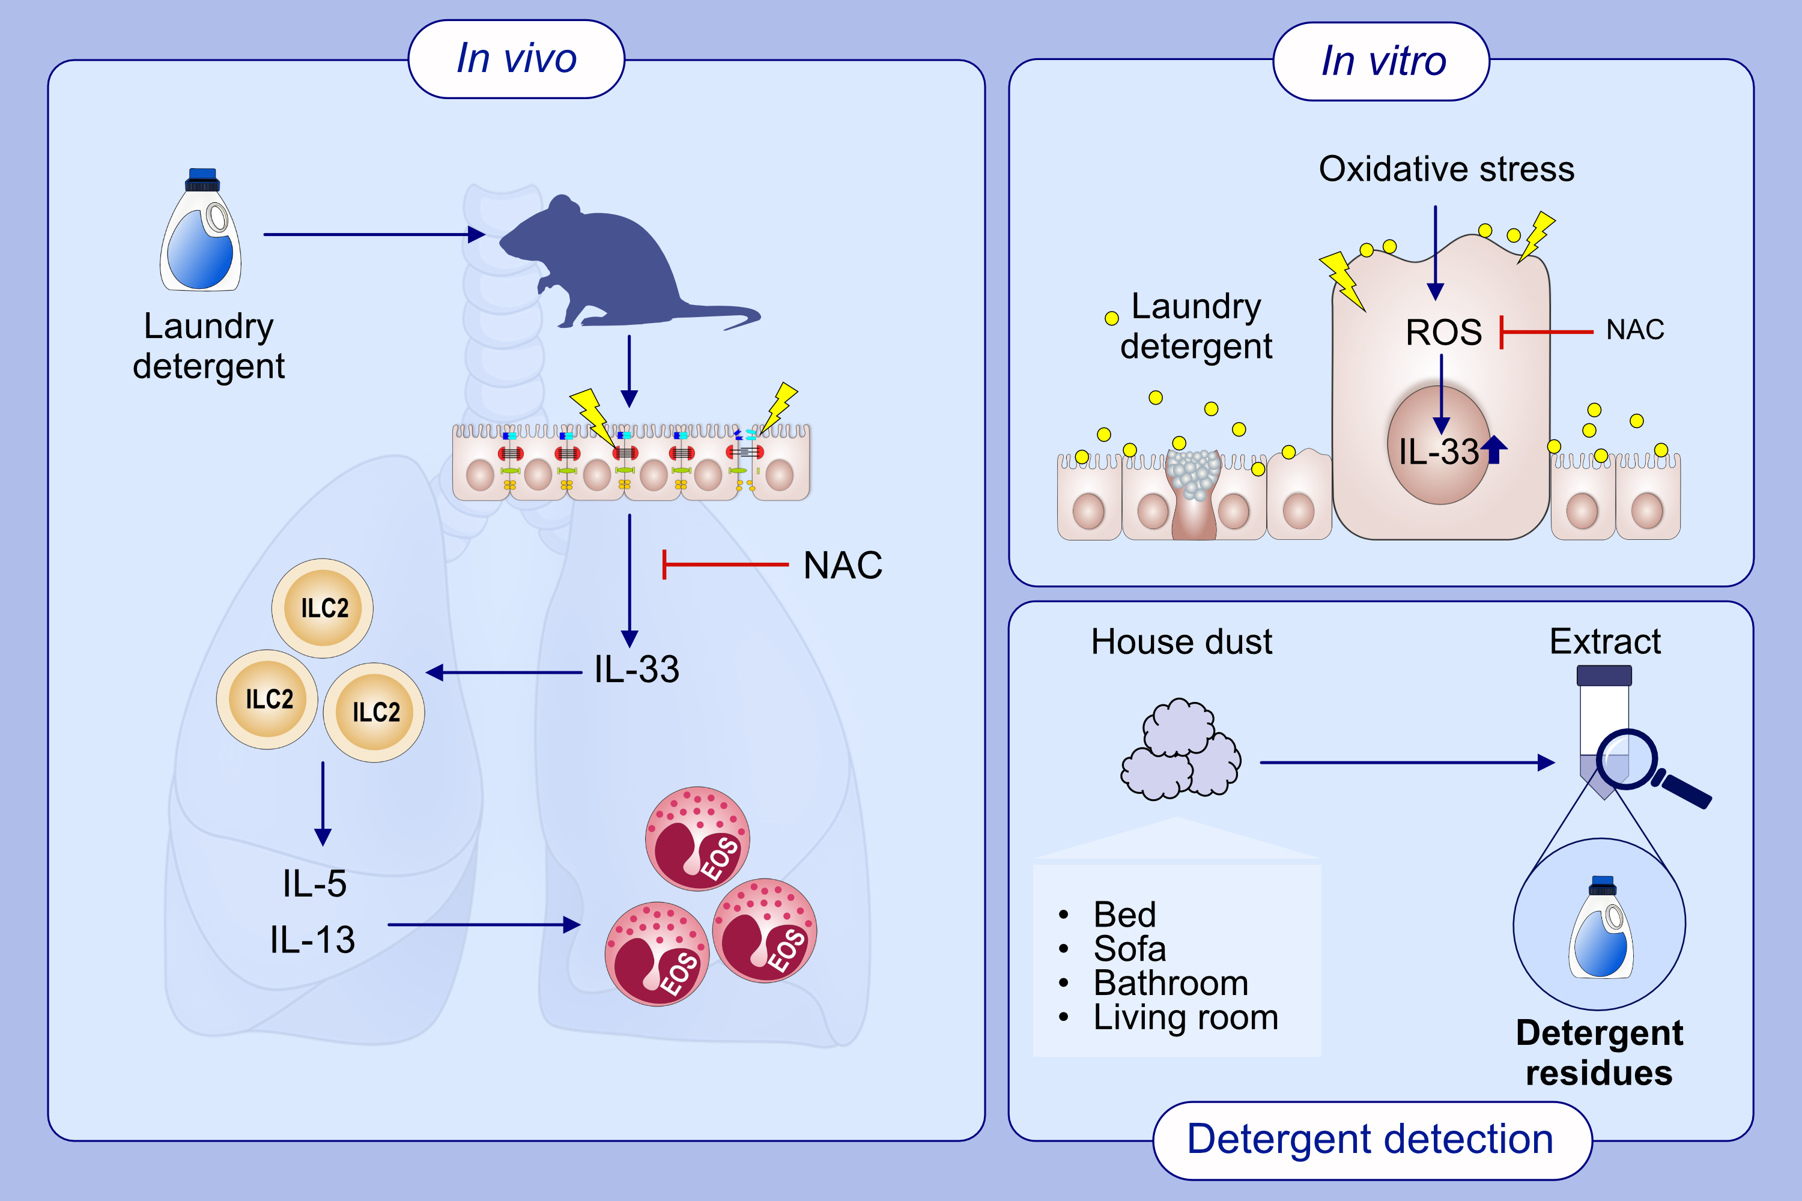
Laundry detergents and surfactants induced eosinophilic airway inflammation by increasing IL-33 expression and activating ILC2s
Kyoko Saito, Keisuke Orimo, Terufumi Kubo, Masato Tamari, Ayako Yamada, et al.
Allergy. 2023; pages:
https://doi.org/10.1111/all.15762
© 2019 EAACI and John Wiley and Sons A/S. Published by John Wiley and Sons Ltd.
Notes:
HIGHLIGHTS
The administered laundry detergents and surfactants induced eosinophilic airway inflammation accompanied by increased IL-33 expression and activation of ILC2s.
Detergent-induced IL-33 expression in the airways was attenuated by an antioxidant (NAC).
Detergent residues were detected in all the tested dust extracts, and their amounts differed among the homes.
Abbreviations: HDM, house dust mite; IL, interleukin; ILC2, group 2 innate lymphoid cell; NAC, N-acetyl-1 cysteine; ROS, reactive oxygen species

